Slide 1
NJDEP/A&WMA Regulatory Update Conference Site Remediation and Waste Management Program Update November 22, 2019
Mark J. Pedersen, Assistant Commissioner
New Jersey Department of Environmental Protection
Site Remediation and Waste Management Program

Slide 2
Topics
Site Remediation Program Metrics
Remedial Action Permitting
Enforcement Initiatives
SRRA 2.0
Solid and Hazardous Waste Update
Regulatory update

Slide 3
Active, New, and Closed Cases (2012-2018)
Year | Total Active | Total New | Total Closed
CY 2012 | 14,369 | 9,612 | 4,735
CY 2013 | 14,577 | 5,287 | 4,236
CY 2014 | 13,795 | 4,928 | 5,036
CY 2015 | 14,245 | 5,390 | 4,638
CY 2016 | 14,357 | 5,129 | 4,540
CY 2017 | 14,223 | 4,975 | 5,003
CY 2018 | 13,707 | 4,862 | 5,061

Slide 4
Response Action Outcomes (2012-2017)

Slide 5
IECs and VCs Report
 | As of October 31, 2019
Active IECs/VCs Cases (Total) | 450
Active LSRP Cases | 216
Active PF Cases | 209
Active Traditional Oversight Cases | 32
Closed IECs/VCs Cases (Total) | 700
Closed LSRP Cases | 548
281sed PF Cases | 151
Closed Traditional Oversight Cases | 1

Slide 6
Compliance Assistance & Enforcement
Compliance rate January 2019 through October 2019: 79%
Batch NOVs initiative

Slide 7
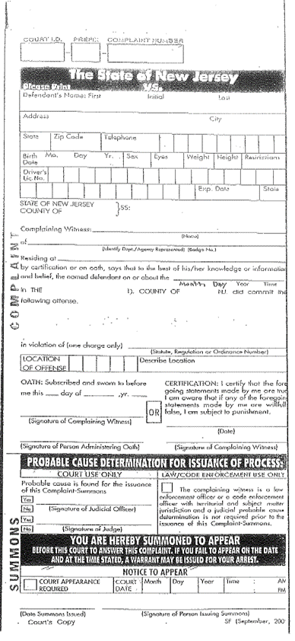
Municipal Ticketing Stats
As of October 31, 2019
168 tickets issued, at 121 sites
Over $372,000 in penalties assessed

Slide 8
SRRA 2.0
Signed into law Friday, August 23, 2019
Officially known as P.L. 2019, c. 263

Slide 9
Definitions
"Remediation" or "remediate" means all [necessary] actions to investigate [and] , clean up , or respond to any known, suspected, or threatened discharge of contaminants, including [, as necessary,] the preliminary assessment, site investigation, remedial investigation, and remedial action, or any portion thereof, provided, however, that "remediation" or "remediate" shall not include the payment of compensation for damage to, or loss of, natural resources;

Slide 10
Definitions
“Retained” means hired, individually or through a firm or other person, by or on behalf of a person responsible for conducting remediation, to perform, manage, or supervise remediation or to periodically review and evaluate a remediation performed by other persons.

Slide 11
SRRA 2.0
Exemptions for needing LSRP
If confirming work performed by another LSRP
Due Diligence
Unregulated Heating Oil Tanks

Slide 12
Code of Conduct
k. If a licensed site remediation professional retained to perform remediation at a site or any portion of a site obtains specific knowledge that a discharge has occurred [on a contaminated site for which he is responsible] at any location on the site, the licensed site remediation professional shall: (1) notify the person responsible for conducting the remediation of the existence of the discharge; and (2) notify the department of the discharge by calling the department's telephone hotline. The person responsible for conducting the remediation shall also be responsible for notifying the department of the existence of the discharge. The provisions of this subsection shall not apply to a discharge that may be a result of the existence of historic fill material.

Slide 13
Code of Conduct
j. If a licensed site remediation professional [identifies] obtains specific knowledge of a condition [at a contaminated site] that in his independent professional judgment is an immediate environmental concern, then the licensed site remediation professional shall: (1) immediately verbally advise , and confirm in writing to, the person responsible for conducting the remediation of that person's duty to notify the department of the condition , provided the person is known to the licensed site remediation professional; and (2) immediately notify the department of the condition by calling the department's telephone hotline.

Slide 14
Definitions
"Immediate environmental concern" means [a condition at a contaminated site where there is]: (1) confirmed contamination in a well used for potable purposes at concentrations [at or] above the ground water remediation standards; (2) confirmed contamination that has migrated into [an occupied] a structure or a confined space producing a toxic or harmful atmosphere resulting in an unacceptable human health exposure, or producing an oxygen-deficient atmosphere, or resulting in demonstrated physical damage to essential underground services; (3) confirmed contamination at the site of a nature that either dermal contact, ingestion, or inhalation of the contamination could result in an acute human health exposure; or (4) any other [condition] confirmed contamination that poses an immediate threat to the environment or to the public health and safety.

Slide 15
IECs at unoccupied structures
Written certification by PRCR from the property owner:
(i) is not occupied,
(ii) will not be occupied, and
(iii) will be demolished,
then no further remediation relative to the IEC in the unoccupied structure is required.

Slide 16
Direct oversight
Site not subject to direct oversight if due to:
Access issues (need to document all efforts made to gain access)
DEP review of federal-lead sites
Direct oversight runs with site, not with PRCR

Slide 17
Direct oversight
DEP may modify DO when:
PRCR demonstrates financial hardship
Public emergency
In the public’s interest and protective of public health and safety- Requires public notice
For pre-purchaser ACOs
Reinstate adjusted requirements

Slide 18
RFS
Post RFS using any mechanism other than self-guarantee
Clarified language for various Remediation Funding Source mechanisms
Added Surety Bonds as Remediation Funding Source mechanism
Allowing Payment Bond (aka Guarantee Bond)
NOT allowing Performance Bond

Slide 19
Public notification
Occurs before the RI phase
Expands the types of reports that can be provided to local governments
Signs and written notification
Public inquiries

Slide 20
Division of Solid and Hazardous Waste
Reuse, Reduce, Recycle!
Download “Recycle Coach” app
Food Waste Reduction
https://www.nj.gov/dep/dshw/food-waste/
Notes:
Moving on to Solid and Hazardous Waste…
Reducing, reusing, and recycling protects the environment and keeps our communities clean. It also saves us money, energy, and natural resources.
And if you can’t reduce or reuse, THEN recycle.
Increasing recycling is the Department’s top priority.
The DEP purchased a new app called Recycle Coach
It is a free recycling app that provides information on recycling programs in more than 200 New Jersey municipalities.
The app can be downloaded to a cell phone, so users can find recycling information specific to where they live or work, because recycling rules can be different for every municipality.
It tells you what you can and cannot recycle in your town.
And consumers can use Recycle Coach to set up a personalized recycling calendar with reminders.
Two years ago, DEP purchased Recycle Coach and are encouraging that all municipalities state wide use this app.
It reduces the confusion on what you can recycle because everything varies from town to town.
And we are conducting a thorough evaluation of our recycling program.
The current recycling goal in New Jersey is 50% of the municipal waste stream (MSW) and 60% of the total waste stream.
Here are some issues we are discussing:
The recycling goals do not adequately capture reduction in waste generated or the weight of materials that are reused.
Over the last few years, recycling rates have begun to drop.
There was a loss of overseas markets. We need to do market research to identify and develop new markets.
Our Recycle stream and unacceptable levels of contaminants in the recycle stream is a problem because it increases processing costs and reduces marketability of the materials recycled.
I also want to mention food waste reduction.
Americans throw out the equivalent of $218 billion worth of food each year¹
Its important for everyone to reduce the amount of food that is wasted.
Check out our new food waste reduction website for tips on reducing food waste.
There are tips for all- information on how to reduce waste food in your home.
There is also a donation webpage to learn more about how to donate food.
There is even a page for processors, restaurants, and new guidelines for schools!
We have produced a draft food waste reduction plan. We received comments and held three public hearings. Check out website in the new year to see the final version of the plan.

Slide 21
Regulatory Update
Recycling Rules: Electronic Waste (E-Waste) Management – N.J.A.C. 7:26A-13
Recycling Rules: Exemptions – N.J.A.C. 7:26A-1.4
Remediation Standards – N.J.A.C. 7:26D
Regulations of the Site Remediation Professional Licensing Board – N.J.A.C. 7:26I
SRRA 2.0 Rulemaking (N.J.A.C. 7:26C and 7:26E)

