Slide 1
New Jersey Surface Water Quality and Ground Water Quality Standards Update
November 16, 2018
17TH Annual Regulatory Update Conference
Kimberly Cenno, Bureau Chief & Rachel White, Env specialist
Bureau of Environmental Analysis, Restoration and Standards (BEARS)
Division of Water Monitoring and Standards (WMS)
New Jersey Department of Environmental Protection

Slide 2
WATER RESOURCES MANAGEMENT
Water Resources Management
Michele Putnam
Assistant Commissioner
Division of Water Monitoring & Standards
Bruce Friedman
Division of Water Quality
Janice Brogle
Division of Water Supply & Geosciences
Pat Gardner
Freshwater & Biological Monitoring
Leslie McGeorge
Marine Water Monitoring
Bob Schuster
Environmental Analysis, Restoration & Standards
Kimberly Cenno

Slide 3
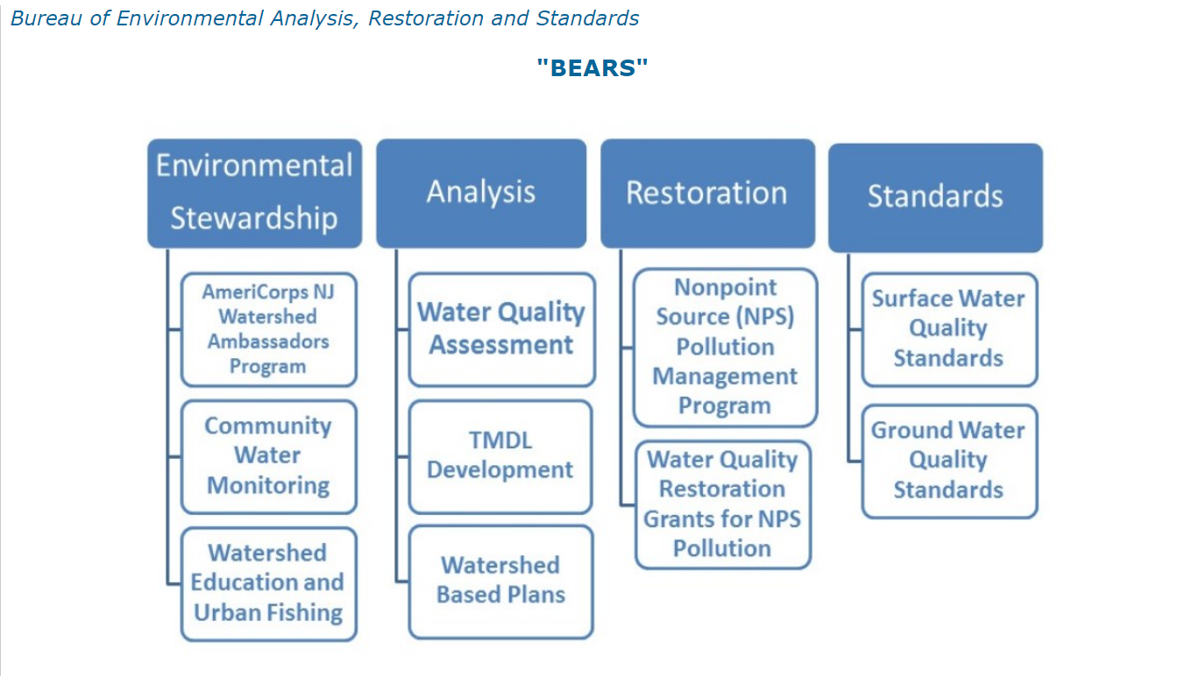
Who We Are

Slide 4
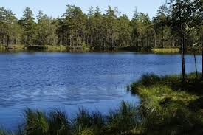
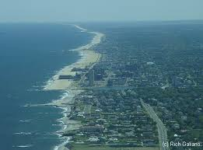
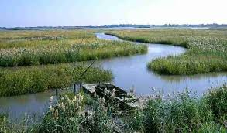
NJ’s Surface Water Classification
Freshwater (FW)
  Tidal & Non-tidal Freshwaters
  FW1 are preserved in their natural state
    No dischargers permitted/No numeric criteria
Saline coastal (SC)
  Water from the Atlantic Ocean bordering NJ’s coast
Saline estuary (SE)
  Estuaries and rivers influenced by tidal forces
  Usually situated between FW & SC waters
    SE1
    SE2
    SE3
FW1,
PL,
FW2-TP,
FW2-TM,
FW2-NT

Slide 5
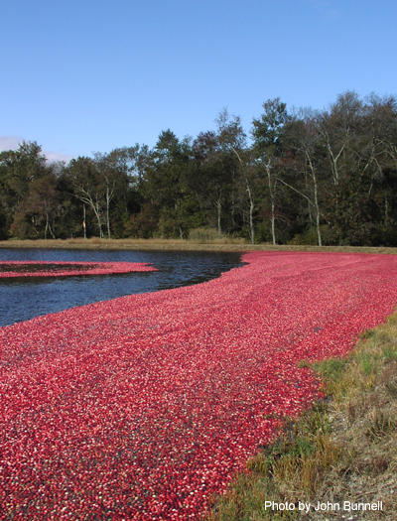
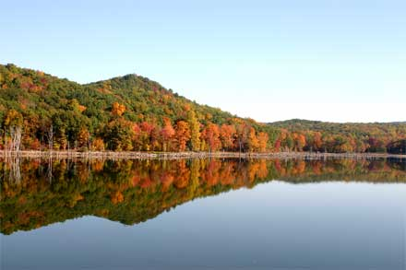
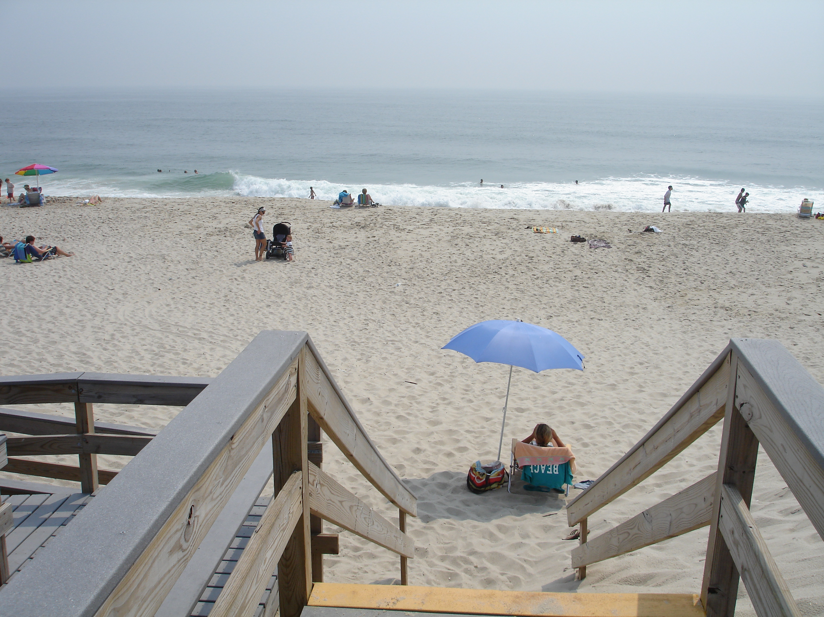
Antidegradation Designations
All surface waters are assigned to one of the three antidegradation designations
ONRW – Outstanding National Resource Waters (FW1 & PL)
Category One
Category Two

Slide 6


Rules were originally promulgated in 1964
Last Revised in 2011
Readopted without change in October 2016
New Expiration date – October 17, 2023
Anticipated Revisions in 2019 - Triennial Review
Notes:
CWA required revisions to SWQS every 3 years.
Any criteria or policy recommendations by EPA must be incorporated in SWQS within 3 years or provide justification.
NJ is working with EPA since 2012 to draft revisions to the SWQS.

Slide 7

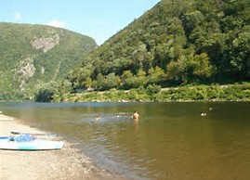
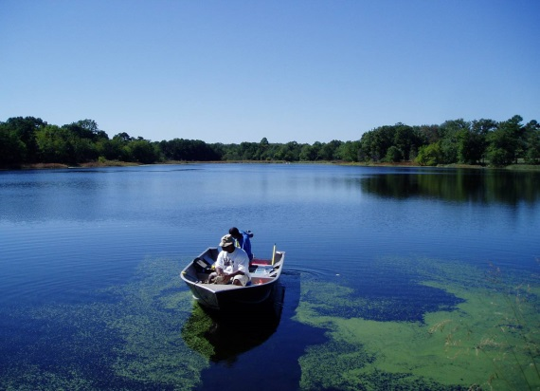
Anticipated Revisions to SWQS
Recreational Criteria – Primary contact
Freshwater Ammonia Criteria
  Water Quality Standards Variance
  Protection of Downstream Uses
  Nutrient Criteria (Stakeholder Meetings 2015)
  C1 Upgrades (To Be Stakeholdered)
EPA
Nutrient Criteria
Notes:
Recreational criteria – 2012
Ammonia – 2013
HH toxics criteria - 2015
WQSV – 2015
Portions of nutrient criteria not approved by EPA.
Protecting downstream uses already practiced however, would like to codify
Held 2 stakeholder meetings in 2015

Slide 8
Comparison of NJ and USEPA Recreational Criteria Enteroccocus for Marine Waters (Saline Estuarine Coastal Waters)
Enterococcus | NJ Current 19 illness/1000 | EPA Option 1 36 illness/1000 | EPA Option 2 32 illness/1000 | NJ Proposed (SE1 & SC)
Geometric mean | 35/100 ml | 35/100 ml | 30/100 ml | 30/100 ml
Single sample maximum | 104/100 ml | N/A | N/A | N/A
Statistical threshold value | N/A | 130/100 ml | 110/100 ml | 110/100 ml
No. of Samples | Minimum 5 in 30 days | Not specified | Not specified | Not specified
Averaging period | 30-days | 30/90 days | 30/90 days | 90 days
Applicability | Annual | Annual | Annual | Annual

Slide 9
Comparison of NJ and USEPA Recreational Criteria
E.Coli for Freshwater – Rivers, streams, lakes
E. coli | NJ Current 8 illness/1000 | EPA Option 1 36 illness/1000 | EPA Option 2 32 illness/1000 | NJ Proposed (All FW2)
Geometric mean | 126/100 ml | 126/100 ml | 100/100 ml | 100/100 ml
Single sample maximum | 235/100 ml | N/A | N/A | N/A
Statistical threshold value | N/A | 410/100 ml | 320/100 ml | 320/100 ml
Sampling frequency | Minimum 5 in 30 days | Not specified | Not specified | Not specified
Averaging period | 30-days | 30/90 days | 30/90 days | 90 days
Applicability | Annual | Annual | Annual | Annual

Slide 10
Water Quality Standards Variance (40 C.F.R. § 131.14)
Definition: A time-limited designated use and criterion for a specific pollutant(s) that reflect the highest attainable condition (HAC) during the term of the WQS variance.
WQSV must include:
  Parameter/pollutant
  Water body / waterbody segment(s)
  Permittee(s)
  Term / Duration (can be longer than 5 years)
    HAC must be met at the end of the term
WQSV is only for NJPDES implementation - Underlying use/criterion remains
Reevaluated every 5 years after EPA approval
Notes:
Great tool to implement arsenic criteria where natural background levels are much higher than criteria.
No approved technology for measuring or treating to the criteria levels.
WQSV once adopted will become WQ criteria and has to be approved by EPA before implementation.
EPA reviews the WQSV during reevaluation and as part of triennial review.

Slide 11
Water Quality Standards Variance
Working with EPA and interested parties to develop WQSV for arsenic
Established a workgroup to discuss options, solicit input, and formalize the process
  Kickoff Workgroup meeting held on September 2017
  Identify qualifying permittees and data requirements
  Reevaluation requirements would enable any advances in technology or research
Contract With Stevens Institute of Technology - benchscale wastewater treatability study – Finish March 2019
Notes:
Invitees: EPA, permittees (AEA, Clean water council); consultants (Klienfelder, Princeton Hydro, Najarian Assoc.); academia (Stevens Institute)
With the help of workgroup, the Department will identify permittees, effluent concentrations, background concentrations, term, HAC, etc.
Selected Hackettstown MUA and Middlesex county MUA for bench-scale study
Prof. Meng has 3 decades research experience in arsenic treatment technology.
On-site bench scale studies will be performed at Hackettstown MUA and Middlesex county MUA.

Slide 12
Category 1 Waters
  N.J.A.C. 7:9B-1.4
  Category one waters are designated for protection from measurable changes in water quality based on one of the following reasons:
  Exceptional Water Supply Significance
  Exceptional Recreational Significance
  Exceptional Ecological Significance
    Threatened & Endangered species as identified in the rule
    Aquatic Community (Biology, Chemistry, Impervious cover and Habitat)
  Exceptional Fisheries Resource(s)
    Trout Production & Unrestricted Shellfish Harvesting
Notes:
“Exceptional water supply significance”
a water supply system that serves a population greater than 100,000, including any reservoirs and their natural tributaries from source to the reservoir.
“Exceptional ecological significance” :
1. Waterbodies with suitable habitat verified by the Department to support Bog Turtle, Brook Floater, Dwarf Wedge mussel, Eastern Pond mussel, Eastern Lamp mussel, Green Floater, and/or Triangle Floater and documented occurrence(s) of at least one of these species verified by the Department for inclusion in the Natural Heritage Program; or
2. A waterbody supporting an exceptional aquatic community as demonstrated by a nonimpaired benthic macroinvertebrate community as measured by the Department’s Rapid Bioassessment Protocol (see http://www.state.nj.us/dep/wms/bfbm/rbpinfo.html) and at least two of the following factors:
i. Optimal habitat as measured by the Department’s Stream Habitat Assessment (see http://www.state.nj.us/dep/wms/bfbm/rbpinfo.html); ii. Excellent fish community as measured by the Fish Index of Biotic Integrity (see http://www.state.nj.us/dep/wms/bfbm/fishibi.html); iii. Water quality data that demonstrates compliance with aquatic life criteria pursuant to N.J.A.C. 7:9B-1.14(d) for dissolved oxygen, temperature, total phosphorus, and total suspended solids; or iv. Impervious surface that is: (1) less than two percent for a HUC 14 of five square miles; or (2) less than or equal to 10 percent for a HUC 14 of greater than or equal to five square miles.

Slide 13
Current C1 Waters
Categories | Current River miles | Percentage
ONRW | 3526.68 | 15.0
C1 | 6813.17 | 29.0
C2 | 13181.35 | 56.0
Total | 23521.20 | 100
Notes:
NOTE: Figure 2 & 3: (Top) Pie chart depicting the current percentages of Antidegredation designations assigned to NJ surface waters, not including NJ reservoirs. (Bottom) Table containing the number of river miles assigned to each Antidegradation class and their relative percentages in the state.
Antidegradation designation last updated in 2009

Slide 14
EES C1 Water Aquatic Community Evaluation Process
Excellent & Good station results
Secondary Factors (2 of 4)
1) Habitat (2016 draft IR & 2017 RHWA) - Optimal
2) Chemistry (2014 IR) – Attaining for Dissolved Oxygen, Temperature, Total Suspended Solids and Total Phosphorus
Validation
Visually validated qualifying HUC14s and identified stream stretches within the HUC14:
Primary factor
1) AMNET
(2016 draft IR & 2014 IR)
2017 Raritan Headwater Association data (RHWA)
4) Impervious Cover (I.C.) (2012 Land-use Layer) –
Station locations
Lakes
Dischargers
Affected Municipalities
Sewer Service Area
Current Category 2 waters
Tributaries
Roads
3) Fish Index of Biotic Integrity (FIBI) (2017 Draft) - Excellent
HUC14 area < 5 sq. mi. < 2% I.C.
HUC14 area ≥5 sq. mi. < 10% I.C.
Notes:
Saline estuary 3 and Saline estuary 2 waters from category 2 because there is no benthic macroinvertebrate rating for saline waters
Prior to preforming the analysis, the C1 waters proposed in 2012 were waters to see if they were still meeting the Requirements based on this definition.
The process is now automated via an excel spreadsheet, all that is needed is data input.
The average HUC14 watersheds size is less than 10 sq. mi, with the smallest one in NJ being 0.67 sq. mi. according to 2014 integrated report (ArcGIS layer)

Slide 15
Potential C1 Upgrades
A Total of 744.9 River Miles Proposed for C1
  Several streams had more than one Exceptional Value
C1 EES → Aquatic Community
  46 Stream Segments = 596.9 River Miles
C1 EES → Threatened & Endangered
  18 Stream Segments =136 River Miles
C1 EFR → Trout Production
  11 Stream Segments = 53 River Miles
Categories | River miles | Percentage
ONRW | 3,526.68 | 15.0
C1 | 7,558.07 | 32.1
C2 | 12,436.46 | 52.9
Total | 23521.20 | 100
Notes:
Additionally, there were 18 stream segments proposed by the BFBM for a modification in their trout designated uses based on surveys. The changes in these designated uses would not affect the streams antidegradation status as most of them were already C1.
The additional data provided by the Raritan headwaters association enabled 5 of the 46 stream segments to qualify for C1 based, increasing the total river miles by 132.2
Overall, there are 32 stream segments that are being reclassified based on their trout capabilities as determined by the sampling data

Slide 16
Integrated Report
Statewide Water Quality Report
Clean Water Act 305(b) and 303(d)
Impaired Waters (parameter/HUC14)
Water Quality Trends
NJDEP Water Quality Management Programs
Notes:
Draft 2016 Methods Document public comment period ended: March 17, 2016

Slide 17
Suite of Parameters
Aquatic Life General | 22 parameters: Biology, nutrients, DO, pH, temperature, TSS, turbidity, metals, toxics
Aquatic Life Trout | Same as Aquatic Life General, including Biology, DO, temperature
Recreation | 3 parameters: Enterococcus, fecal coliform, or E. coli
Public Water Supply | 65 parameters: Nitrate, TDS, chloride, sulfate, metals, toxics
Fish Consumption | 20 parameters: mercury, PCB, DDX, chlordane, dioxin, metals, toxics
Shellfish Harvesting | Shellfish Classification
Underlined parameters are required for full assessment

Slide 18
Statewide Water Quality Trends Analysis
Time period over 30 years
28 monitoring sites
Overall nutrients showed improved or stabilized conditions statewide
Increases in nitrate accompany decreases in ammonia
TDS and chloride show worsening trend
Notes:
However, the best method is to determine how the state’s waters are doing is to look at long-term trends. 10 years is usually the minimum time frame that will show any kind of trends.
Robust assessment tool that allows to incorporates flow, seasons, and censored data. Use state-of-the-art statistical software.
Nutrient and DO improvements are consistent with improvements to water quality expected from upgrades to wastewater treatment plants that have occurred since the 1980’s. Nutrient loads, especially ammonia, have been reduced through more extensive wastewater treatment.
TDS exceedances have been associated with runoff from urban and agricultural areas, including runoff of salt used to control ice on roadways. Wastewater treatment discharges and discharges from septic systems can also contribute to increased TDS loadings. The TDS and SC trends were found in all types of land uses (urban, agricultural, mixed, and undeveloped) and physiographic regions.
These overall results suggest that for constituents removed by the treatment of point sources, water quality has definitely improved; high biological oxidation demands and the resulting depression of DO levels have generally been addressed. However, these DO results are based on daytime sampling. Diurnal dissolved oxygen monitoring indicates that DO concentrations fluctuate and may actually drop below the criterion overnight indicating that nutrients, including phosphorus, are contributing to excessive plant growth.

Slide 19
GWQS Rules, N.J.A.C. 7:9C
  Ground Water Classifications: Class I, II and III
  Established based on hydrogeologic characteristics of the ground water resource and the designated use(s) to be maintained, restored and enhanced within the classification area.
Designated Uses: Nondegradation, Water Supplies, Other Reasonable Uses
Constituent Standards
  Numeric Criteria
  Practical Quantitation LEvels (PQLs)
  Antidegradation Policies
Notes:
The GWQS rules are promulgated under the authority of the New Jersey Water Pollution Control Act, N.J.S.A. 58:10A-1 et seq., and the Water Quality Planning Act, N.J.S.A. 58:11A-1 et seq.
Establish the ground water classifications throughout the State and assign designated uses within each classification
Also establish the water quality criteria, constituent standards and antidegradation policies applicable to each classification to ensure that the designated uses are adequately protected.
The GWQS also include an antidegradation policy to maintain ground water quality using a nitrate target of 2 mg/L, which is evaluated on a regional scale through the development of Wastewater Management Plans under the Water Quality Management Planning (WQMP) rules at N.J.A.C. 7:15, and at a project-specific scale for facilities that require a NJPDES-DGW permit pursuant to N.J.A.C. 7:14A.

Slide 20
Class I – Nondegradation Waters
  Designated Uses: Maintenance of special ecological resources and potable, agricultural and industrial water supplies (secondary use).
    Class I-A: Watersheds of FW1 surface waters and State-owned Natural Areas
    Class I-PL (Pinelands Protection Area)
    Class I-PL (Pinelands Preservation Area)
  Ground Water Quality Criteria:
    “Natural quality”: Class I-A and Class I-PL (Pinelands Preservation Area)
    “Background water quality”: Class I-PL (Pinelands Protection Area):
Notes:
The GWQS rules establish narrative descriptions of these classifications and their corresponding criteria, which are determined by the Department on site-specific, case-by-case basis.
Maps are available that identify the geographic boundaries of Class I-PL, Class III-A and Class III-B ground water
Not yet digitized – not available electronically or as data layer
GWQS are not self-executing. Implemented via regulatory programs, primarily Site Remediation and NJPDES DGW

Slide 21
Class II – Potable Supplies
Designated Use: Potable water supplies.
  Class II-A: Used as potable water supplies with conventional treatment at current water quality
  Class II-B: Potential for use as potable water supplies after enhancement or restoration of regional water quality
Ground Water Quality Criteria: Specific, Interim Specific, or Interim Generic
Constituent Standard: Higher of the Criterion and the PQL = GWQS=Remediation Standard
Notes:
Class II includes all ground waters not designated as Class I or Class III. Class II-B criteria are same as Class II-A.
Class II criteria are health-based concentrations of constituents above which the water would pose an unacceptable risk for drinking water.
Derived to protect public health without consideration of analytical feasibility, treatability, and cost.
Reflect the most recent toxicological information to ensure adequate protection.

Slide 22
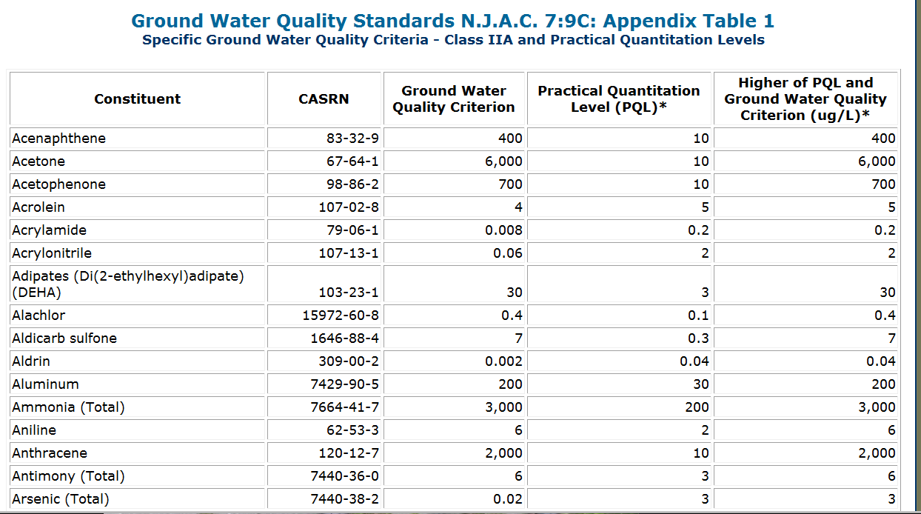
Specific Criteria
Notes:
The GWQS include criteria for 192 constituents for Class II-A (Appendix Table 1)
The ground water quality standard (constituent standard) is the higher of the health-based ground water quality criterion and the corresponding PQL.
The PQL represents the lowest concentration of a constituent that can be reliably achieved among laboratories within specified limits of precision and accuracy during routine laboratory operating conditions (i.e., the lowest quantifiable concentration).

Slide 23
Interim Specific Criteria
GWQS rules allow Department to establish interim specific criteria and interim PQLs prior to rulemaking:
  For Class II constituents without a specific criterion or PQL (i.e., not on Appendix Table 1)
  Sufficient information available to determine human health risk and derive toxicity factor
  Usually in response to cleanup of contaminated site
  Higher of criterion and PQL = Interim GWQS
Currently there are no interim specific GWQS
Posted on Department website
  See “Interim Ground Water Quality Criteria Table”
    http://www.state.nj.us/dep/wms/bears/gwqs_interim_criteria_table.htm

Slide 24
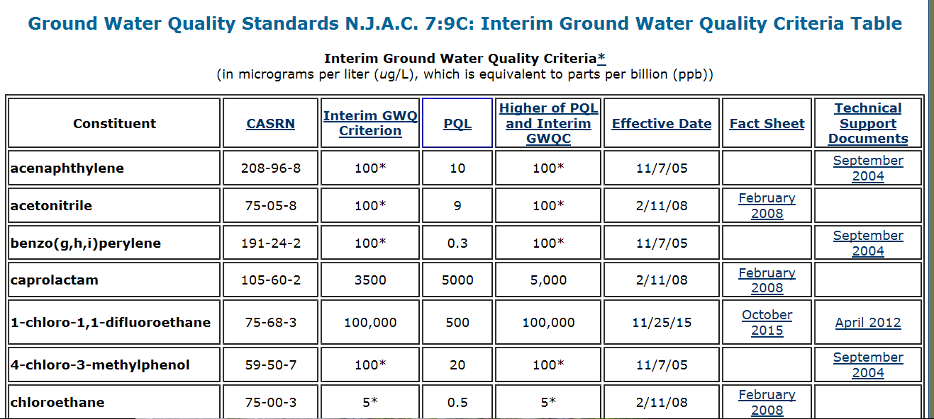
Interim Specific Criteria
Notes:
There are currently 23 interim specific criteria posted on the Department’s Web site at http://www.state.nj.us/dep/wms/bears/gwqs_interim_criteria_table.htm.
The Interim Criteria table also includes the Department’s determination of carcinogenicity (i.e., which of the Appendix Table 2 interim generic criteria apply) for 10 additional constituents.

Slide 25
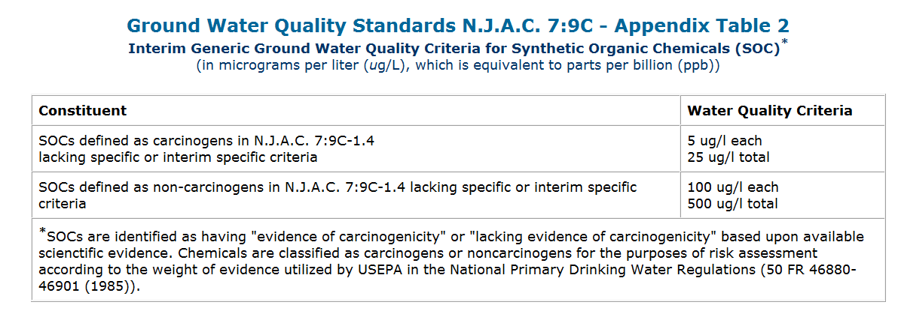
Interim Generic Criteria
The standard for a constituent not found on Appendix Table I is the interim generic criterion listed in Appendix Table II (based on carcinogenicity)
Notes:
).

Slide 26
Recent GWQS Rule Amendments
23 interim specific criteria were proposed to be replaced with specific criteria and added to Appendix Table 1 as part of the January 2018 Rulemaking. three constituent standards becAme more stringent based on updated criterion or PQL:
2-Hexanone: 300 ug/L to 40 ug/L
4,6-Dinitro-o-cresol: 1 ug/L to 0.7 ug/L
Caprolactam: 5,000 ug/L to 4,000 ug/L
PFNA Adopted 0.013 ug/l to GWQS & Hazardous substance list (making cleanups eligible for Spill FundS)

Slide 27
Class III – Nonpotable
Designated Use: Not suitable for potable supplies due to natural hydrogeologic characteristics or natural water quality.
  Class III-A: Release or transmittal of adjacent ground or surface waters
  Class III-B: Any reasonable use at existing water quality, other than potable water.
Ground Water Quality Criteria: The ground water quality criteria for Class III ground water are determined by the Department on a site-specific, case-by-case basis pursuant to N.J.A.C. 7:9C-1.7(e)-(f).

Slide 28
GWQS Rule Amendments
Key Issues Under Consideration:
  Update current numeric ground water quality criteria and PQLs and Consider adopting new standards in response to Emerging contaminants
  Changes to designated uses, classification areas, and/or classification area maps
  Clarify, simplify and streamline the rules and their implementation
  Stakeholder Input will be sought
Notes:
Last major amendments were in 2005; Current rules were readopted without change in 2014; expire in 2021
Need to determine if changes in the derivation of toxicity factors for other standards trigger changes to GWQS
EPA’s Final Updated Ambient Water Quality Criteria for the Protection of Human Health [EPA-HQ-OW-2014-0135; FRL-9929-85-OW] (see 80 FR 36986)
SRP’s Stakeholder process recently conducted to inform development of proposed amendments to the New Jersey Remediation Standards at N.J.A.C. 7:26D (see http://www.nj.gov/dep/workgroups/srp.html).
2016 Stakeholder process stated in public notice announcing denial of petition for rulemaking for new criterion and PQL for BCEE. (see 9/21/15 NJR): “The Department will be reviewing this new information, and intends to initiate a stakeholder process in 2016 to gather additional information to determine if updates to any of the health-based criteria or PQLs are warranted based on current scientific information, which would subsequently be proposed as amendments to the GWQS rules.”

Slide 29
Health-based Standard Development Process for New Ground Water Contaminants

Slide 30
New data or scientific information
Need for remediation standard
New federal guidance or new/revised federal standard
Petition for rulemaking
If sufficient information is available to develop a standard.
GWQS program requests review of new contaminant.
Division of Science and Research evaluates scientific literature and other government agencies’ evaluations for information on contaminant’s health effects.
If sufficient information is not available.
GWQS program and Division of Science and Research continue to review data and relevant information as it comes out.
Triggers
Standards
Development
Rulemaking
Adopted
Standards
KEY

Slide 31


.
Health-based criterion derived/recommended based on health effects and exposure factors to protect the most sensitive groups.
Rulemaking process with new criterion, PQL and standard. The new standard is the higher of the criterion and the PQL.
PQL derived/recommended based on analytical capabilities of NJ certified laboratory community.
Adopted Ground Water Quality Standard
Safe Drinking Water Maximum Contaminant Levels (MCLs)
NJR Notice of Administrative Change
Ground Water Remediation Standards
Triggers
Standards
Development
Rulemaking
Adopted
Standards
Adopted ground water standards become the remediation standards for sites with contaminated groundwater.
KEY

Slide 32
Contact Information
NJDEP Stakeholder WorkgroupS and Public Meeting Schedule
Materials posted on the Department’s website at
http://www.nj.gov/dep/workgroups/
NJDEP Division of Water Monitoring and Standards
Bureau of Environmental Analysis, Restoration & Standards (BEARS)
httpS://www.state.nj.us/dep/wms/bears/index.html

