Slide 1
Air and Waste Management Association
Assistant Commissioner Paul Baldauf
Air Quality, Energy and Sustainability
November 22, 2019

Slide 2
AQES Topics for Today
This morning -- AC Baldauf
RGGI update – implementation on two fronts
2050 Climate Goal – Building on the Energy Master Plan
This afternoon – AD Ken Ratzman
Air Rule Update
Community Corner

Slide 3
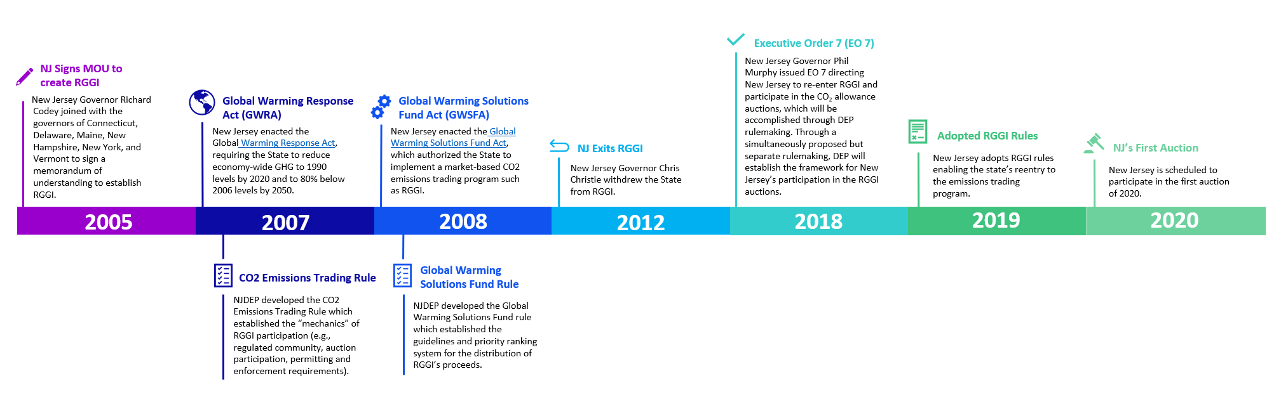
Back to the Future:
New Jersey Rejoins RGGI
1

Slide 4
DEP RGGI Rules
On June 17, 2019 NJDEP adopted two RGGI-related rules.
The CO₂ Budget Trading Rule establishes the mechanisms for rejoining RGGI and sets an initial state budget of 18 million tons in 2020.
The Global Warming Solutions Fund Rule establishes the framework for how the State will spend the proceeds from the quarterly RGGI CO₂ auctions, emphasizing projects that will support disproportionally burdened communities.
New Jersey will participate in the first RGGI auction of 2020.
CO₂ Budget Trading Rule
Global Warming Solutions Fund Rule
Legal commitment to the RGGI process.
Adopts framework of RGGI Model Rule.
Establishes budget of 18 million tons in 2020.
Framework for how the state will spend auction proceeds.
Adheres to legislative mandates.
Incorporates EO 7 criteria.

Slide 5
How Does RGGI Work?
2
CO₂
Regional greenhouse gas emissions cap is established
States offer allowances for sale in quarterly auctions
Electric Generating Units purchase allowances to equal emissions for 3-year control period
States receive revenue from quarterly auctions to invest
Allowance
Notes:
Once we receive these revenues what will we do with the cash money

Slide 6
What do RGGI Regulated Entities Need to Do? And By When?
☑ Install, certify and operate systems to monitor CO₂ mass emissions by June 11, 2019.
□ Submit an operating permit application including all applicable RGGI requirements by January 1, 2020 – 15 facilities (69 EGUs) currently in compliance.
□ Obtain CO₂ allowances annually equal to their mass emissions. Failure to meet this obligation by the control period (3-years) deadline results in the facility needing three times the number of required allowances.
□ Submit a compliance certification report for each control period.
34 Fossil Fuel Power Plants
100 Electric Generating Units (EGUs)
New Jersey

Slide 7
How Much Money?
3
The amount of money received will depend upon the price of carbon at the time of each auction.
Best Guess:
$80 million in 2020
EDA
$48 Million
BPU
$16 Million
DEP
$8 Million
+
$8 Million
Notes:
- If the current clearing price holds constant, New Jersey’s best estimate for auction proceeds collected in 2020 is $80 million.
-Projection out to 2030
-Anticipating decrease in funding over time, less money over time because emissions will fall

Slide 8
5
FUNDING PLAN
FRAMEWORK
1
2
3
4
Public Meetings
Develop Initiatives
Rank Initiatives
Report Out
Host four public meetings to educate about the funding requirements and to gather input on spending priorities.
Identifies initiatives each agency will sponsor during the corresponding funding period.
Ranks initiatives against six objectives by the state agencies. Each objective must be ranked critical to at least one initiative.
Subsequent funding plans must report on previously funded projects and programs.

Slide 9
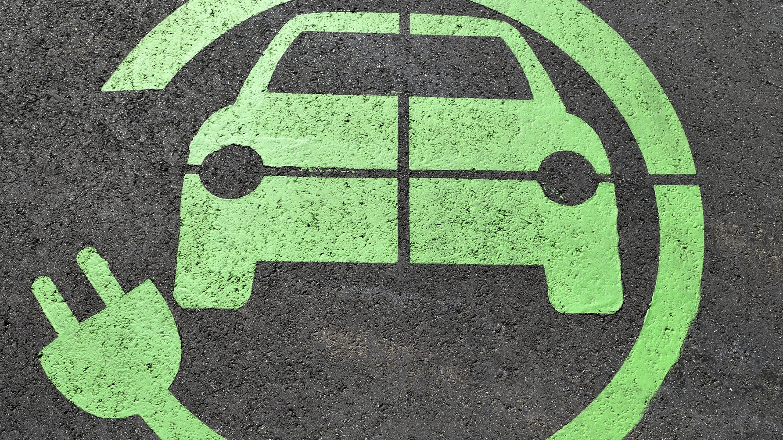
Governor’s Funding Priorities
13
Electrification of transportation in the State.
Provide meaningful benefits to communities most affected by pollution and climate change

Slide 10
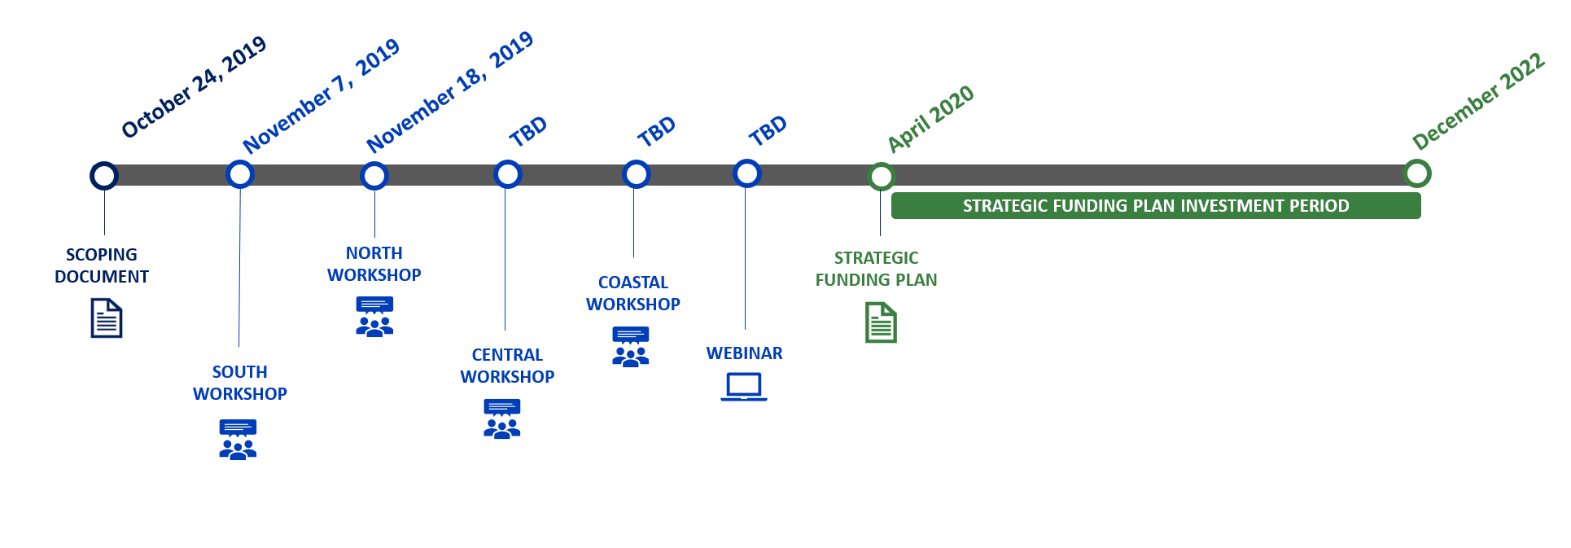
Timeline
24
December 12, 2019
November 25, 2019
December 6, 2019

Slide 11
Global Warming Response Act
N.J.S.A 26:2C-37
Enacted July 6, 2007
Calls for 80% reduction in greenhouse gases from baseline year 2006 by 2050
How can we achieve this goal?
Regional Greenhouse Gas Initiative
Renewable Energy Portfolio
Offshore Wind
Electric Vehicles
Natural Carbon Sinks
Energy Efficiency
80%
from 2006 baseline by
2050

Slide 12
NEW JERSEY’S GREENHOUSE GAS REDUCTION TARGETS
DRAFT, FOR CONSIDERATION ONLY, NOT FOR DISTRIBUTION
125
120.6
97
85
24.1
*Estimated emissions reductions based on fulfillment of Clean Energy Act Mandates that include 3500 MW of Offshore Wind by 2030 and annual savings of 2% due to electrical energy efficiency and 0.75% due to natural gas energy efficiency.

Slide 13
Notes:
This slide will transition us to talk about the conceptual model for emissions analysis
This is the GHG inventory and the breakdown of emissions. Transportation and electric sectors are the biggest contributors. We will also consider non-energy sources and carbon sinks in our analysis.

Slide 15
GWRA Approach
EMISSIONS DRIVERS
EMISSIONS ACTIVITIES
EMISSIONS REDUCTION PATHWAYS
STRATEGIES
An underlying factor that is indirectly responsible for a change in energy consumption by way of influencing energy demand, for example, population density
An action or a set of actions that is responsible for direct GHG emissions. The direct emissions can be a consequence of combustion, chemical production and/or biological processes. For example, vehicle miles traveled
A sector-specific strategy that can be implemented though a set of actions that will reduce emissions in that sector, for example, fleet electrification, reduction of VMT, electrification of space heating etc.
Legislative and regulatory action that will lead to the realization of the pathways. For example, adopting stricter Café Standards
Actions used as a measure of transformation or progress of a sector towards reducing emissions.. For example, increasing public transit capacity

Slide 16
Recommendations Timeline
June 2019
Draft EMP Released
December 2019
Final EMP
June 2020
Final GWRA Recommendation Report

