Slide 1
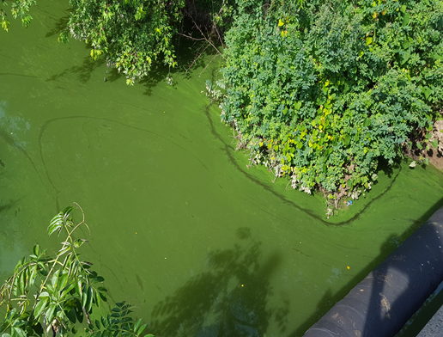


Freshwater Monitoring and Cyanobacterial Harmful Algal Blooms (HABs) Response
Leslie McGeorge, MSPH, Administrator
NJDEP - Bureau of Freshwater & Biological Monitoring (BFBM)
Division of Water Monitoring & Standards (DWM&S)
18th Annual Joint Venture NJDEP/A&WMA Regulatory Update Conference
November 22, 2019

Slide 2
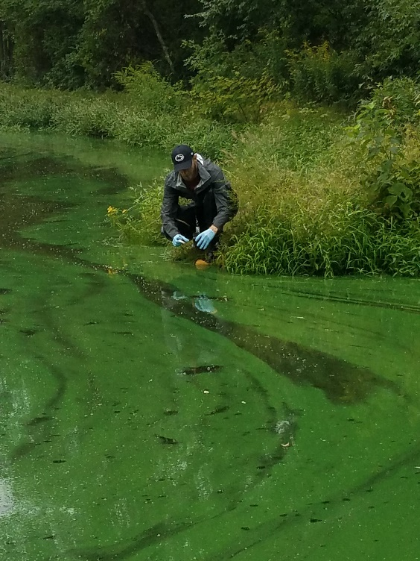
Overview
Bureau of Freshwater & Biological Monitoring
HABs & Need for Response Preparedness
NJ Response Strategy & Monitoring
DEP HAB Website
2017 - 2019 HAB Responses
2019 Governor’s HAB Initiative

Slide 3
WATER RESOURCES MANAGEMENT
Water Resources Management
Michele Putnam
Assistant Commissioner
Division of Water Monitoring & Standards
Bruce Friedman
Division of Water Quality
Janice Brogle
Division of Water Supply & Geosciences
Pat Gardner
Freshwater & Biological Monitoring
Leslie McGeorge
Marine Water Monitoring
Bob Schuster
Environmental Analysis, Restoration & Standards
Kim Cenno
Rivers, lakes streams & groundwater
Physical/chemical, biological monitoring
HAB monitoring & response
Ocean and estuaries
Physical/chemical, biological monitoring
Shellfish sanitation
WQ standards, assessment & restoration
TMDL development
WQ management planning
Stewardship

Slide 4
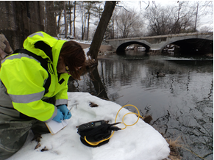
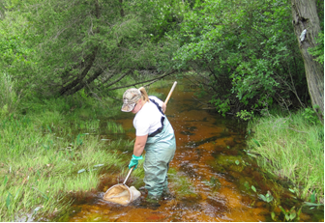
Bureau of Freshwater and Biological Monitoring
Rivers/streams, lakes & groundwater
  Chemical/Physical - water & sediment
  Biological – macroinvertebrates & fish assemblage, fish tissue
  Microbiological
Data to assess Clean Water Act uses – aquatic life, recreation, drinking water & fish consumption
Partners - include: Marine Water Monit., Div. of Science & Research (DSR),C & E, USGS, EPA, Academia, Watershed Assoc’s
Special Projects include:
  Nutrient Criteria development
  Harmful Algal Bloom (HAB) Recreational Response

Slide 5
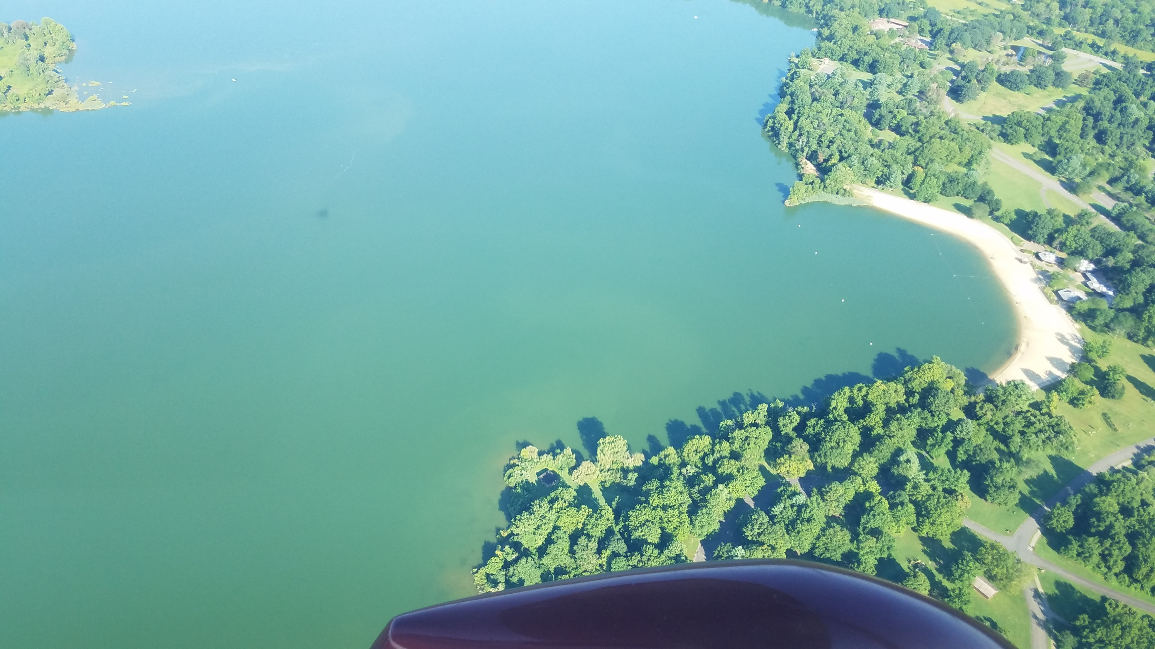

Need For State Capacity Building & Preparedness for
Freshwater Cyanobacterial Harmful Algal Blooms (HABs)
Increasing global incidence & concern
Impacts - human & animal health, ecosystem & economic
Human Health – recreational & drinking water exposure
High profile blooms (e.g., Lake Erie, Ohio River, & Lake Okeechobee)
NY – developed HAB response program in 2012
NJ developed lab capabilities, monitoring, & response Strategy 2013-2017
Today ~ 30 states with HAB strategies or
public info. resources
Notes:
US Blooms – 1) Toledo - in 2014, bloom in Lake Erie left ½ million people in Toledo without drinking water for 2 days. $65 million in lost drinking water and recreational benefits.
2) Ohio River – In 2015, bloom in 650 miles of the Ohio River affected drinking water of 5 million, and recreation in 5 states
3) Lake Okeechobee – In 2016, major bloom in Lake Okeechobee impacted downstream waters, including coastal beaches and the tourism industry
NY - 168 HABs reported in 2017

Slide 6
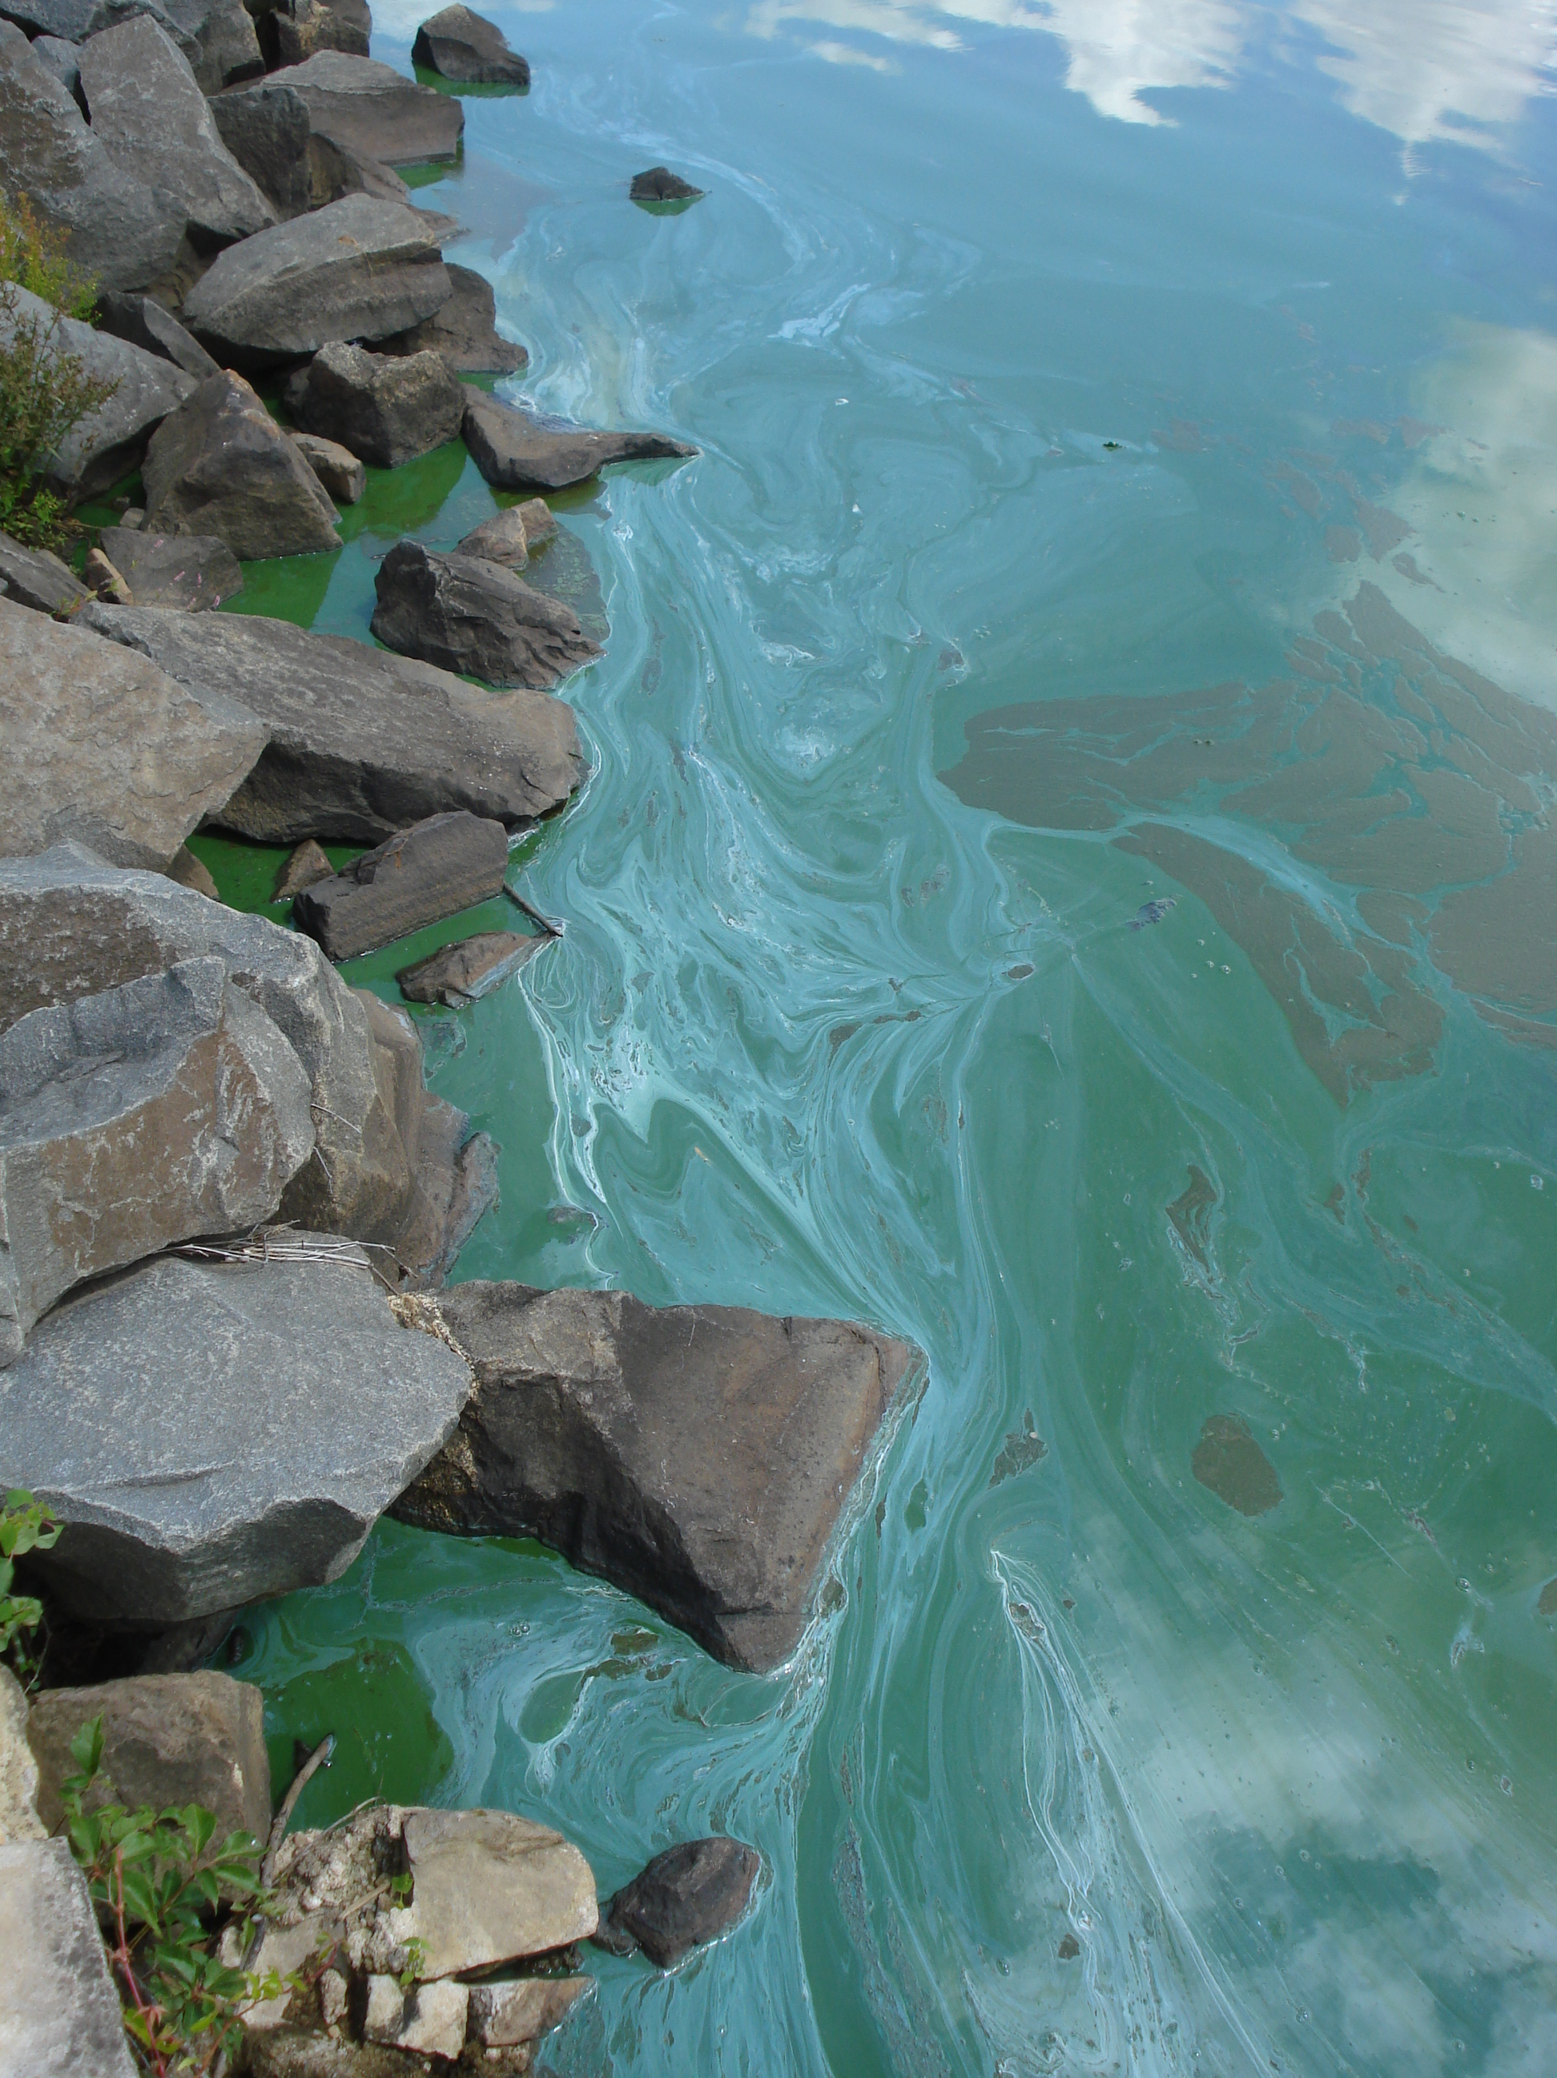
What are Cyanobacterial HABs?
Cyanobacteria
Blooms
Cyanobacterial HABs (CyanoHABs) -
  Can produce potent cyanotoxins
  Blooms not producing toxins can also have adverse impacts
Notes:
Cyanobacteria are naturally occurring bacteria in lakes and streams in low numbers.
They are also known as “blue-green algae”, but are not true algae. Function like algae and can photosynthesize.
Can grow to large numbers and form blooms under suitable environmental conditions – typically: sufficient sunlight, elevated nutrients, warm temperatures and calm water
CyanoHAB Blooms: can discolor the water (often blue-green, can be white, yellow ,brown ) or produce floating mats or "scums" on surface. Blue-green color – phycocyanin pigment
Cyanobacteria can produce toxins called Cyanotoxins that are dangerous to humans, pets, livestock and wildlife. Most common group of cyanotoxins are microcystins. Others that we occasionally monitor for are cylindrospermopsin and anatoxin-a, but there are many cyanotoxins.

Slide 7
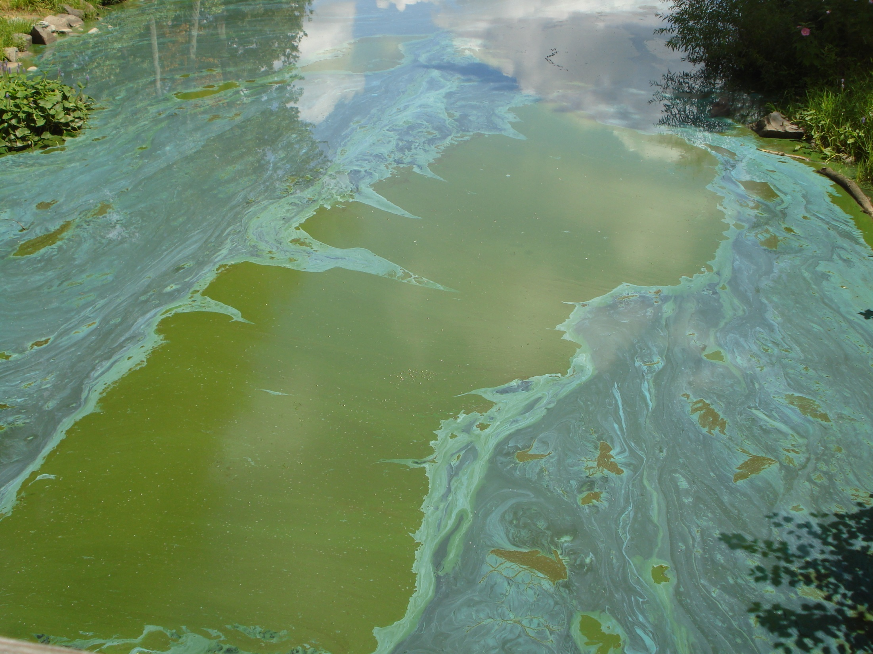
What are the Risks?
Humans:
Adverse effects can include: Flu-like symptoms, rash, allergic reactions, or more serious liver, kidney or nervous system impacts.
Animals:
Many cases of wildlife, pets, and livestock sickness and death.
Notes:
Flu- like symptoms – Headache, nausea, vomiting, diarrhea

Slide 8
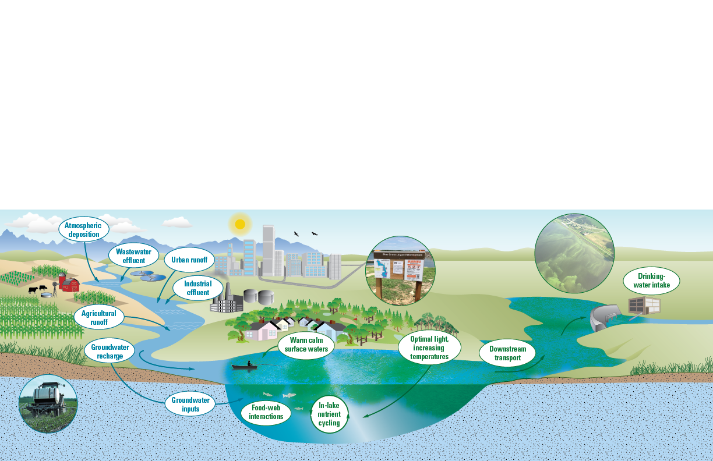
Background
What Causes Algal Blooms?
Many environmental factors influence the occurrence of algal blooms. In general, an algal bloom indicates an ecosystem imbalance.
After Graham and others, 2016, USGS OFR 2016-1174
http://dx.doi.org/10.3133/ofr20161174
Notes:
USGS slide from national HAB expert – Jennifer Graham
What causes HABs? While much is known, much remains unknown. Overall HABs indicate an imbalance in the aquatic ecosystem.
Factors influencing the occurrence of algal blooms include:
Nutrient enrichment - including runoff from agriculture and urban land uses, and from groundwater flow
Calm water
Optimal light and elevated temps
Nutrient cycling in the lake can make nutrients available
Biological Community Interactions
Transport downstream – can impact water supply intakes, and beaches

Slide 9
NJ Cyanobacterial Harmful Algal Blooms (HABs)
Freshwater Recreational Response Strategy -
Released 2017
RECREATIONAL THRESHOLDS –
Cell density and 3 toxins ( DSR and WHO recommendations)
HAB MONITORING & RESPONSE
ADVISORIES
RESEARCH
OUTREACH & COMMUNICATION

Slide 10




Cyanobacterial Harmful Algal Blooms (HABs)
Freshwater Recreational Response Strategy
Unified approach for HAB response in recreational waters & sources of drinking water.
Defines response actions of Departments and programs
  DEP, DOH (Licensed bathing beaches) and Dept Ag
  Coordinated by DEP’s Bureau of Freshwater & Biological Monitoring
  DEP programs include: BMWM, DSR, DWSG, DPF & DFW
Notes:
Programs include DOH, Ag, Fish & Wildlife, and Parks….

Slide 11
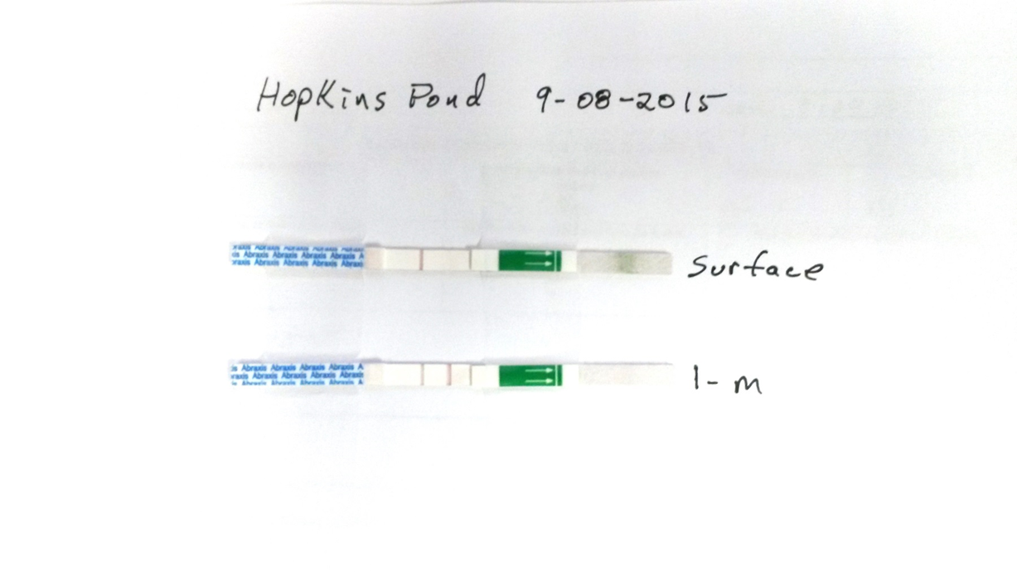
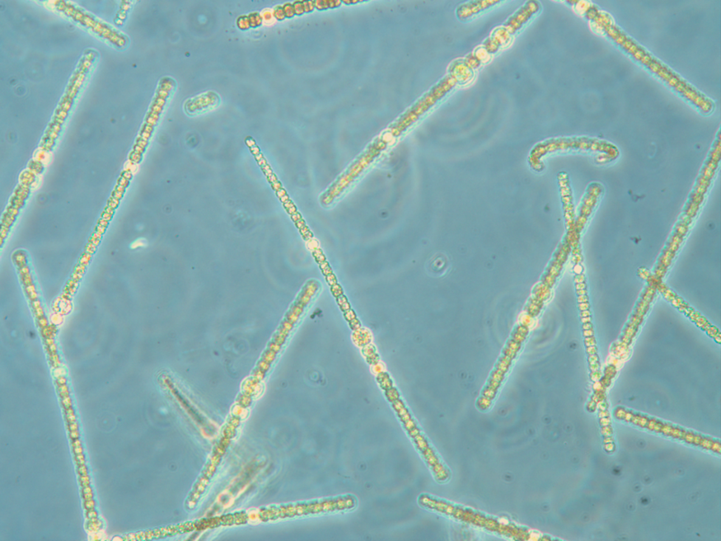
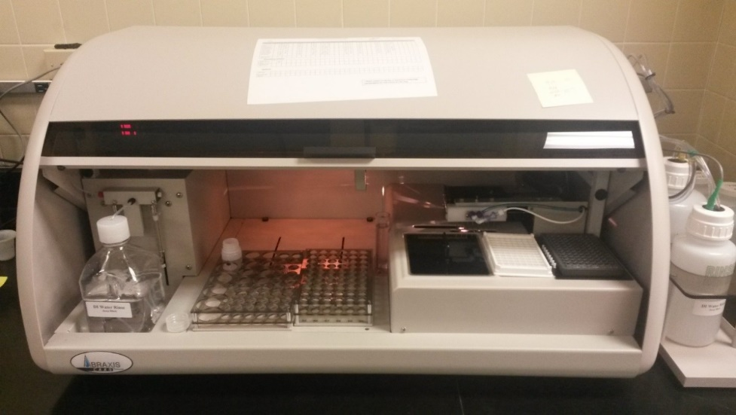
Cyanobacterial Harmful Algal Blooms (HABs)Freshwater Recreational Response Strategy and Guidance
HAB MONITORING AND RESPONSE
Field screening and
visual surveillance -
(e.g., toxin strip tests)
Discrete and advanced water monitoring
Lab - Species ID and cell counts
Toxin lab analysis - ELISA
  CAAS - Cyanotoxin Automated Assay System
Notes:
Strip tests used – microcystins. Distributed to state parks.
Semiquantitative test – results indicate >10 ug/l. Can detect < 10 ug/l but not accurate at that level.
Phycocyanin – unique pigment to cyanobacteria, confirms presence of cyano’s
Hand held meters – testing;
ELISA - enzyme linked immunosorbent assay, Abraxis equipment
CAAS - Cyanotoxin Automated Assay System. Performs three toxins simultaneously.

Slide 12
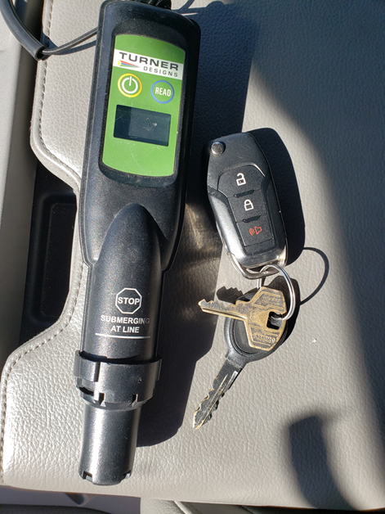
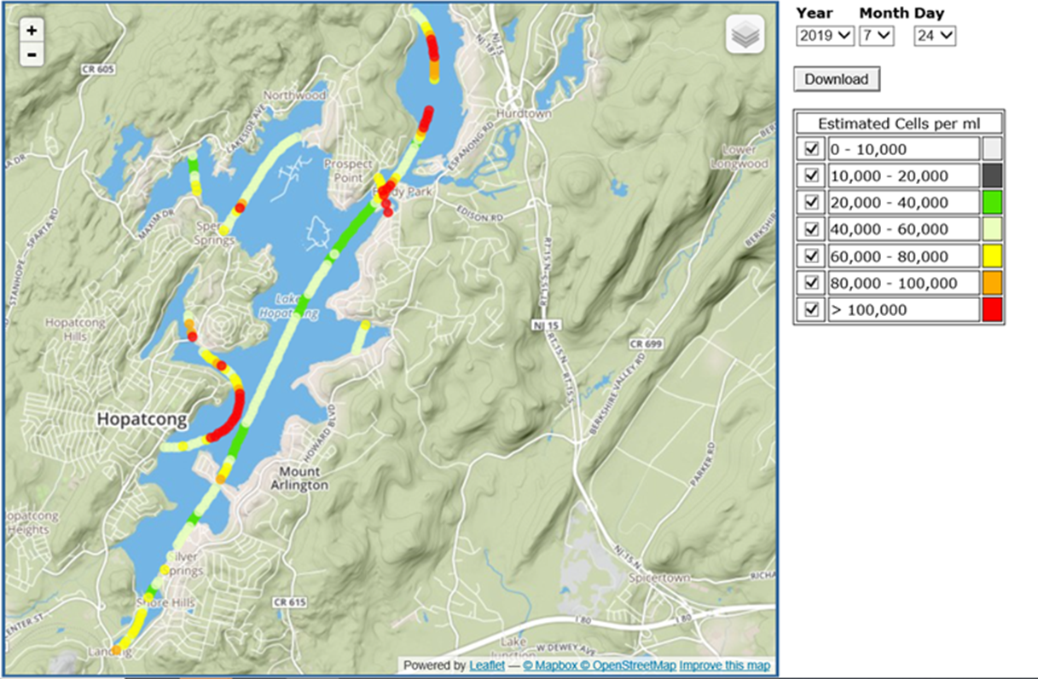
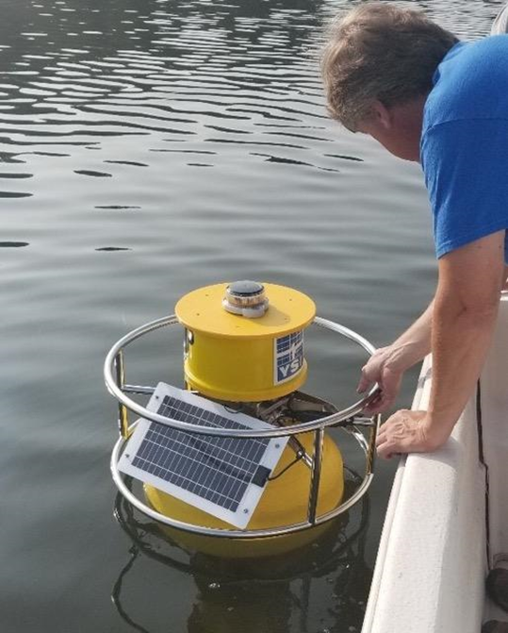
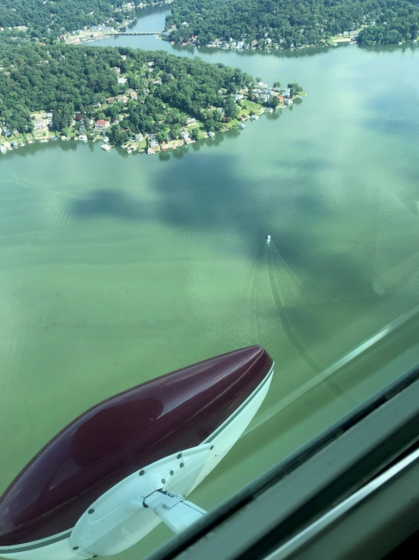
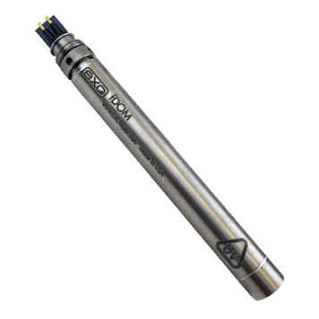
DEP Use of Advanced Technology for HABs
Hand-held phycocyanin meters
Aircraft remote sensing
Continuous monitoring buoys
Notes:
Hand held used as screening for relative Phyco levels. Unique pigment
Because of intensive surveys we have data to relate meter readings to cell counts for more reliable field screenings.
Will be a good tool for partners to screening suspected HABs and prioritize sampling.
Air craft – phyco measurements based on an algorithm using hyper spectral sensors.
Marine water monitoring are experts and have used for years on ocean flight recon

Slide 13

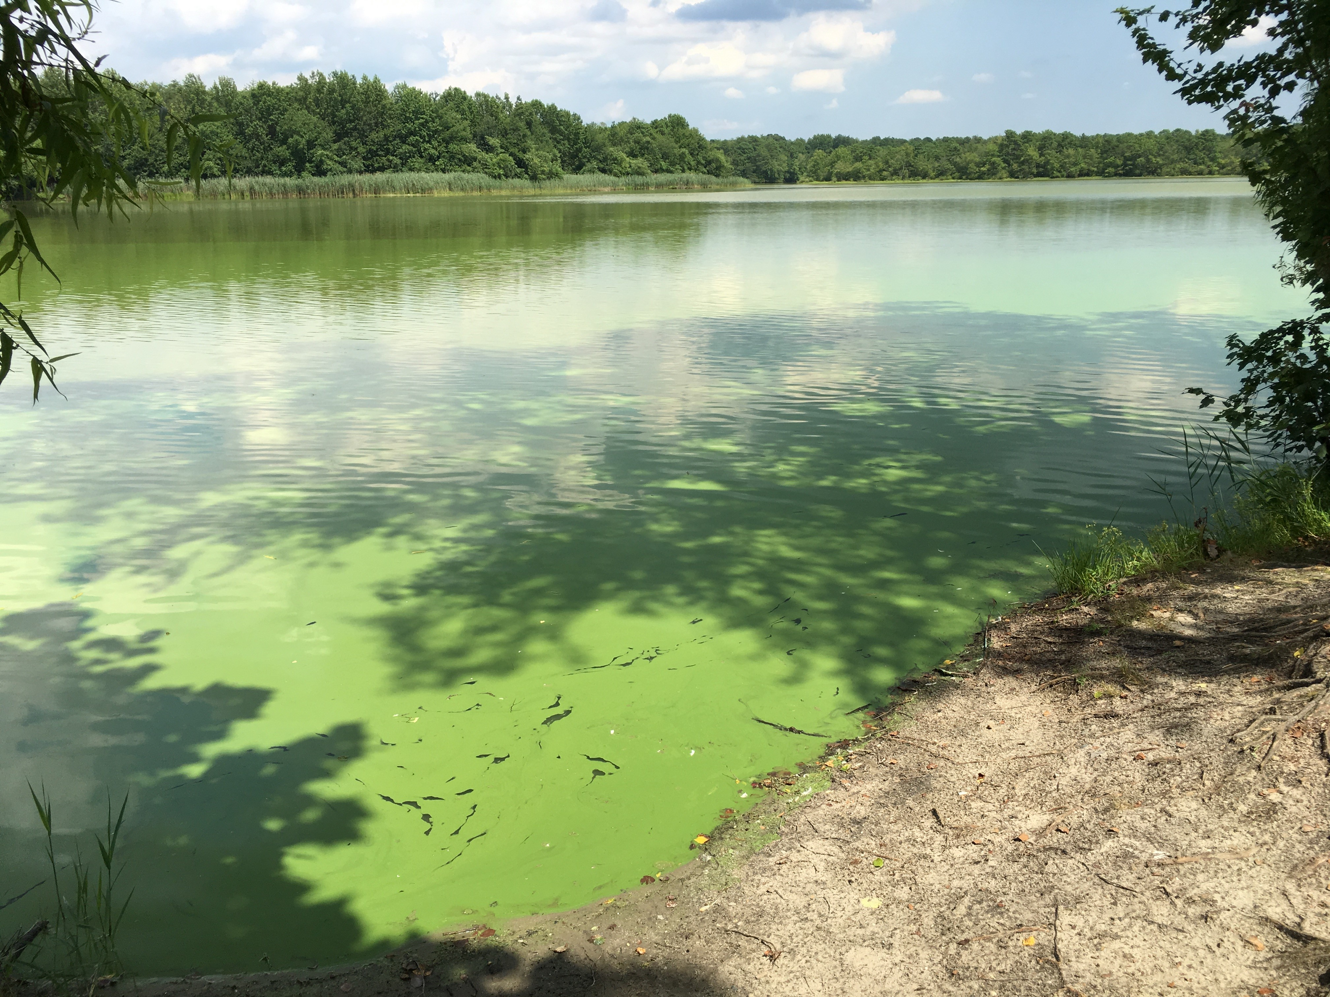


HAB Public Message and Reporting
Public Message – Avoid and Report
How report a suspected HAB?
Call NJDEP Hotline: 1‐877‐WARNDEP (1‐877‐927‐6337)
or Use the free WARNNJDEP mobile app http://www.nj.gov/dep/warndep.htm
HAB Button: NJDEP Homepage
http://www.nj.gov/dep/hab
Notes:
All reports directed to go through NJDEP central communication center Hotline; internal DEP or external reports
Call or use WarnDEP App
Can get information on reporting on DEP homepage
Online HAB reporting form available to provide more detail as an option

Slide 14
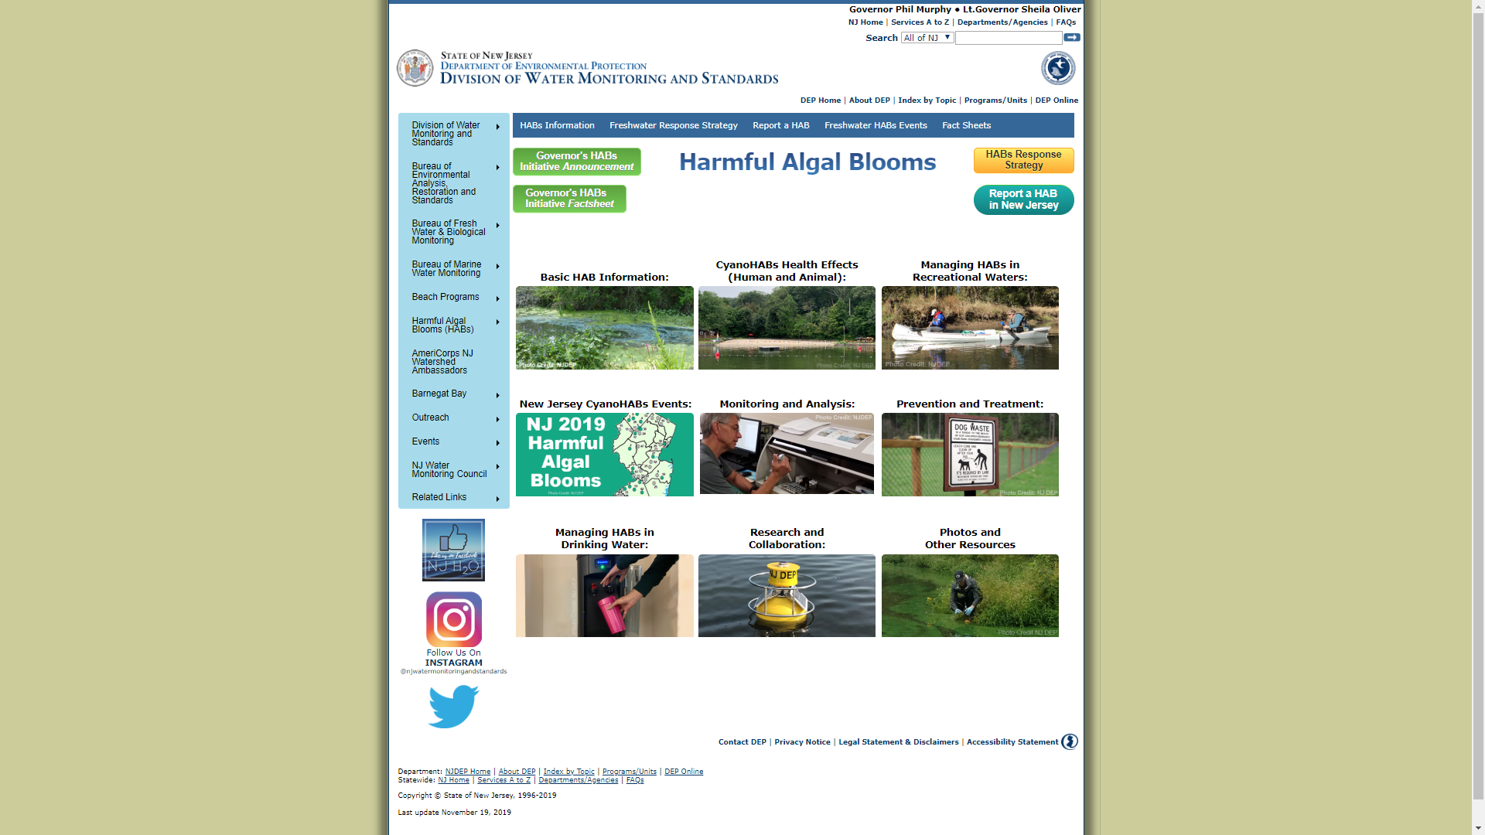
Harmful Algal Bloom Website https://www.nj.gov/dep/hab/
https://www.state.nj.us/dep/hab/
Notes:
Website has strategy available for download.
Other information on HABs and how to report them.
The HAB Event Tab provides a table of reported HABs
Whether they were confirmed and if advisories were posted or lifted.

Slide 15
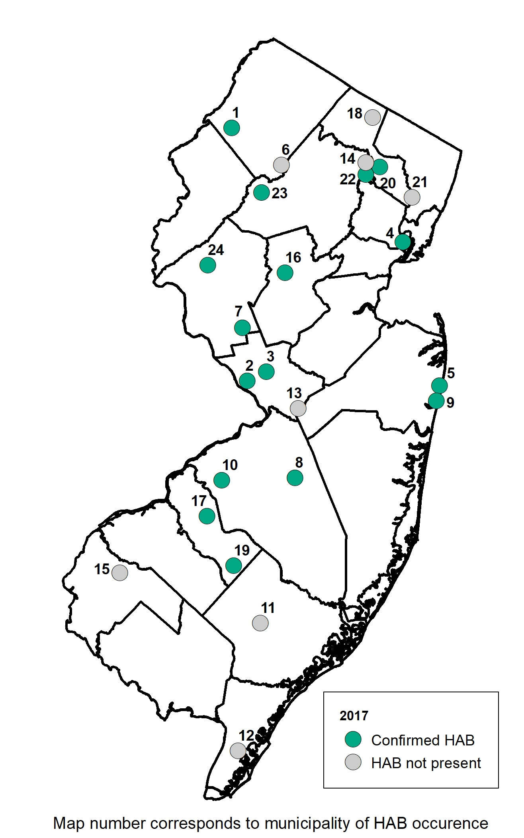
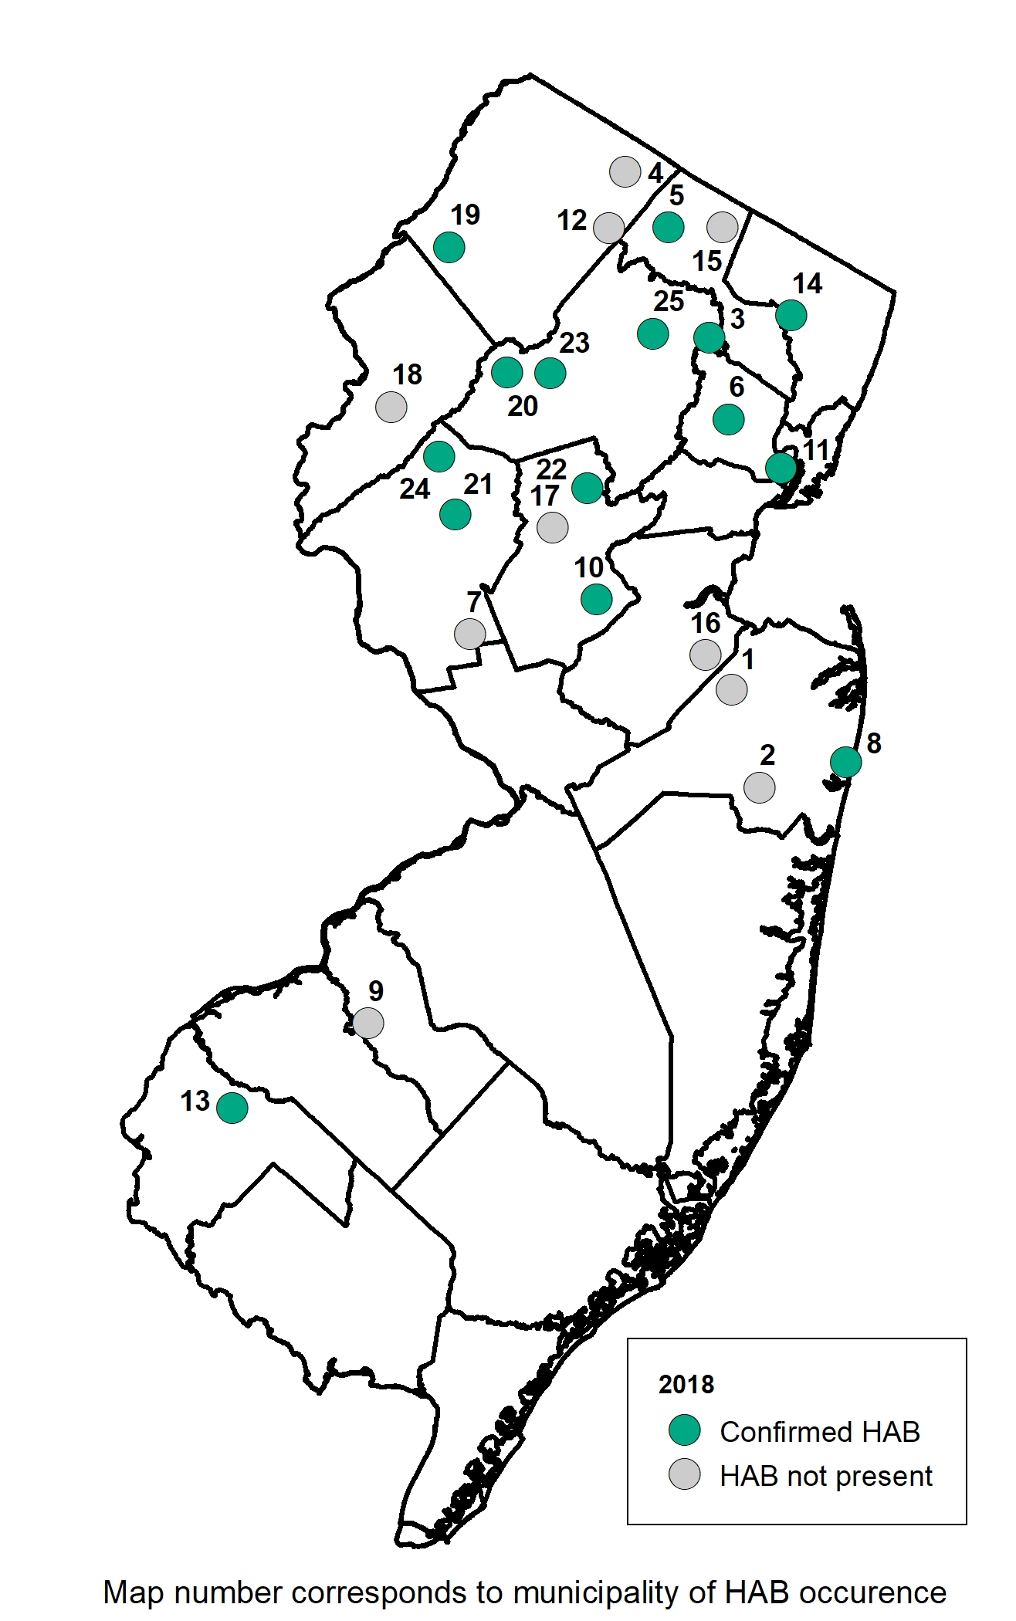
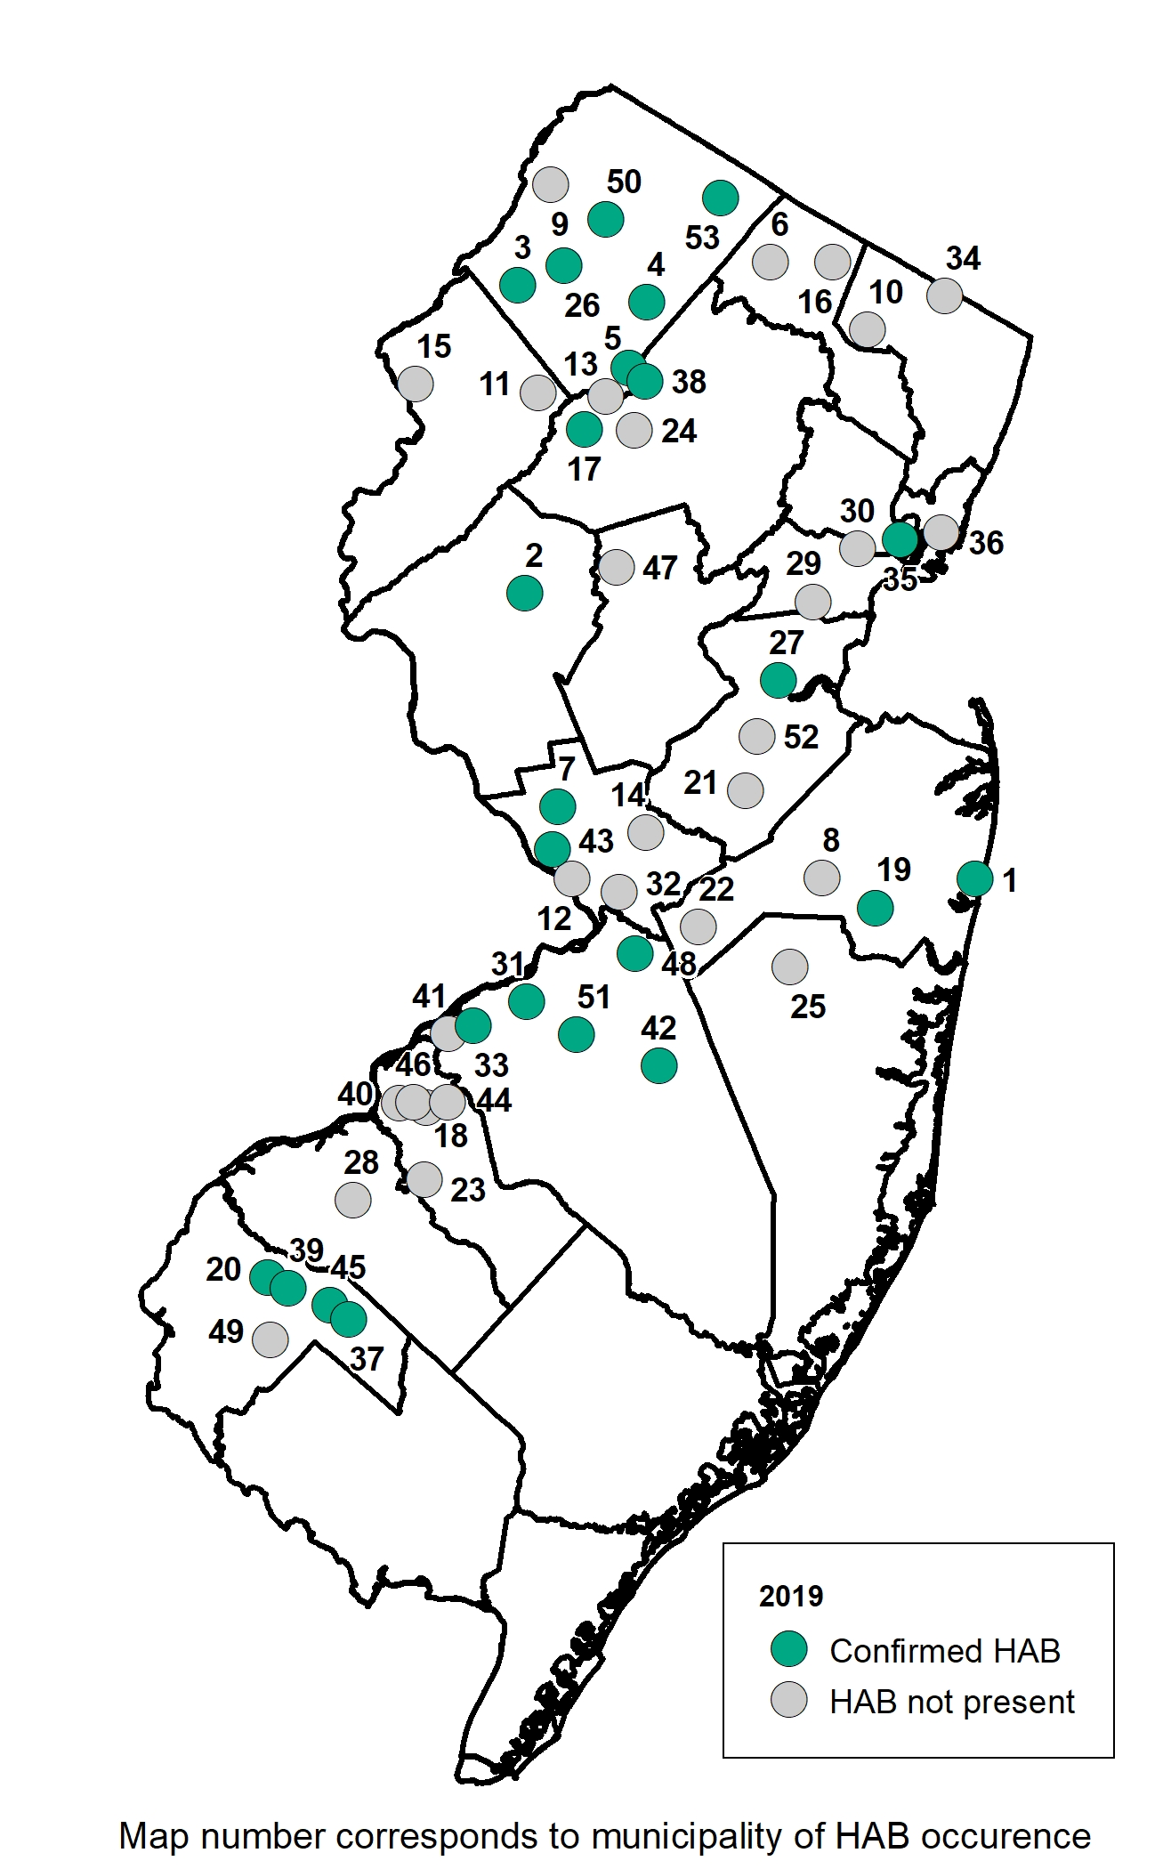
2017-2019 HAB Responses (by Municipality)
2017
2018
2019
Notes:
Visual of occurrence throughout the state in the 3 years since strategy was implemented.
Green –confirmed HAB
Gray – confirm not a HAB
2017 –30 reports 22 confirmed.
- 32 reports 20 confirmed.
2019 – 73 reports 39 confirmed.

Slide 16
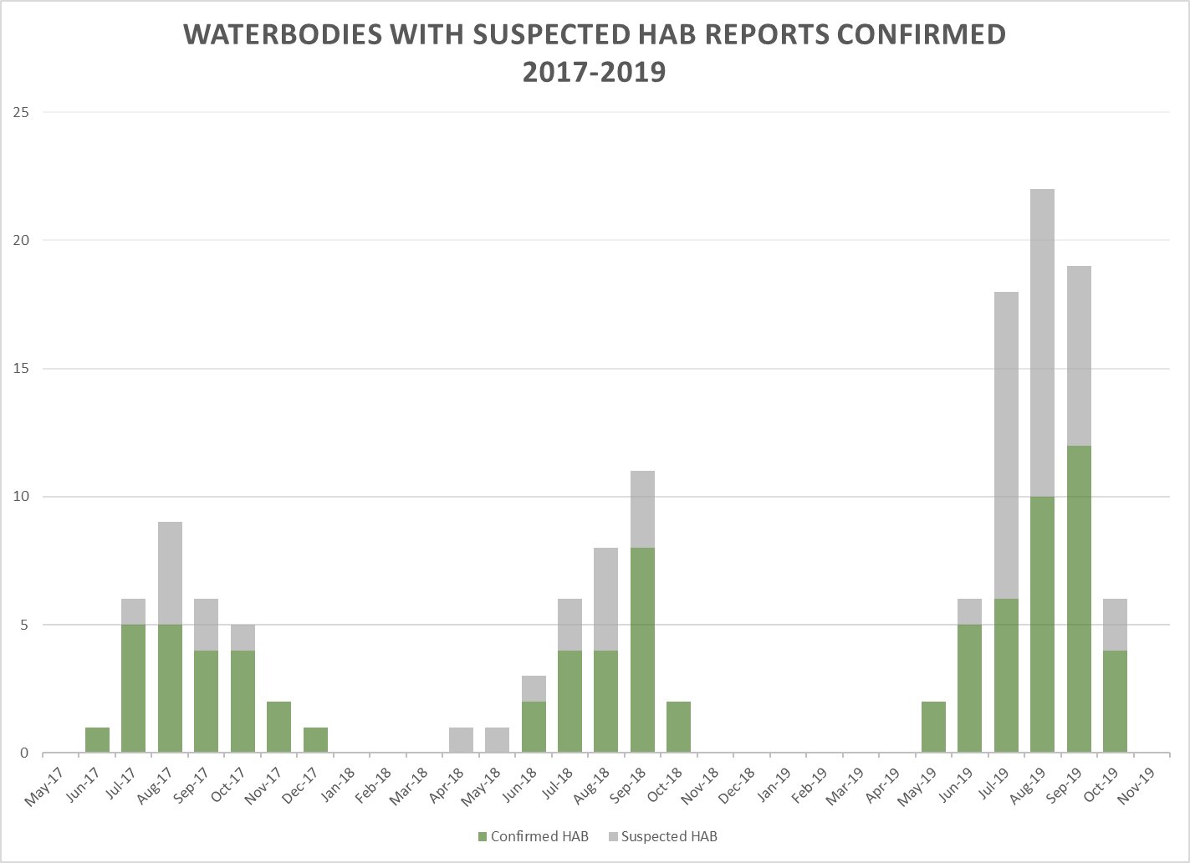
(by month)
2019
2018
2017
Notes:
From 2018- 2019 , 48 % increase in confirmed HAB events
56 % increase in waterbody responses to reported suspected HABs

Slide 17
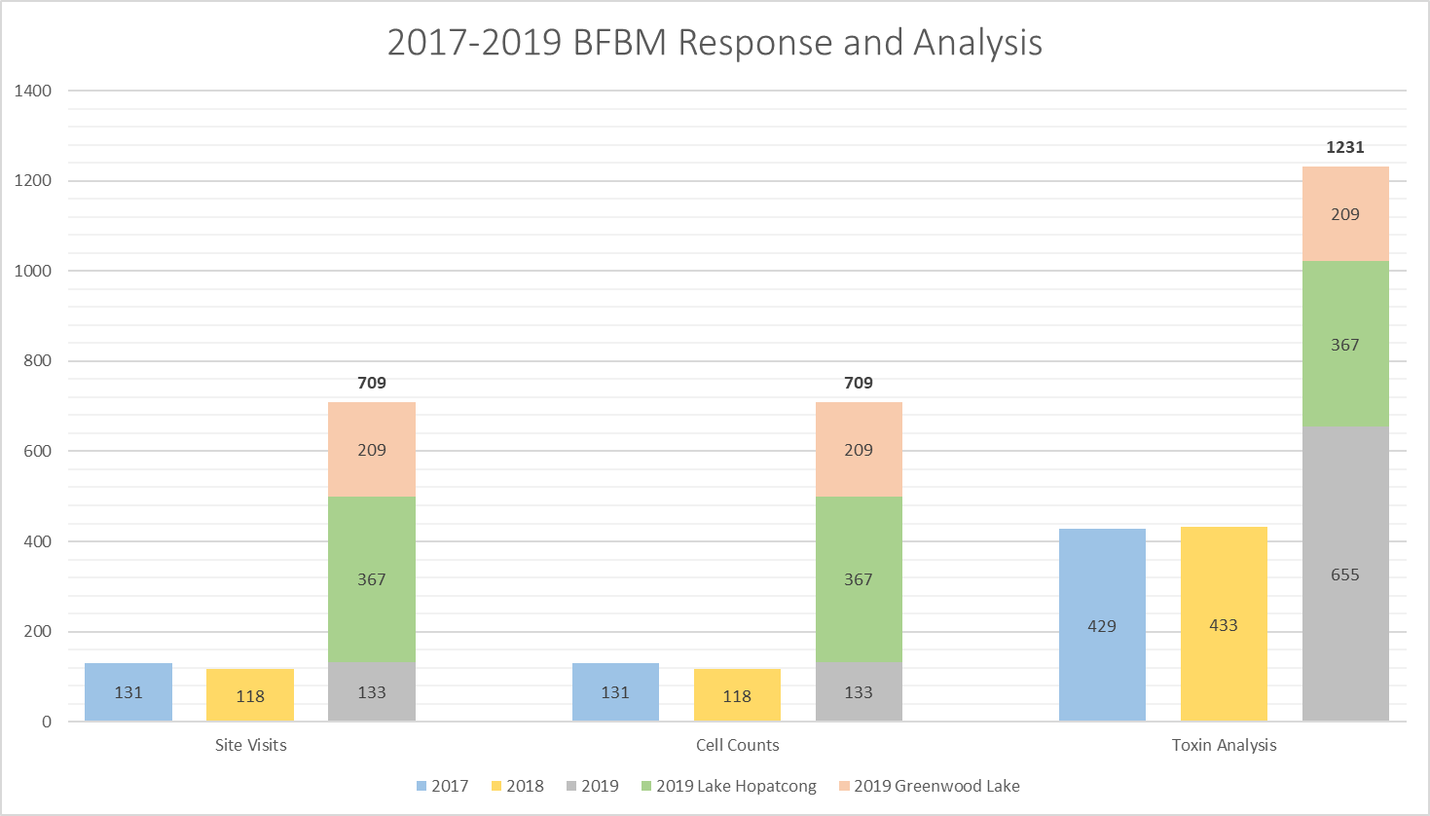
Site Visits
Cell Counts
Toxin Analysis
Notes:
2019
500% increase in-lake site monitoring
̴180% increase in toxin analyses
̴ 500% increase in cell count analyses

Slide 18
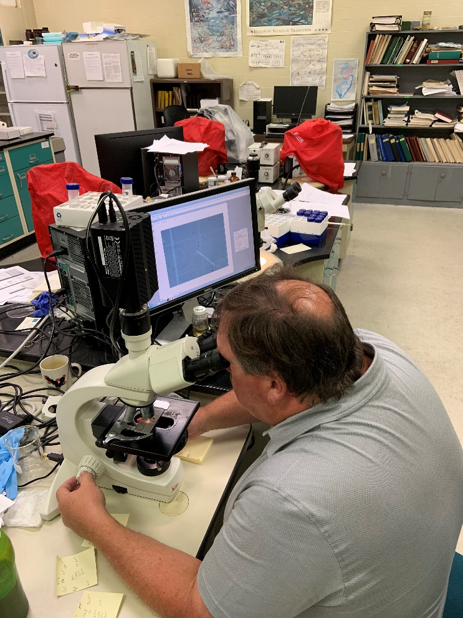
2019 Summary (By Waterbody Event) - 11/20/19
39 confirmed HABs/ 73 responses to suspected HABs
25 -Bathing Beaches (in season)
  18 at Lake Hopatcong
  3 at Greenwood Lake
  4 other lakes
4 - Drinking Water Sources
Notes:
2019 25 bathing beaches, though 18 were at Lake Hopatcong
We are still only finding toxins above our Guidance thresholds in same % range as previous years.
100% confirmed events above threshold for cell count ( 20,000 cells/ml)
76% above 100,000 cells/ml
Highest 56,300,000 cells/ml ( Rosedale)
50% also above 3 µg/l threshold for a cyanotoxin
Highest 423 µg/l ( Canistear) Actually now >900 ug/l

Slide 19
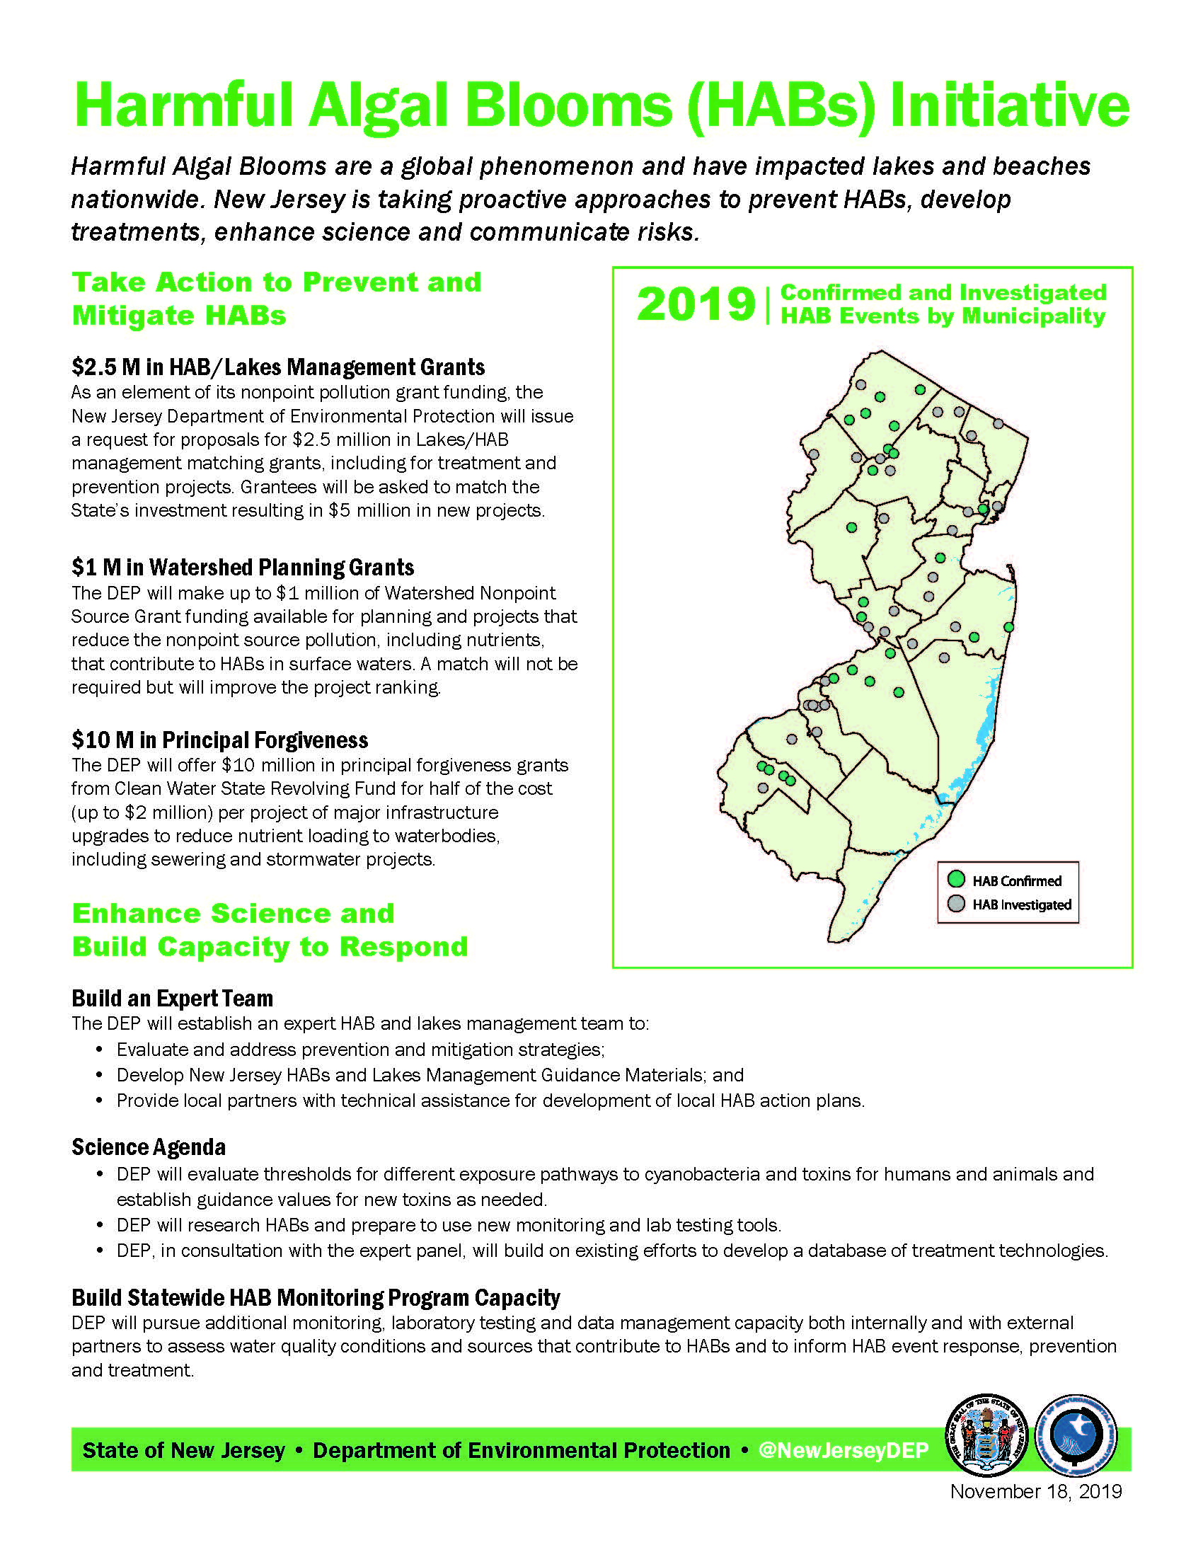
Governor’s HABs Initiative
Announced 11/18/19
3 Major Components
Prevent & Mitigate HABs
Lake Management Grants ($2.5M)
Watershed Planning Grants ($1M)
Principal Forgiveness Grants – infrastructure upgrades ($10M)
Enhance Science/Build Capacity
Build Expert Team –Lakes Mgt, Prevention & Treatment
Develop Science Agenda – guidelines, research
Build Monitoring/Lab/Data Mgt Capacity

Slide 20
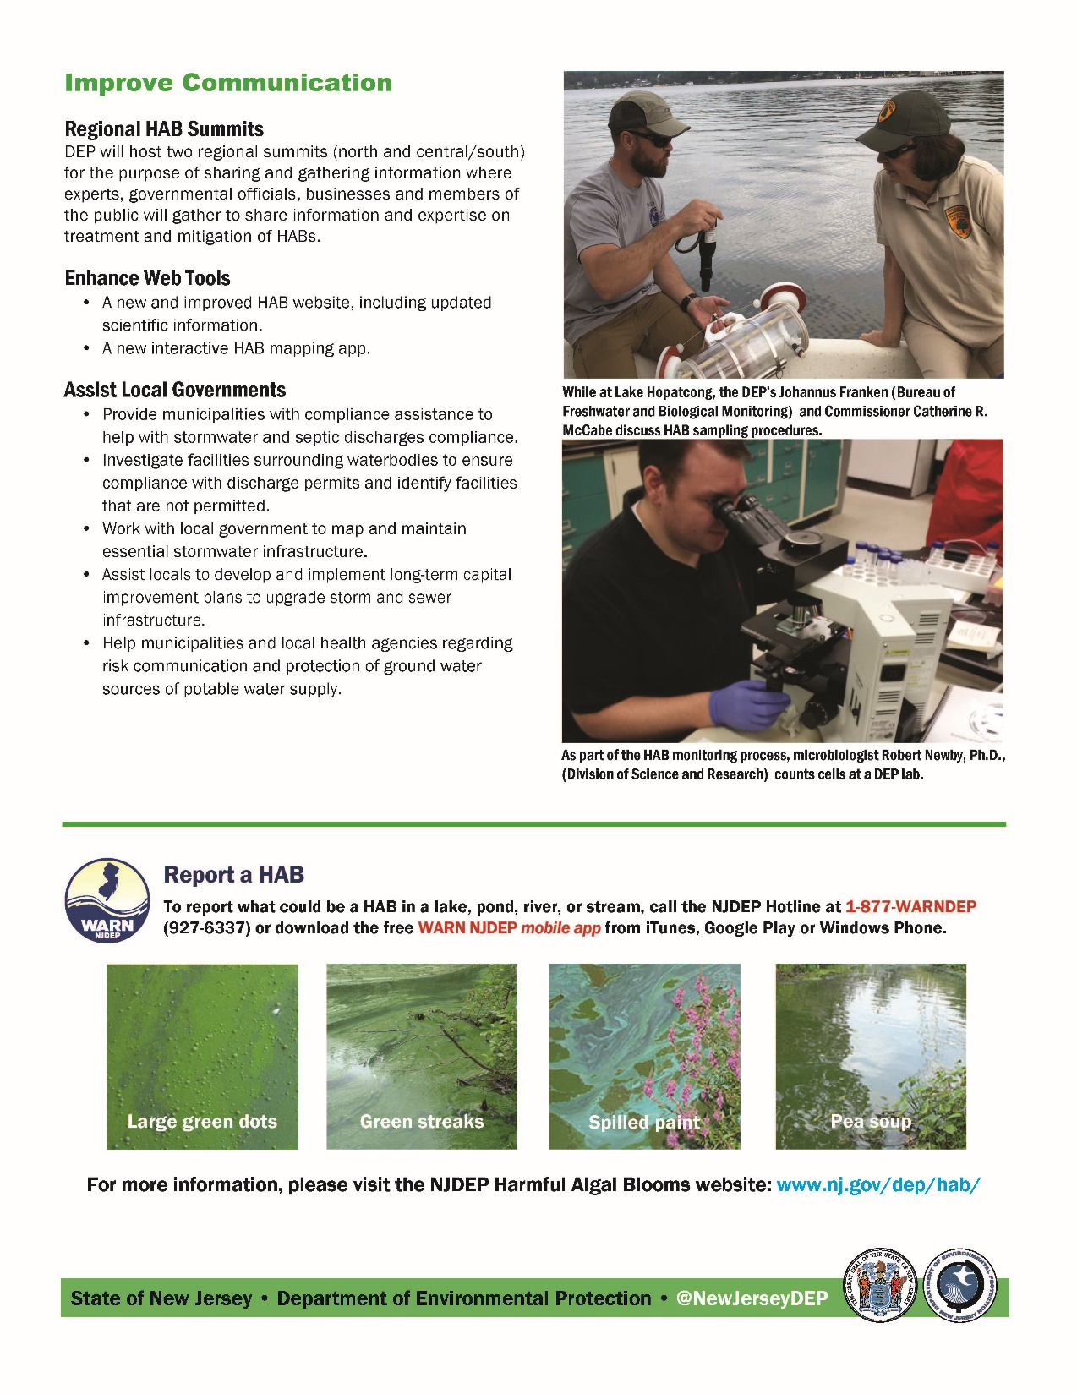
Governor’s Initiative (cont)
Improve Communication
Regional Summits (2) –Jan/Feb
Enhance Web Tools
  Improved website
  New interactive map
Local Government Assistance e.g., Stormwater/septic compliance assistance, map and maintain stormwater outfalls

Slide 21
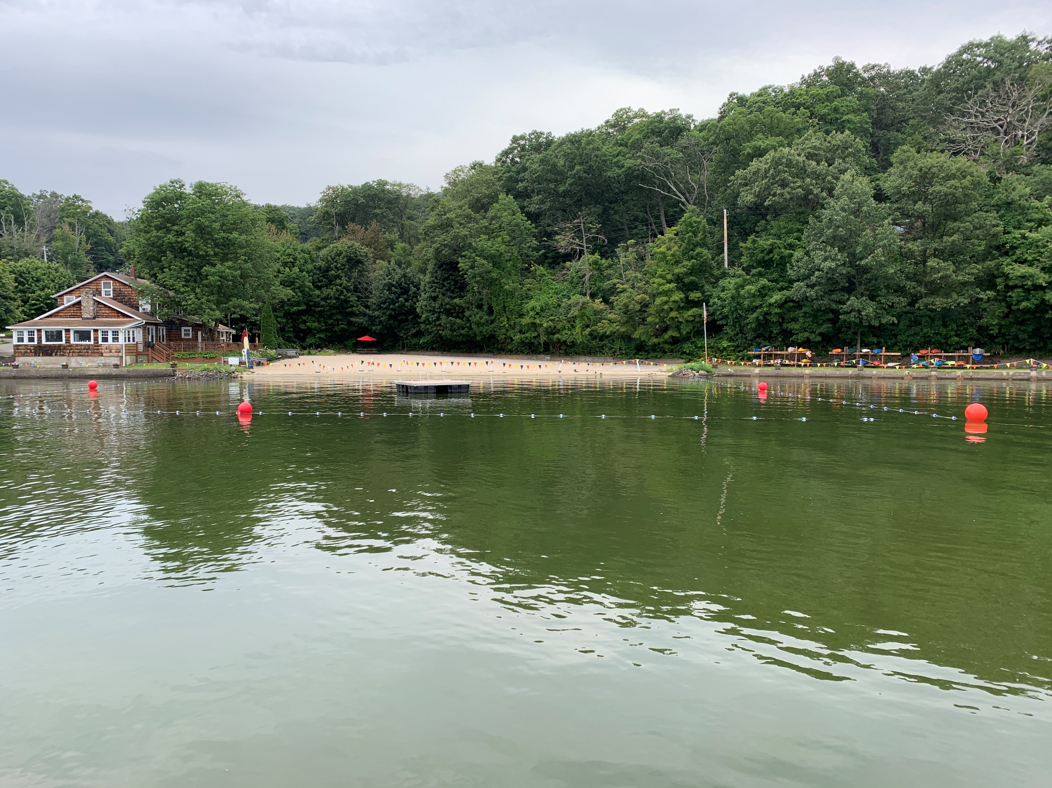
Contact Information
NJDEP Bureau of Freshwater and Biological Monitoring
Leslie McGeorge, MSPH, Administrator
Leslie.McGeorge@dep.nj.gov
Phone – 609-292-0427
Website - http://www.state.nj.us/dep/wms//bfbm/

