Slide 1

Compliance & Enforcement
Division of Air Enforcement
November 22, 2019
Richelle Wormley, Director

Slide 2

PARTNERSHIPS

Slide 3
EPA Region 2
  Alternate Compliance Monitoring Strategy Plan(CMS)
    Submitted a proposal for 4 year CMS
Enforcement Cross Media
  Landfill
  Water Treatment Facilities
  Cross Media Referrals

Slide 4
Permitting Process
  Air Permitting Conditions based on historical enforcement actions
  Participating in pre-application meetings
  Permit staff reviewing compliance schedules
  Multiple Coordination Meetings

Slide 5
Air Enforcement Initiatives
Tampering Of Emission Control Systems on Vehicles
  Diesel Enforcement Program/Bureau Mobile Sources
  Emission control modifications/ removals
Removal of catalyst, diesel particulate filter, SCRs
  30% non compliance rate for diesel trucks within the diesel powered vehicles with a gross vehicle weight rating (GVWR) 8,501 to 17,999

Slide 6
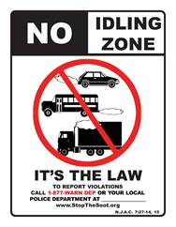
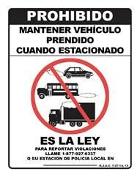
Idling
  Idling Sweep Ironbound Community May 2019
  More targeted efforts are forthcoming to include other agencies
  Settlements to include posting signage

Slide 7
N.J.A.C. 7:27 – 16.2(l)(7)(v and vii)
  For an internal floating roof installed prior to July 23, 1984, ensure that the concentration of organic vapor in the vapor space above the internal floating roof shall not exceed 50 percent of its lower explosive limit; and
  For an internal floating roof installed after July 23, 1984, ensure that the concentration of organic vapor in the vapor space above the internal floating roof shall not exceed 30 percent of its lower explosive limit.

Slide 8
COMPLIANCE ADVISORIES

Slide 9
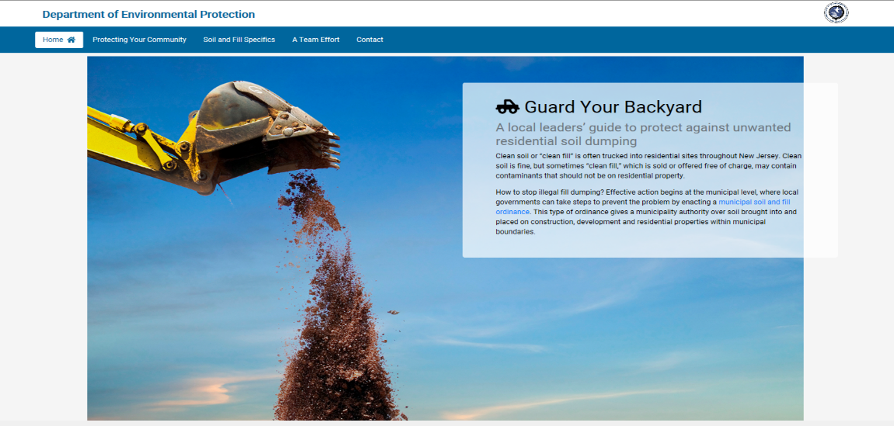
Aug. 2019 – BSWC&E issued a Compliance Advisory Enforcement Alert
Oct. 2019 - NJDEP launched an information campaign on fill material via a dedicated website.
Guardyourbackyard.nj.gov

Slide 10
Guard Your Backyard
Contains 3 Sections with additional information:
  Protecting Your Community: Model Ordinance, examples of Municipalities with local laws already enacted
  Soil and Fill Specifics: DEP’s advisory materials and informational documents
  A Team Effort: Describes the groups involved or impacted by contaminated soil/fill material and gives additional information on what to be aware of and steps to take
    The Department NJ Residents
        Municipalities Industry Leaders or Companies

Slide 11
    Compliance Advisory Enforcement Alert
    Soil and Fill Materials Must Meet NJDEP Fill Requirements
    Two page document explaining the concerns and efforts NJDEP is taking to ensure compliance with the requirements and ways to limit the risks posed by the use of unacceptable soil and fill material.
    Includes websites and contact phone numbers for additional information.
    https://www.nj.gov/dep/enforcement/advisories/2019-05.pdf
    Soil/fill materials found to be solid waste or contaminated can be cited as a violation of the Solid Waste Rules and require removal by the responsible party(ies) for proper disposal.
    Note: The web page and the model ordinance do not apply to site remediation sites (i.e., sites that are known to be contaminated).

Slide 12
UPCOMING AIR COMPLIANCE ADVISORIES
Emergency Generators 005A or 005B
  Artificially low hours for testing and maintenance selected by regulated entities
Above Ground Storage Tanks and related Dispensing Equipment
www.nj.gov/dep/enforcement/advisories.html

Slide 13
TRAINING
County Environmental Health Agencies Only
  Above Ground Storage Tanks
  General Permit Inspection Checklist
Air Compliance and Enforcement (ACE) Academy – May 6th
  Open to regulated community and all interested parties

Slide 14
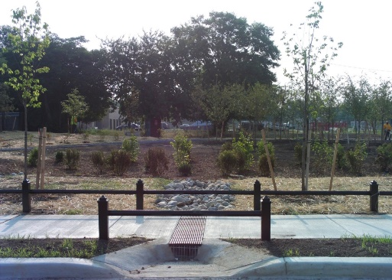
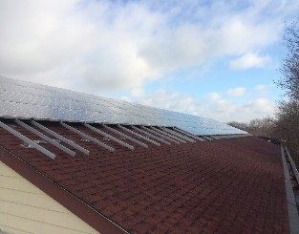

Supplemental Environmental Projects
C&E SEP TOOLS
SEP MAP
Proposed Charging

Slide 15
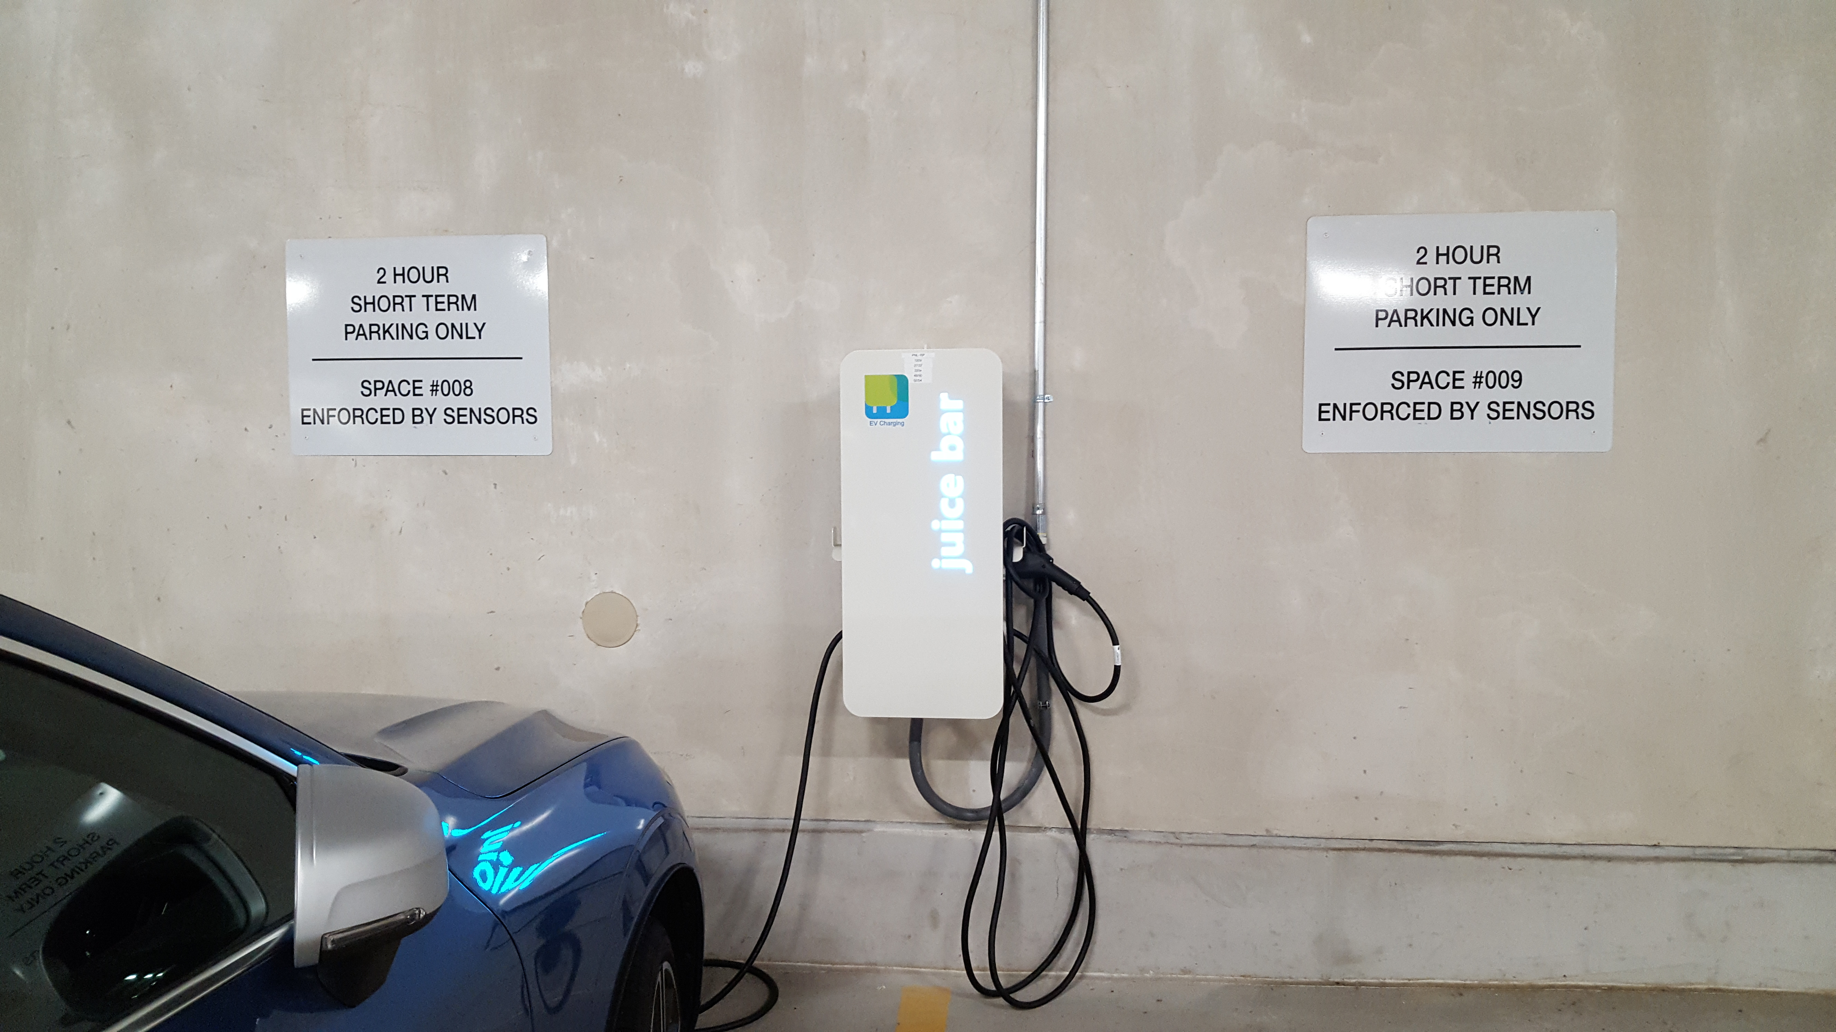
Electric Vehicle Charging Station – Metuchen, NJ

Slide 16
Supplemental Env. Projects
Electric Vehicle charging stations in Gloucester County
  Gloucester Public Works Dept
  Rowan College in Sewell
  Woolwich Township Municipal Building
Mercury Recovery Program
  School Project to inventory mercury containing equipment
  Collection, disposal , and replacement

Slide 17
LISTSERVES
Air Permitting –
  http://www.nj.gov/dep/aqpp/listserv.html
Emission Statement –
  http://www.nj.gov/dep/aqm/es/listserv.htm
Air Rules –
  http://www.state.nj.us/dep/baqp/airrules.html
Stop The Soot –
  http://www.stopthesoot.org/sts-listserv.htm
*Air Quality Forecast –
  http://www.enviroflash.info/
*Compliance & Enforcement - http://www.nj.gov/dep/enforcement/listserv.html

Slide 18

Questions

