Slide 1
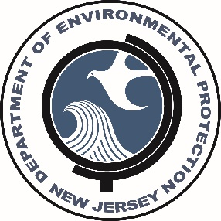
Division of Science and Research
2019 Update on Current and
Recent Research
Nicholas A. Procopio, Ph.D.
Chief, Bureau of Environmental Assessment
Division of Science and Research
NJDEP
November 22, 2019
DEP/A&WMA Conference

Slide 2
DSR Goals:
Provide the department with, and access to, expertise and information that supports its technical, program and policy needs.
Act as liaisons to the Science Advisory Board and Standing Committees that will help provide the DEP with outside expertise on scientific issues.
Perform research to meet the information and problem-solving needs of the department, and to identify and understand emerging issues that require the department's attention and response.
Advocate and integrate the multi-disciplinary perspective into the department's identification, analysis and resolution of environmental issues.

Slide 3
Staff Expertise
Toxicologists/Risk Assessment
Biologists/Ecologists
Air Quality/Modeling Specialist
Water Quality Specialists
GIS
Chemist
Statistician
Microbiologist
Environmental Scientists

Slide 4
Science Based Support
Air Monitoring/Modeling
Fish Monitoring & Consumption Advisories
Human Health Risk Assessment
Standards Development
Data Analysis & Interpretation
Analytical Chemistry
Field Investigations and Sample Collection
Literature Reviews

Slide 5
Science Advisory Board
http://www.state.nj.us/dep/sab/
NJDEP COMMISSIONER
DSR
SCIENCE ADVISORY BOARD
CLIMATE & ATMOSPHERIC SCIENCES COMMITTEE
ECOLOGICAL PROCESSES COMMITTEE
PUBLIC HEALTH COMMITTEE
WATER QUALITY & QUANTITY COMMITTEE
AD HOC COMMITTEE(S)
DEPARTMENT STAFF
PUBLIC
Notes:
58 members; 15 members on the full board

Slide 6
SCIENCE ADVISORY BOARD
Completed or pending Board review in 2019
How could pipeline installation and operation affect groundwater quality in those areas of the Piedmont province?
How can the DEP be proactive in working with citizen scientists throughout the state?
What are the actual or potential impacts of seismic testing on ocean resources?
Peer-Review of CHANJ (Connecting Habitat Across New Jersey Initiative
What are potential human health and environmental exposures to asphalt millings or RAP?

Slide 7
Science advisory board – ongoing Work
Is there a way of looking at contaminants of emerging concern (CECs) in a broader context and how should DEP approach and manage the thousands of chemicals in use today?
What are the potential impacts to groundwater and air from outdoor food waste composting?
What are potential effects on drought, streamflow and flooding in terms of recent weather patterns, broad weather patterns, and expected climate change?
What are the potential impacts of sea-level rise on salt marshes in NJ

Slide 8
Completed Research
Highlights

Slide 9
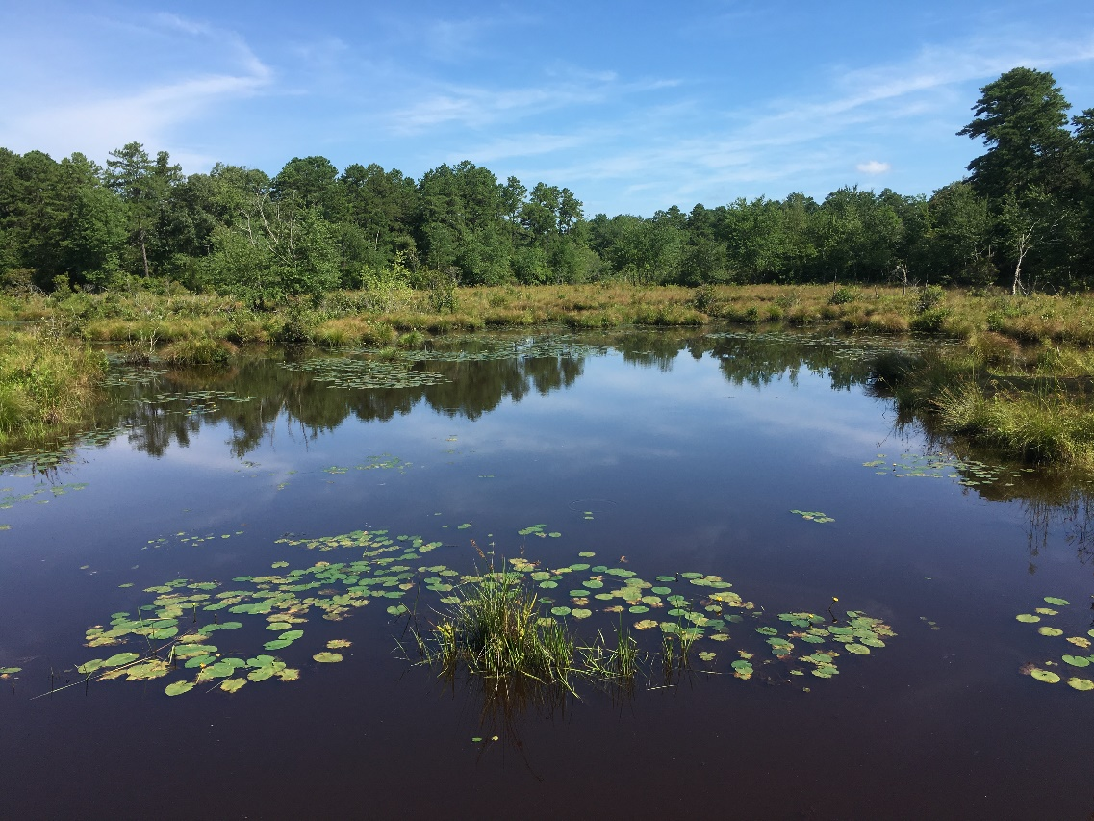
Investigation of Levels of PFAS Compounds in Fish, Surface Water, and Sediment
Surveyed 11 waterways and 14 locations
PFAS detected in all three matrices
PFOS found to accumulate in fish tissue
PFAS detected even in fish from Echo Lake, a background high elevation lake.
Results provided guidance to establish fish consumption advisories for the monitored lakes and streams.
https://www.nj.gov/dep/dsr/

Slide 10
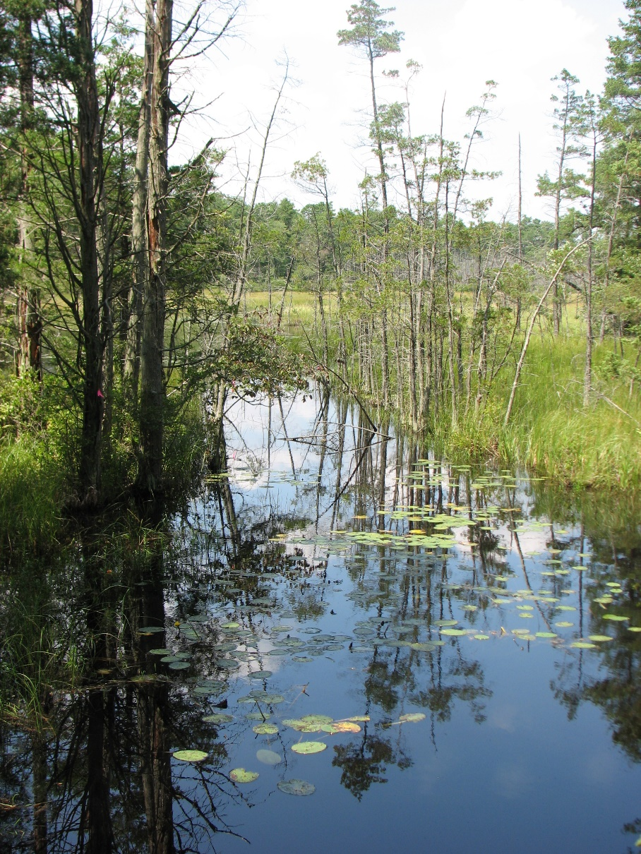
Arsenic Benchscale Treatability of Wastewater
Objective:
NJ has a surface water quality standard of 0.017 µg/L for arsenic which is often difficult to meet. This bench scale investigation looked at the treatability of arsenic in wastewater using various existing technologies.
Phase 1. Chemical Analyses of Wastewater and Sludge
Phase 2. Treatment of Wastewater Samples Collected from the Primary Clarifier Effluent and Aeration Tanks
Notes:
Phase 3. Treatment of water samples collected from the effluent of the secondary clarifiers was not conducted….
If Phase 2 proves to remove total arsenic to less 3.0 µg/L, the experiments in Phase 3 will not be conducted.

Slide 11
Diatom Research
Assessment of Barnegat Bay condition based on sediment core analysis - assessed historical conditions and the impact of human activities on Barnegat Bay based on diatom assemblages.
  Provides quantitative evaluation of changing nutrient conditions in the bay.
Use DNA-metabarcoding of diatom assemblages for biomonitoring of New Jersey streams – developed procedures to identify diatom assemblages using molecular techniques in addition to morphological techniques.
Notes:
Cooperative projects with NRCS and ANS.

Slide 12
Active Research

Slide 13
Environmental Trends
39 chapters on the status of key environmental parameters
Updated as new data become available
Provides a summary of a major environmental issue
Each chapter includes references, DEP contacts, and sources of additional information
Ten reports updated since last November.
https://www.nj.gov/dep/dsr/trends
Figure 1: Annual mercury emissions from NJ coal-burning power plants
Notes:
#1 = Climate Change, #2 White-tailed deer, #3 Beach Closings, #4 Solid Waste and Recycling, #5 Endangered Plants

Slide 14
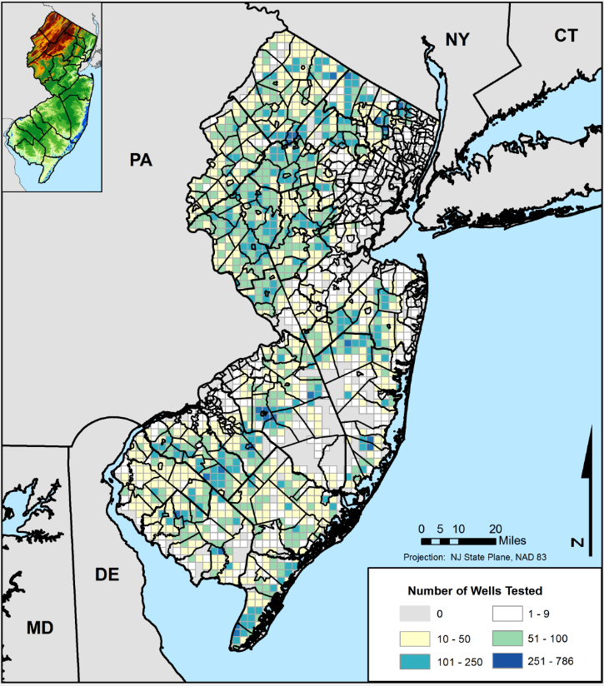
New Jersey Private Well Testing
Approximately 400,000 private wells (13 % of residents) in NJ.
Wells are required to be tested for bacteria, nitrates, 26 volatile organic compounds, lead, pH, arsenic, gross alpha (radionuclides), iron, and manganese. Mercury and uranium are only required in certain counties.
Analysis of data show the variability in the concentration for each parameter in relation to state standards.
Data from the PWTA can be used to identify vulnerable communities and direct outreach efforts.
Data is also used by SDW, SRP, and NJGS.
http://arcg.is/1CPkHyC

Slide 15
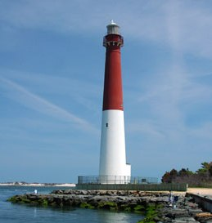
Barnegat Bay

Slide 16
Barnegat Bay Research – Additional Research
Ecosystem monitoring of pre- and post-closure of Oyster Creek Nuclear Generating Station (Year 2).
  Assessment of the impacts of the OCNGS on gelatinous zooplankton and planktonic community structure (Montclair)
  Assessment of the effect of cooling water effluent on fish, crab, and benthic invertebrates (Rutgers and Rider Univ.)
  Study of zooplankton for monitoring and assessment of the closure Oyster Creek Nuclear Plant (Monmouth Univ.)
  Characterization of phytoplankton community changes in Barnegat Bay related to the closure of Oyster Creek Nuclear Generating Station, combining next generation sequencing and microscopy analyses (George Mason Univ.)
Notes:
Up to $10M in grants are available in SFY 18 for watershed restoration, enhancement, and protection strategies that address NPS pollution within the Barnegat Bay Watershed

Slide 17
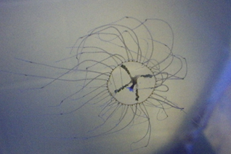
Assessment and Distribution of Clinging Jellyfish (MSU & dsr)
Objectives (year 4):
Extent of clinging jellyfish in Shrewsbury River, Manasquan River & Barnegat Bay.
Are medusa being transported to other waters?
What is the reproductive potential in these waters?
Status:
2019 Field sampling in the Shrewsbury and Manasquan Rivers, and Barnegat Bay complete.
DNA sequencing and analyses.
NJDEP Interactive clinging jellyfish map updated to track confirmed sightings.
New sighting in North Wildwood.

Slide 18
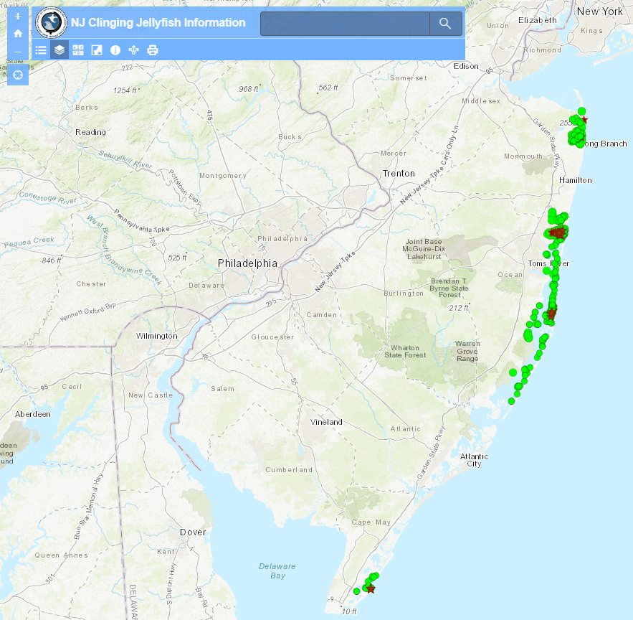
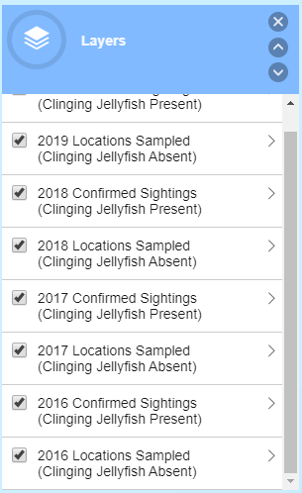
Clinging jellyfish – Invasive SPECIES

Slide 19
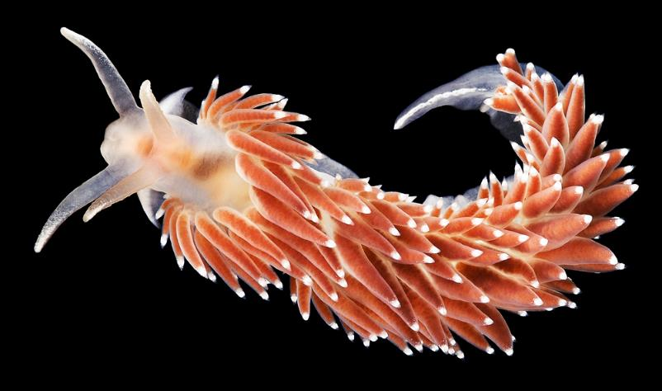
Biological Control of Sea Nettles using Nudibranchs (Montclair State University)
Objectives:
Identify potential nudibranch predators of sea nettle polyps in Barnegat Bay.
Assess nudibranch potential as a biological control of sea nettle polyps.
Field assessment of nudibranch feeding.
Status:
50 laboratory feeding trials on sea nettle polyps with a few different Nudibranch species.
Field based experiments conducted
DNA analysis for species identification.
Coryphella sp. Source: njscuba.net
Notes:
few different species of

Slide 20
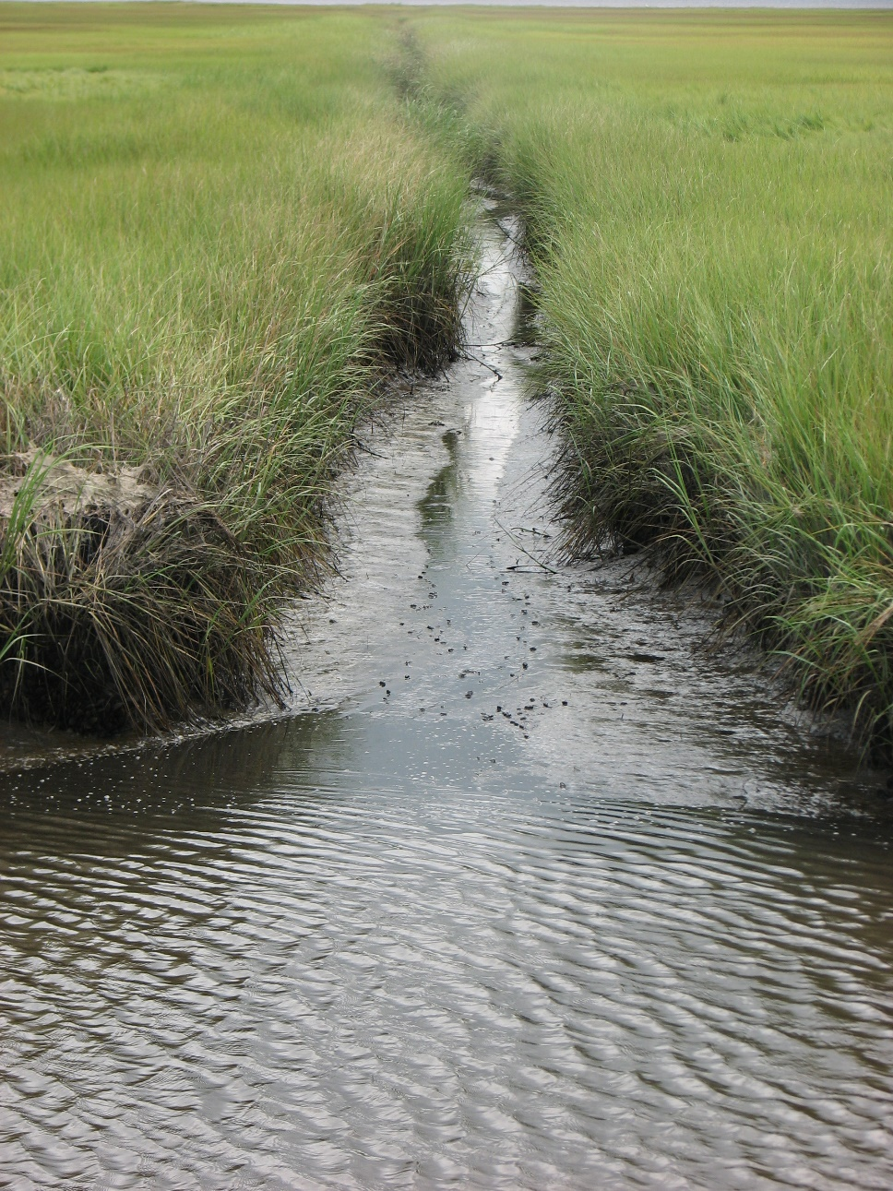
Nutrient and Carbon Fluxes to Barnegat Bay from Marginal Saline Wetlands (USGS and ANS-DU)
Goals and Objectives
Measure nutrient and carbon exchange between the tidal streams flowing through marginal saline wetlands of Barnegat Bay.
Determine whether the marshland surrounding the creek is acting as a source or sink of nutrients as they are transported from the uplands, through the marsh complex into the bay
The results will provide information needed to integrate wetlands into the Barnegat Bay geochemical model and determine how marsh creeks impact nutrient loading.
Notes:
The hypothesis is that the input of nutrients from the watershed will be modified and in some cases reduced as they flow through the marginal wetlands and into the Bay.

Slide 21
USGS Cooperative projects:
Natural Background Investigation of Arsenic and Vanadium concentrations in glauconitic soil and sediments in central NJ
This study is evaluating elevated trace metal concentrations in soils by re-examining presumed natural (background) ranges for geogenic sources and to determine probable regional extent of strata or horizons showing the greatest enrichment. Supports implementation of the Remediation Reform Act (SRRA).
Analysis of total mercury and mercury isotopes in groundwater of the Kirkwood-Cohansey Aquifer
Assessing and identifying the source of mercury through the use of isotope analysis as a “fingerprinting” tool. Such identification can help regulators make informed decisions and direct policies that aim to reduce mercury exposure to fish, wildlife, and humans.
Notes:
Elevated levels of arsenic and vanadium (As/V) were detected at multiple locations along the Route 130 corridor with no associated industrial discharge or agricultural arsenical pesticide/fungicide usage.

Slide 22
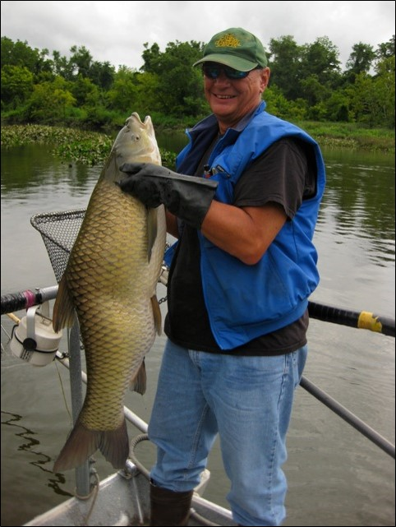
Monitoring and Targeted Research of Selected Chemical Contaminants in New Jersey Fish
Task 1 - Routine Monitoring of Toxics in Fish
  Includes the monitoring of fish tissue statewide, evaluating multiple target contaminants, fish species and water bodies;
  Informs the appropriateness of current fish consumption advisories and need for modifications;
  Examine new species, contaminants, and waterbodies; and
  Support education and outreach efforts in protecting the public.
Bruce Ruppel, DSREH
http://fishsmarteatsmartnj.org/

Slide 23
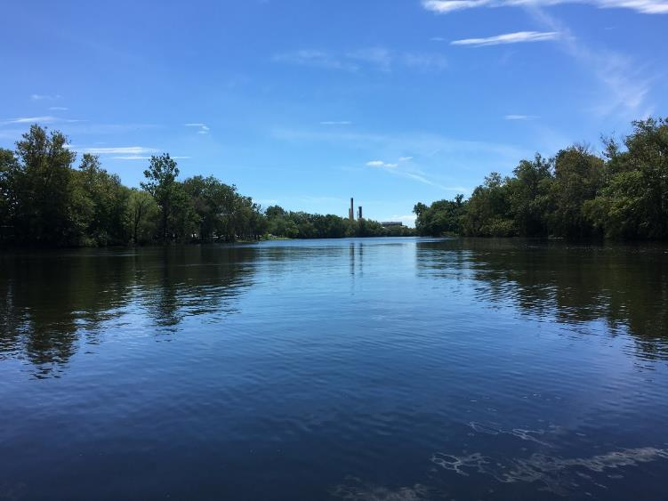
Monitoring and Targeted Research of Selected Chemical Contaminants in New Jersey Fish
Task 2- Investigate Levels of Perfluoroalkyl Substances (PFAS) in NJ Fish Species, sediment and water
  As an emerging compound, PFAS, particularly PFOS, have been found to accumulate in fish tissue if a source is present.
  Contamination has been identified in public and private drinking water wells, and potential sources have been identified, NJ fish and consumers may be impacted.
  Concentrations in fish tissue will be quantified and evaluated along with health criteria.
Passaic River

Slide 24

Polycyclic Aromatic Hydrocarbon Study
Objectives:
Phase I - determine background levels of the contaminants throughout New Jersey and assess potential relationships between PAH concentrations and characteristics including depth of sample, county, population density, distance to nearest known contaminated site, forested versus open areas, and metal concentration.
Phase II - determine whether there was a change in PAH concentrations as distance from potential sources, such as railroads and asphalt surfaces, increased.
Notes:
Status:
Finalizing results and reports

Slide 25
EPA Wetland Development
Grant-funded Research

Slide 26
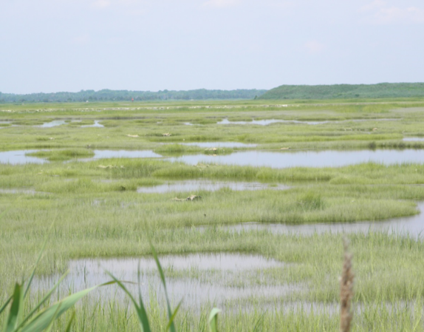
Developing a Reference Wetland Tool for Tidal Wetland Restoration Planning (EPA Grant)
When making management decisions, local reference sites make useful comparisons for evaluating wetland condition, designing restoration projects and setting realistic goals. Unfortunately, it is often time and cost prohibitive to collect data at local reference sites as part of a restoration project.
Objectives are to:
  Aggregate and summarize the extensive tidal wetland monitoring data collected across NJ in the publicly available Reference Wetland Database and Tool, developed by Riparia at Penn State;
  Expand the long-term wetlands monitoring system to be inclusive of coastal wetland systems found in NJ.
  Study the hydrology of tidal wetland systems in NJ to help inform future restoration projects.

Slide 27
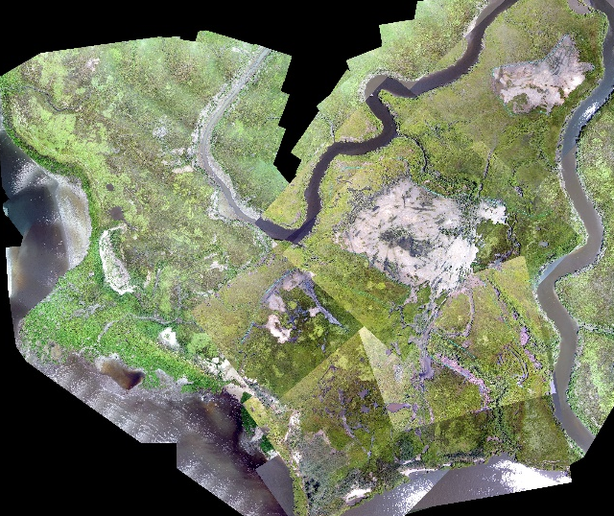
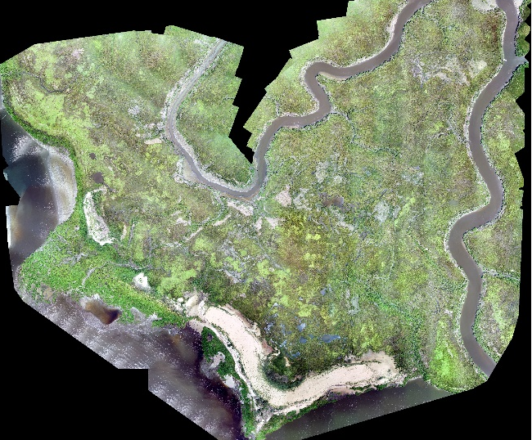
Improving Marsh Restoration (EPA Grant)
Continued monitoring of three pilot projects that used dredged material to enhance salt marshes and dissemination of lessons learned.
Objectives are to:
  Track changes in the marsh ecosystem after dredged sediment was placed to increase elevation;
  Relate findings back to enhancement methods in order to improve methods for future projects;
  Make best management practices that can be gleaned from the pilot projects readily available to the public.
2006
2008

Slide 28
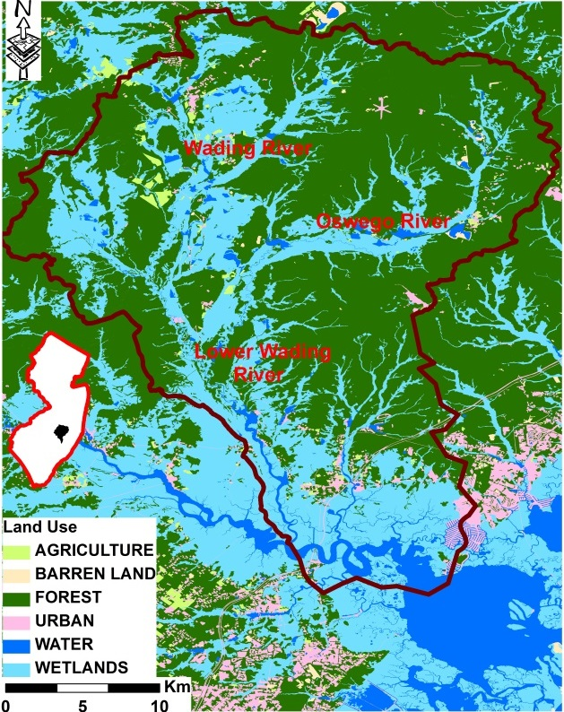
Developing a Wetland Baseline at the Watershed Scale (EPA Grant)
Up to 80% of commercial/recreational fishes, shellfish and their forage base in coastal regions have “estuarine dependent” early life stages.
Objectives:
  conduct a meta-analysis of existing literature that relates the role of riverine fresh, tidal fresh, and tidal saline marshes as essential habitat for the secondary production of fauna:
  use aerial photo interpretation and remote sensing to develop qualitative measures of vegetation coverage, diversity, and “health”;
  establish quantitative metrics that relate marsh geomorphology to species access.

Slide 29
Division of Science and Research
Acknowledgements: DSR Scientists, DEP Programs, Principal Investigators and their Universities
Director: Gary.Buchanan@dep.nj.gov
609-984-6070
Bureau Chief: Nick.Procopio@dep.nj.gov
609-633-7713
Information and Publications:
www.nj.gov/dep/dsr/
Check for new reports!

