Slide 1
Air and Waste Management association Workshop
Presented by Kenneth Ratzman (Rule Update) & Brad Bollen (Community Corner)
November 22, 2019

Slide 2
Air Rule Updates
Outer Continental Shelf
Air Toxics/Fumigation
Ozone Transport Commission Model Rules
Consumer Product
Architectural Coatings
Aftermarket Catalysts
GHGs/HFCs
Air and Waste Management Association: Presented by DEP, Kenneth Ratzman

Slide 3
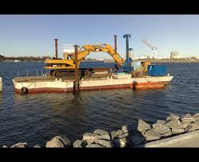
Outer continental shelf
Adoption for the purpose of requesting delegation of permitting oversight on the outer continental shelf (OCS) along New Jersey’s seaward boundary – 40 CFR Part 55
Intent is to streamline/facilitate permitting for NJ facilities
Permitting approach differs to the extent that 40 CFR Part 55 defines an OCS source more broadly than an onshore source
Proposed in the November 4, 2019 NJR
Air and Waste Management Association: Presented by DEP, Kenneth Ratzman

Slide 4
Air toxics/Fumigation
Add Air Toxics to Sub 17 (Health Risk Concerns)
Clarify that fumigation operations require a permit in Sub 8 and Sub 22
Add Air Toxics to reporting requirements under Sub 21
Proposal - this Winter?
Air and Waste Management Association: Presented by DEP, Kenneth Ratzman

Slide 5
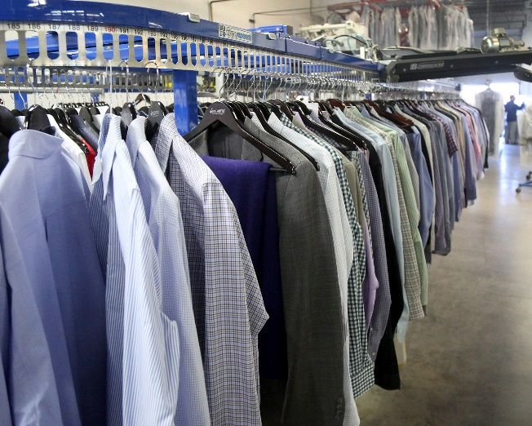
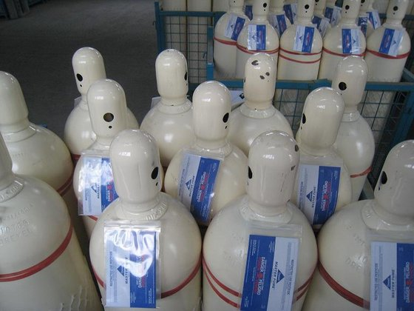
Additional air Toxics
Hydrogen Sulfide
Landfills
Odor
N-propyl Bromide
Dry Cleaning
Degreasing
Sulfuryl Fluoride
TAP in MD
Significant Use
Air and Waste Management Association: Presented by DEP, Kenneth Ratzman

Slide 6
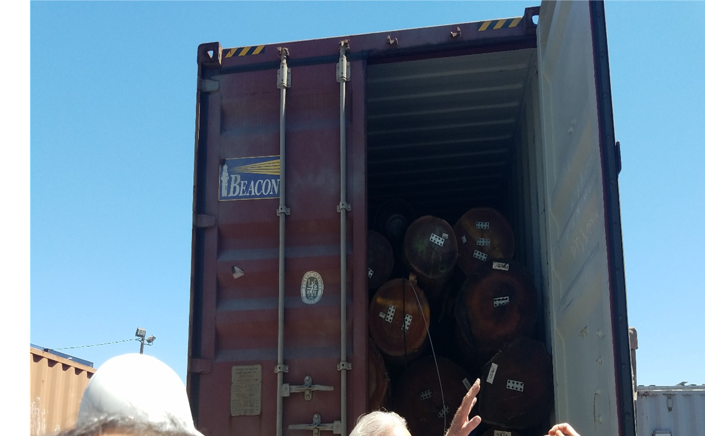
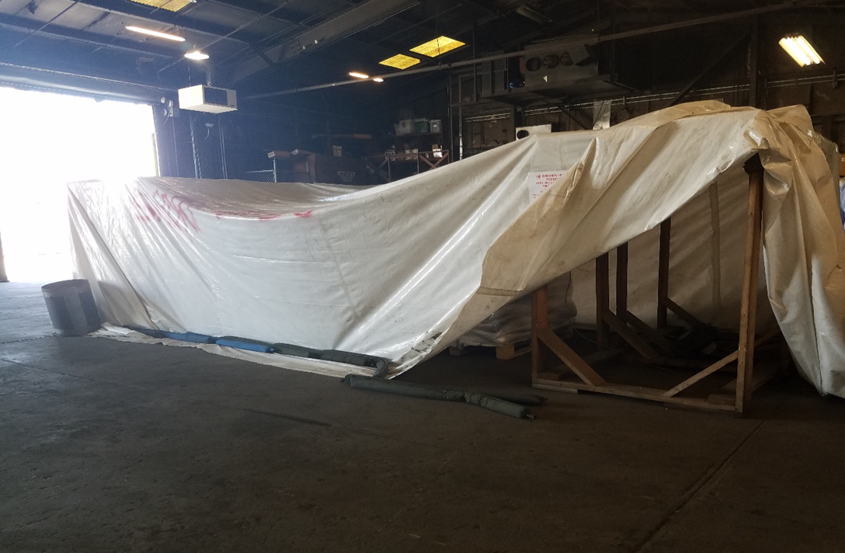
Clarify Fumigation Applicability
Significant Risks at Low Concentrations
Fumigants are used to control (kill) invasive species
Close Proximity to Communities
Ground Level Emissions (Frequently no stack)
Air and Waste Management Association: Presented by DEP, Kenneth Ratzman

Slide 7
ENVIRONMENTAL JUSTICE!!!
Location of Fumigation Facilities in NJ

Slide 8
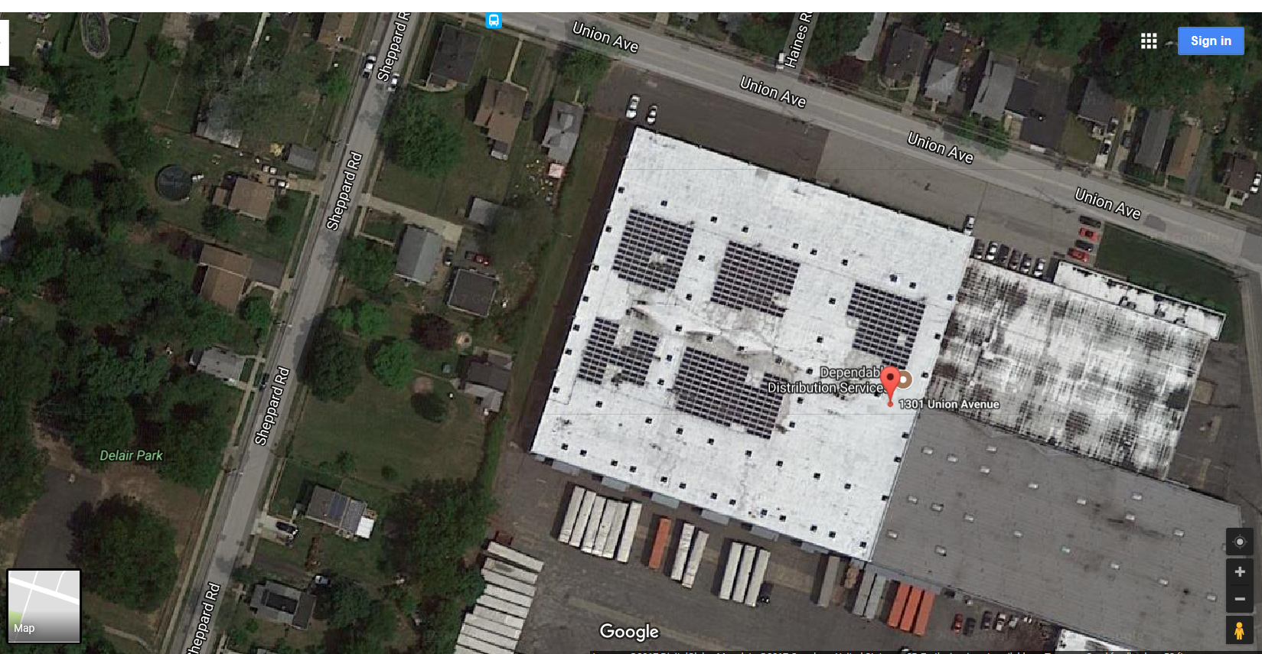
What Is Wrong With This Picture?
HOUSE
DOOR

Slide 9
Fumigation Operation
Notes:
Very crude

Slide 10
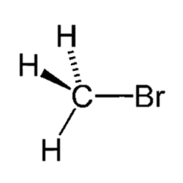
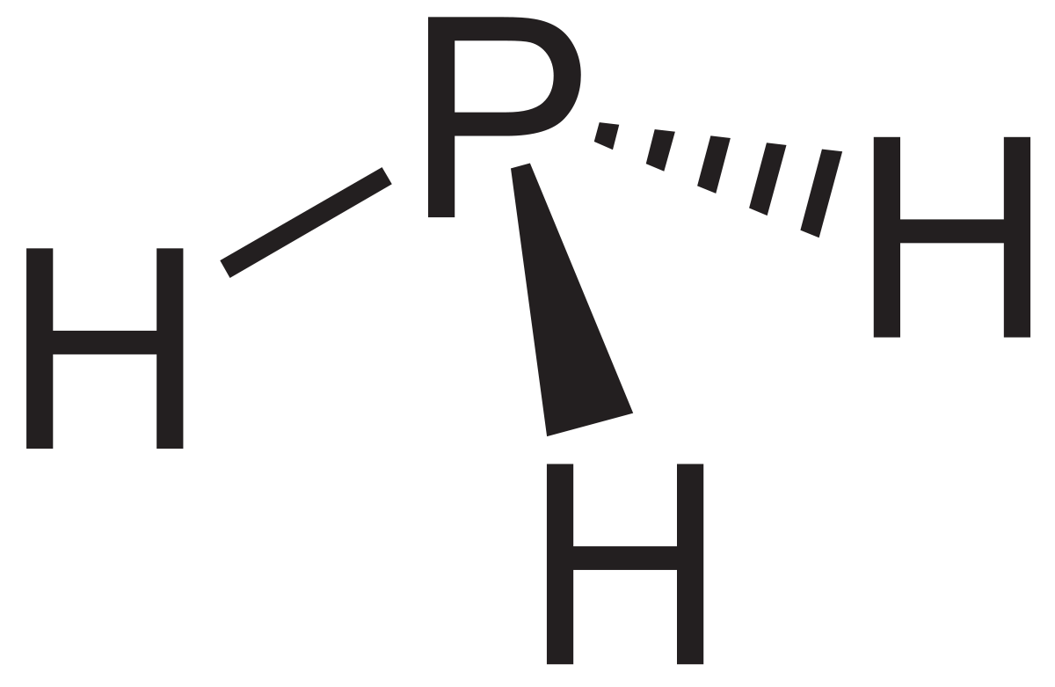
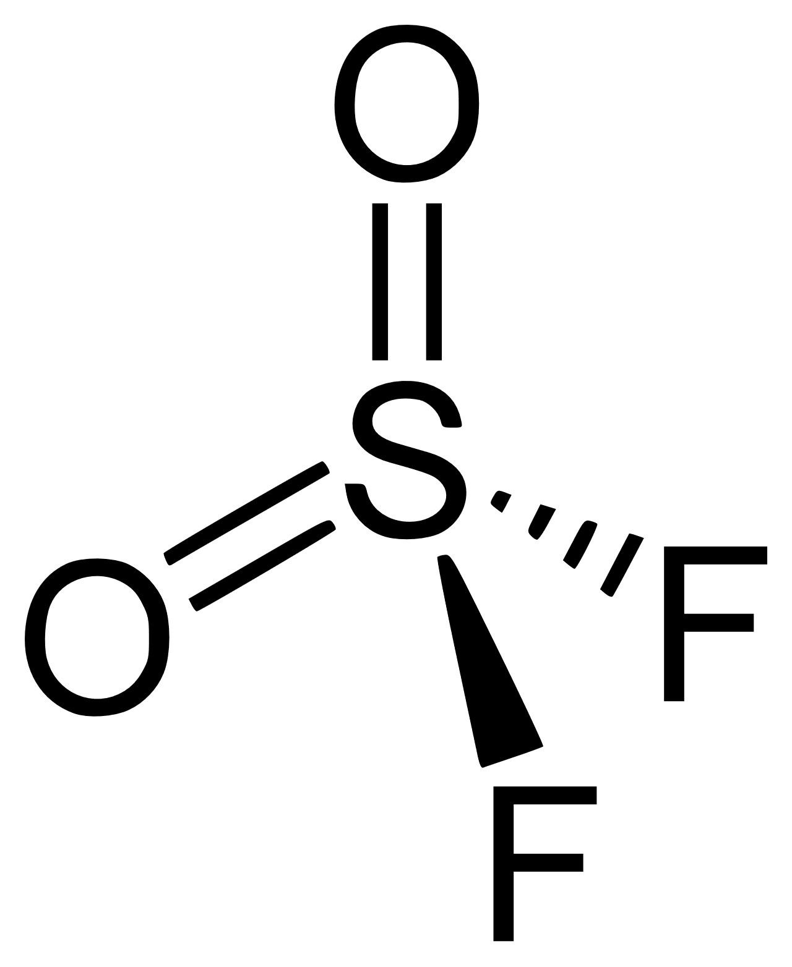
Typical Fumigants
Phosphine
Methyl bromide
Hazardous Air Pollutant
NOT a VOC
Colorless and Garlic/Fish like Odor
High Toxicity
Sulfuryl fluoride
Hazardous Air Pollutant
Volatile Organic Compound
Colorless and Odorless
Ozone Depleting Substance
High Toxicity
Limiting Ban - 2005
NOT a HAP
NOT a VOC
Colorless and Odorless
Greenhouse Gas
High Toxicity
Food commodity tolerances proposed to be banned in 2012 – never finalized
Many other potential fumigants, including Ethylene Oxide
Notes:
Methyl Bromide
Pesticide used in agriculture, shipping, and commodities.
Restricted use by the Montreal Protocol.
Human exposure to high concentrations of methyl bromide can cause central nervous system and respiratory system failures and can harm the lungs, eyes, and skin
Sulfuryl Fluoride
Insecticide and rodenticide fumigant of Residential structures, Processed-food and pet food facilities, Warehouses, Shipping containers, and synthesis of organic drugs and dyes.
Commercial names: Vikane® (+ chloropicrin, odor agent) and ProFume®
Central nervous system depressant
Repeated exposures to high concentrations of sulfuryl fluoride may cause lung and kidney damage
Phosphine
Used as an insecticide for the fumigation of grains, animal feed, and leaf-stored tobacco, and as a rodenticide
Commercial name: ECO2FUME™
Restricted Use Pesticide due to the acute inhalation toxicity of phosphine gas
Acute inhalation exposure to phosphine can result in respiratory, neurological, and gastrointestinal effects

Slide 11
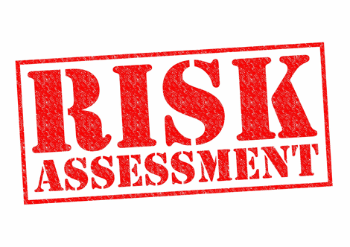
Challenging Industry
Variable Operations
Frequent relocations
Intermittent use (once every other year)
New fumigants – some not specifically regulated
Not a HAP?
Not a VOC?

Slide 12
Emission Statement
Based on Relative Risk
What is Actually Released?
We don’t know
We do know what is in permit
Has not been evaluated since 2003
Air and Waste Management Association: Presented by DEP, Kenneth Ratzman

Slide 13
Ozone transport Commission (OTC) model Rules
Vetted at National/Regional level via California standards and OTC model rule public process
NJ Stakeholder Meeting held September 6, 2019, accepted comments through October 4, 2019
Proposal Summer 2020?
Air and Waste Management Association: Presented by DEP, Kenneth Ratzman

Slide 14
Consumer Products (CP)/Architectural Coatings(AIMS)
The existing NJ product rules control the emissions of VOCs and some toxics from CP and AIMS by setting manufacturing limits on the VOC content of products sold in the state for use in the state.
Existing regulated CPs include, but are not limited to, hair styling products, insecticides, household cleaners, air fresheners, automotive maintenance products, personal care products, carpet and upholstery cleaners and household and commercial adhesives.
AIMS include, but are not limited to, paints, varnishes, stains, industrial maintenance coatings, and traffic coatings.
CPs and AIMS represent the largest source of volatile organic compound (VOC) emissions (an ozone precursor) in the air emission inventory. 12 TPD and 8 TPD for of VOC reduction from CP and AIMS respectively.
Air and Waste Management Association: Presented by DEP, Kenneth Ratzman

Slide 15
Consumer Products/Architectural Coatings (cont)
The proposed rules would revise VOC limits for several existing categories of products and add new categories of products for regulation.
These new limits are already effective in California. These rules would be based on the following OTC model rules:
1) Consumer Products Phase III 2010;
2) Consumer Products Phase IV 2012;
3) OTC Regulatory & Technical Guideline for Consumer Products Phase V 11/20/2018; and
4) OTC Architectural & Industrial Maintenance (AIM) Coatings Phase II June 2011
Air and Waste Management Association: Presented by DEP, Kenneth Ratzman

Slide 16
Aftermarket Catalyst
In the event of an out-of-warranty catalytic converter replacement on a motor vehicle, the proposed rules would require the use of an aftermarket catalytic converter approved by the California Air Resources Board (CARB) or original equipment.
Catalysts approved by CARB are more durable, have a longer warranty and better reduce exhaust pollutants than EPA-approved catalysts.
The installation of used catalytic converters would be prohibited.
This proposal could yield 3 tons per day of NOx reductions.
Air and Waste Management Association: Presented by DEP, Kenneth Ratzman

Slide 17
Aftermarket Catalyst (cont.)
In addition to the OTC model rule, we are also proposing some amendments to mobile source rule penalties.
This will ensure that all relevant motor vehicle violations have an associated penalty.
The proposal would also increase penalties for emission control tampering, as our enforcement efforts have detected increased problems in this area.
Air and Waste Management Association: Presented by DEP, Kenneth Ratzman

Slide 18
GHG/HFCs
On July 23, 2019, Governor Philip D. Murphy enacted legislation amending the Global Warming Response Act.
By January 2021, monitoring and reporting from significant emitters of greenhouse gases required.
Includes GHG emissions from fuel suppliers, electric generators, public utilities and any other entities the Department determines are significant.
The Department will evaluate highly warming gasses including refrigerants (HFCs), and the Rule Team will need to develop an inventory of the possible affected sources.
Air and Waste Management Association: Presented by DEP, Kenneth Ratzman

Slide 19
That is the rules
Air and Waste Management Association: Presented by DEP, Kenneth Ratzman

Slide 20
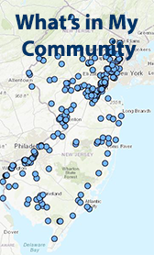
Community Corner
Web Based Application
https://www.state.nj.us/dep/aqpp/
Easy to Use
No software download needed
Includes
Air Permits
Emission Statements
Enforcement Actions
Current Wind Speed/Direction?
Future Enhancements
Real Time Monitoring Data
Public Announcement Link https://vimeo.com/350820997
Air and Waste Management Association: Presented by DEP, Brad Bollen

