Slide 1
Punit Arora, PhD CUNY/ Rutgers
Stakeholder Complexity in Environmental Justice.
A panel discussion on “Industrial Operation with a Community Focus.”
Sep 27, 2023.

Slide 2
Agenda
ESG: Broad trends
01
Successes and challenges
02
Stakeholder complexity & pushback
03
Complex strategies / responses
04
Conclusion
05

Slide 4
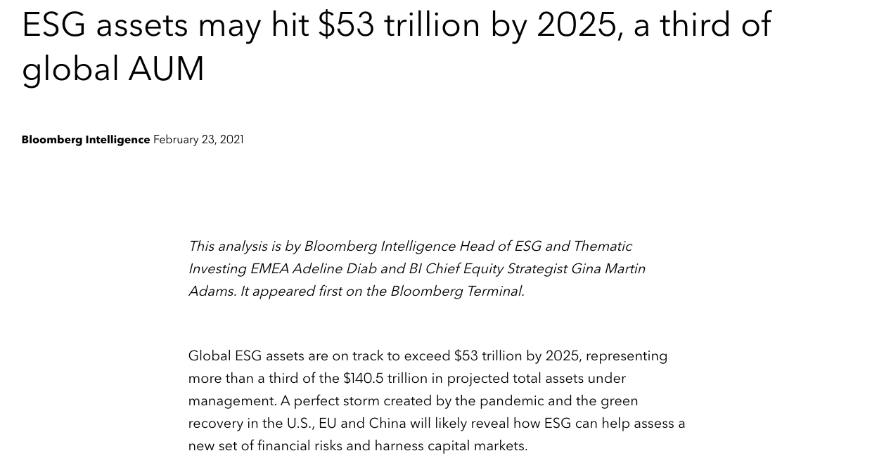
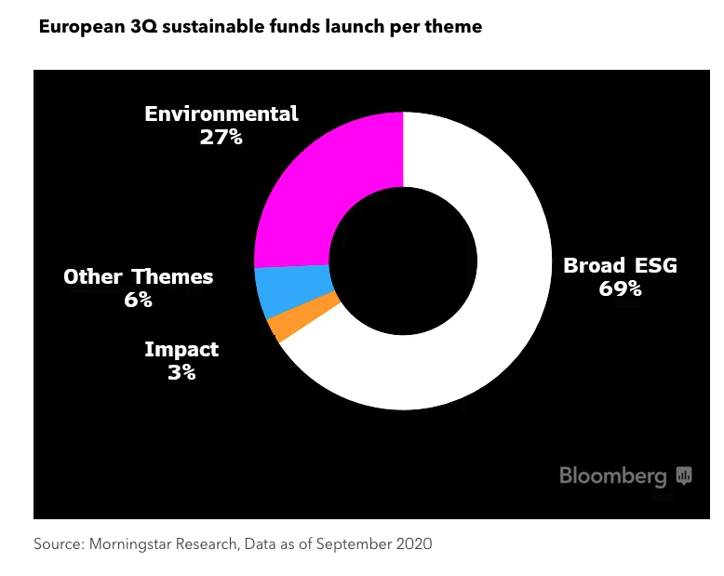
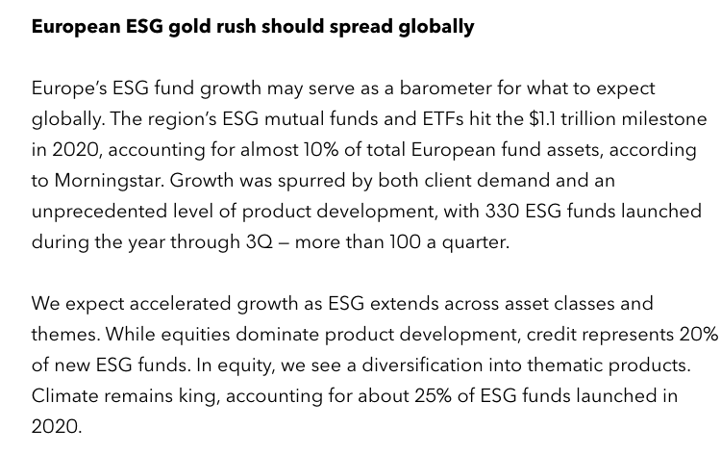
Notes:
AUM= All assets under management

Slide 5
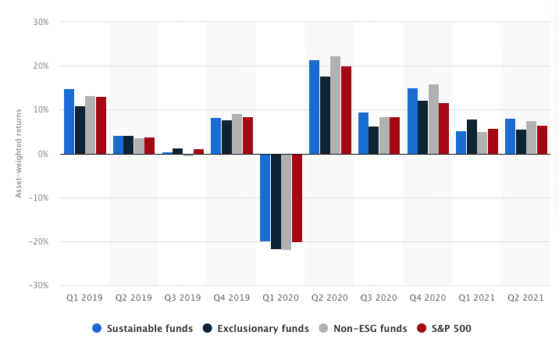
Performance of investment funds

Slide 6
ESG ratings of the largest 10 firms

Slide 7
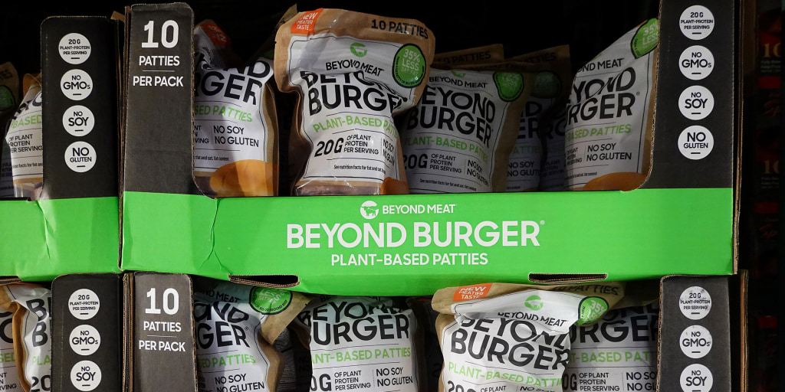
Notes:
Nestle - In 2020, Nestle announced a plan to invest 3.2 billion Swiss francs ($3.58 billion) over the next five years to reduce its carbon footprint and achieve net-zero emissions by 2050. While this initiative was seen as a positive step towards sustainability, the company's stock price declined in the short term, which some analysts attributed to concerns about the cost of implementing the plan and the potential impact on profitability.
Danone - In 2020, Danone announced a series of sustainability measures, including plans to become carbon neutral by 2050 and to transition to a new legal structure that would prioritize social and environmental goals alongside financial performance. However, the announcement was followed by a sharp decline in the company's stock price, as investors expressed concern about the potential costs and risks associated with these initiatives.

Slide 8
Notes:
slap a green label on something to make it appear more sustainable or healthy, as Coca-Cola did with Coca-Cola Life — that with 6.6% sugar was far from a healthy drink

Slide 9
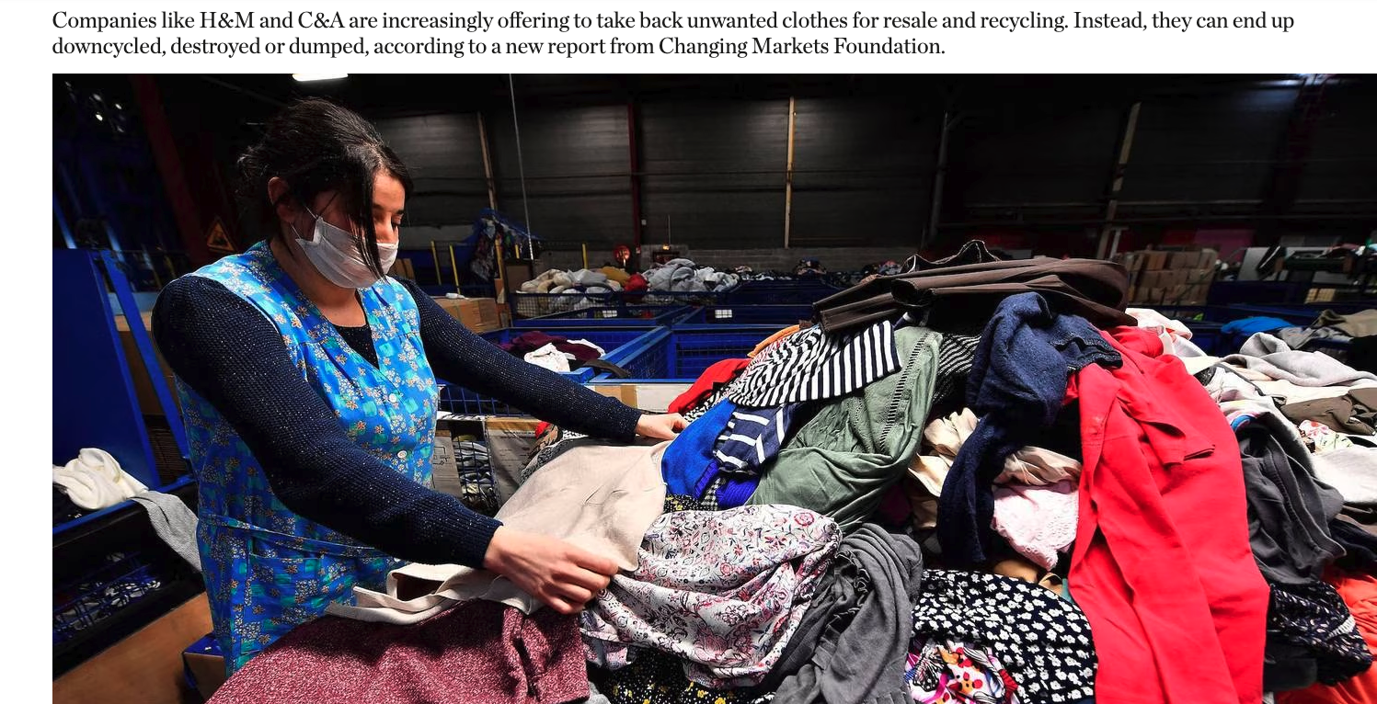
Notes:
https://www.businessoffashion.com/articles/sustainability/clothes-take-back-recycling-waste-handm-zara-primark-changing-markets/?utm_source=newsletter_sustainability&utm_medium=email&utm_campaign=Sustainability_280723&utm_content=intro

Slide 10
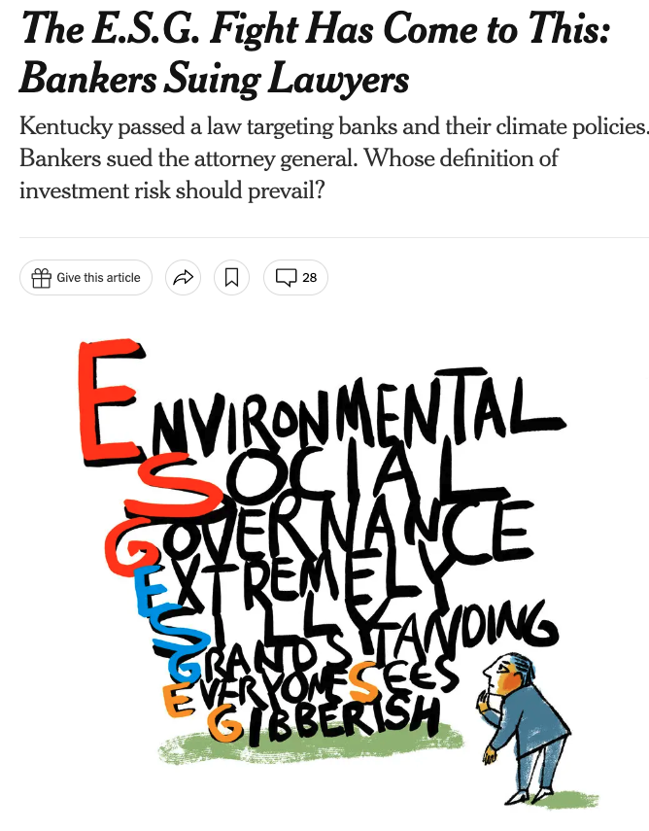
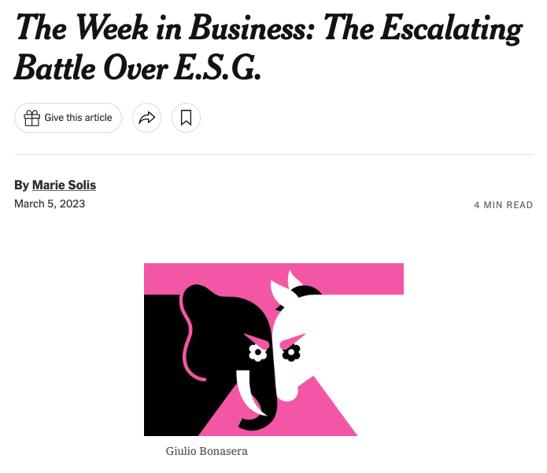
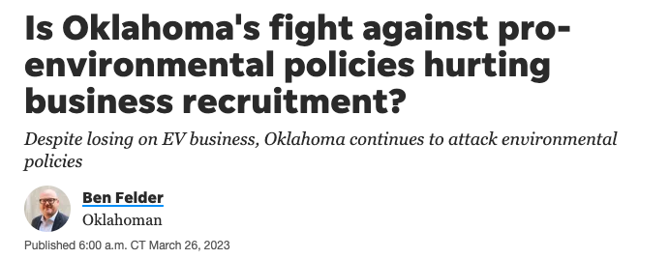

Slide 12
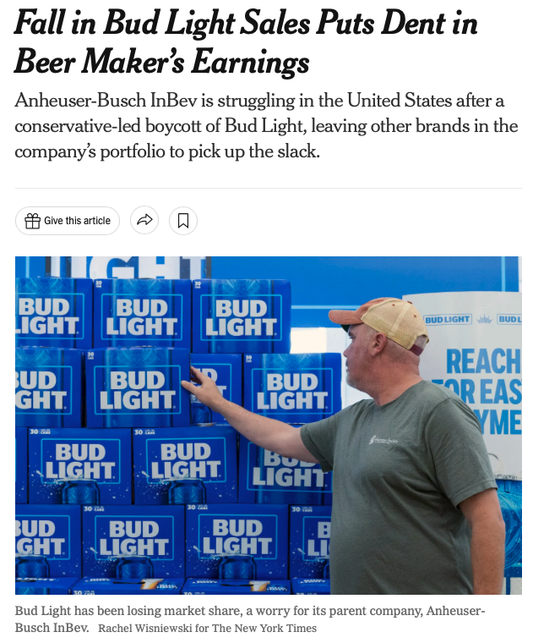

Slide 13
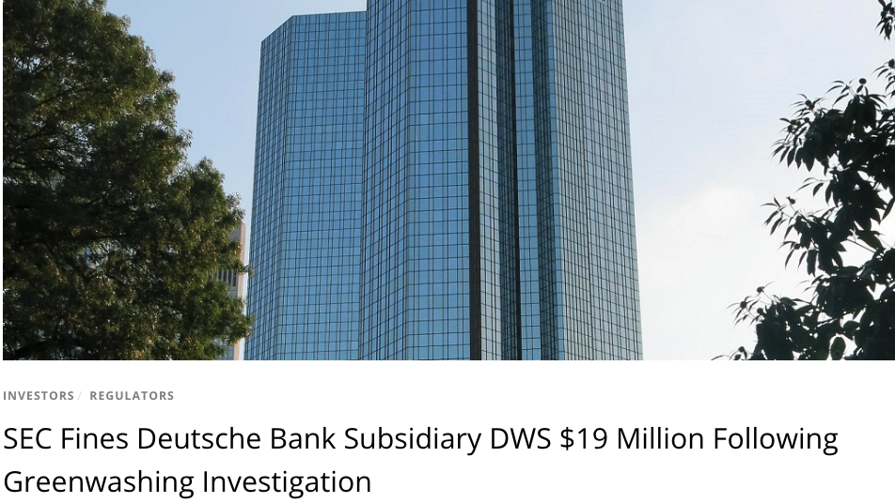

Slide 14
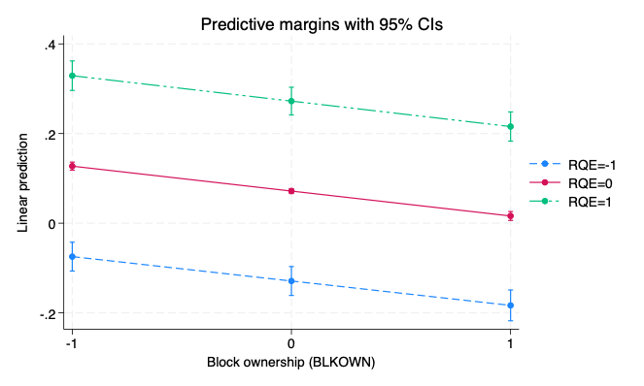
Communalizing Private Costs: Ownership Concentration, Institutions and Corporate Environmental Performance
Owners have an incentive to push clean up costs on to communities – UNLESS checked by strong regulatory institutions and vigilant stakeholders.

Slide 15
Monopolies
High market power
Few choices
Passed on to consumers
COMPETITION INTENSITY, STAKEHOLDER VOICE AND ENVIRONMENTAL IRRESPONSIBILITY: A CROSS-COUNTRY ANALYSIS
Moderate competition
Visible
Resources available
Consumer choice
Fragmented markets
Price wars
Resource challenges
”Invisibility”

Slide 16
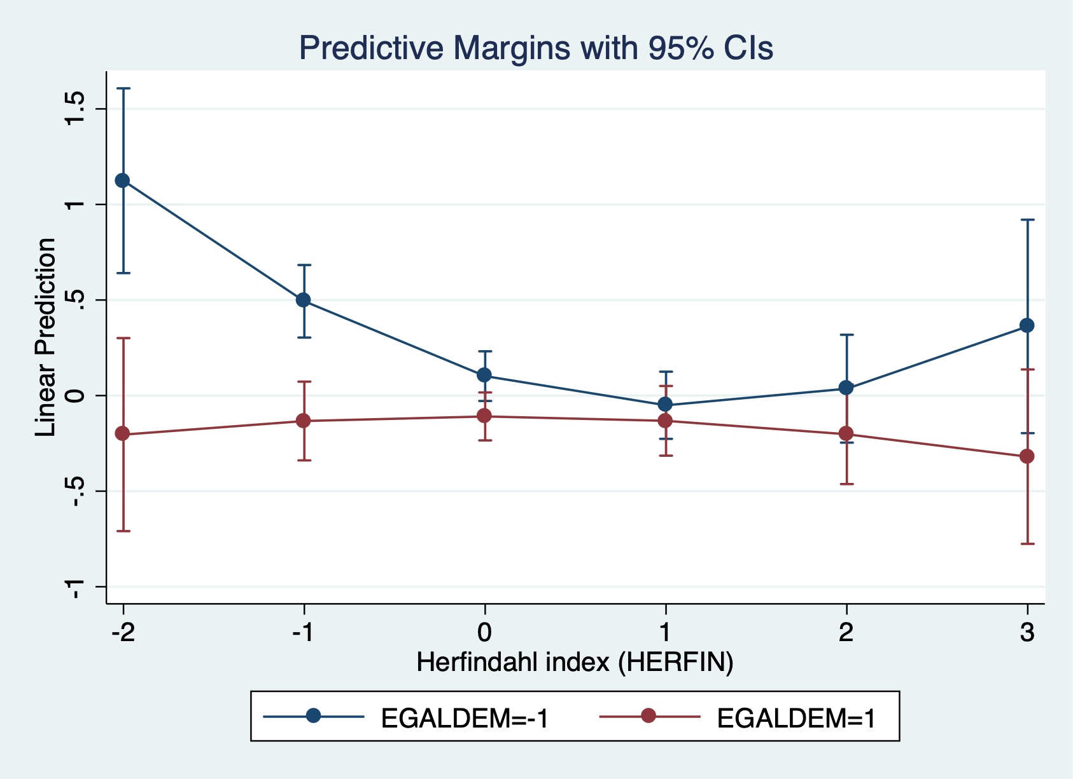
Competition, stakeholder voice and irresponsible behavior
Stakeholder voice is pivotal to minimize environmentally irresponsible behavior, especially when market competition is too high or too little.

Slide 17
Stakeholder strategy
Analyst Feedback
H3
H4
Strategic leadership
TMT diversity
BOD diversity
Environmental innovation
H1, H2
Pathways to Environmental Innovation: Gender diversity, stakeholder feedback and innovation.

Slide 18
Key results …
Gender diverse teams develop a better stakeholder strategy leads more environmentally innovations.
Stock market analyst feedback has both direct and indirect impact on CSR strategy.

Slide 19
Key takeaways
Complex web of relationships and interests
Dialogue and Stakeholder strategy
External feedback including from community organizations
Clear upward trend

Slide 20
Thank you!!!

