Slide 1
NJDEP/A&WMA Regulatory Update Conference Site Remediation and Waste Management Program Update November 16, 2018
Mark J. Pedersen, Assistant Commissioner
New Jersey Department of Environmental Protection
Site Remediation and Waste Management Program

Slide 2
Topics
Site Remediation Program Metrics
Remedial Action Permitting
Enforcement Initiatives
SRRA 2.0
Regulatory Update

Slide 3
Active, New, and Closed Cases (2012-2017)
Year | Total Active | Total New | Total Closed
CY 2012 | 14,369 | 9,612 | 4,735
CY 2013 | 14,577 | 5,287 | 4,236
CY 2014 | 13,795 | 4,928 | 5,036
CY 2015 | 14,245 | 5,390 | 4,638
CY 2016 | 14,357 | 5,129 | 4,540
CY 2017 | 14,223 | 4,975 | 5,003

Slide 4
Response Action Outcomes (2012-2017)

Slide 5
IECs and VCs Report
 | As of November 11, 2018
Active IECs/VCs Cases (Total) | 450
Active LSRP Cases | 216
Active PF Cases | 209
Active Traditional Oversight Cases | 25
Closed IECs/VCs Cases (Total) | 810
Closed LSRP Cases | 539
Closed PF Cases | 229
Closed Traditional Oversight Cases | 0

Slide 6
Remedial Action Permits
 | Jan. 2018- Oct. 2018
Average Number of Days for Application to be Administratively Complete | 37.70
Average Number of Days for Application to be Technically Complete | 180.68
Average Number of Days for DEP Total Process Time | 150.33
Average Number of Days for Permits to be Issued | 187.95

Slide 7
SRRA 2.0
Potential amendments to the Site Remediation Reform Act and other statutes, commonly known as “SRRA 2.0”

Slide 8
Direct Oversight
Remediate as DEP directs, using an LSRP
Do a feasibility study
Implement remedy the DEP selects
Submit public participation plan- 30 days
Submit remediation cost review- 60 days
Establish Remediation Trust Fund- 90 days
DEP must approve disbursements
Pay RFS surcharge

Slide 9
Compliance Assistance & Enforcement
Compliance rate January 2018 through October 2018: 86%
NOVs for SRRA Violations
Automating the process
Municipal Ticketing Program

Slide 10
Municipal Ticketing Program
If a remediation deadline is missed:
A compliance officer files a summons
Municipal court issues the summons and sets a court appearance date.
DAG sends a letter to the defendant offering to settle the violation
If a settlement cannot be reached, the case goes to trial in municipal court.

Slide 11
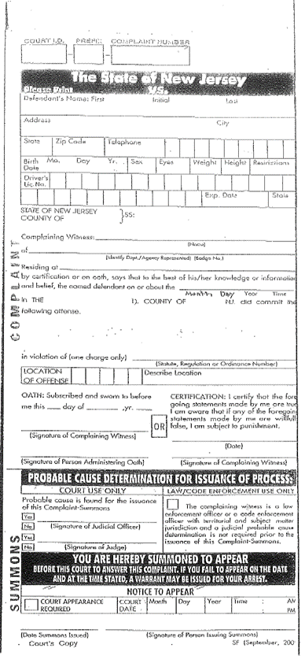
Municipal Ticketing Stats
As of October 31, 2018
113 Issued, at 86 sites
Over $261,000 in penalties assessed

Slide 12
Regulatory Update
Chapter 26F: Heating Oil Tank System Remediation Rules- Adopted August 6, 2018
Updating Remediation Standards, N.J.A.C. 7:26D

Slide 13
Questions?
SRP Website: www.nj.gov/dep/srp/
SRPL Board:www.nj.gov/lsrpboard/

