Slide 1
Bureau of Mobile Sources
Funding to reduce mobile source emissions

Slide 2
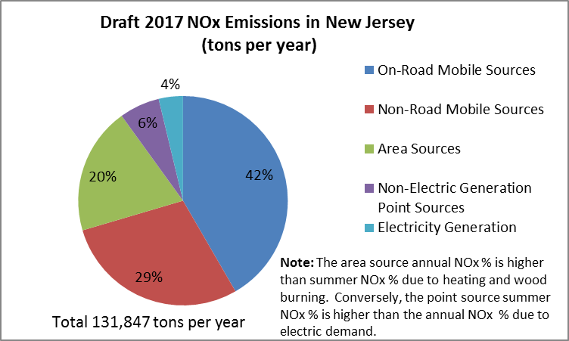
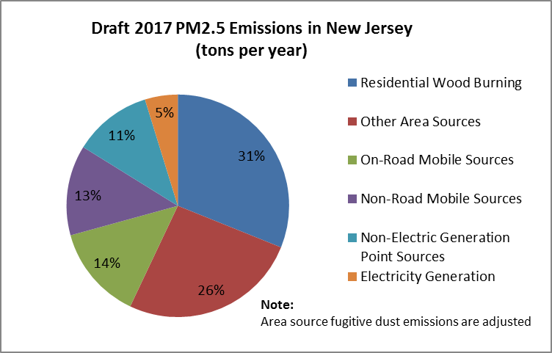
MOBILE SOURCE EMISSIONS IN NEW JERSEY
Notes:
70% of Nox from mobile so impt area of focus for VW settlement as well as other regulatory & policy initiatives.
Mobile sources big contributor to GHG, PM & toxics too.

Slide 3
Historic voluntary diesel reduction projects in nj prior to 2016

Slide 4
Current funding for diesel projects
Project Type | Funding Amount | Project description
Marine Repower Program | $7 M | Repower of passenger ferries, tour boat cruises and fishing vessels
Retrofits/Replacements | $6.5M | Construction vehicles
Idle Reduction Program | $3 M | Replace diesel TRUs with electric or hybrid TRUs. Electrify parking spaces at distribution centers.
EMS Idle Reduction | $200,000 | Provide a reduction in idling emissions generated from Emergency Medical Services vehicles (ambulances) with the installation of an Auxiliary Power Unit enabling the power of all necessary functions of the vehicle without requiring the engine to be on.

Slide 5
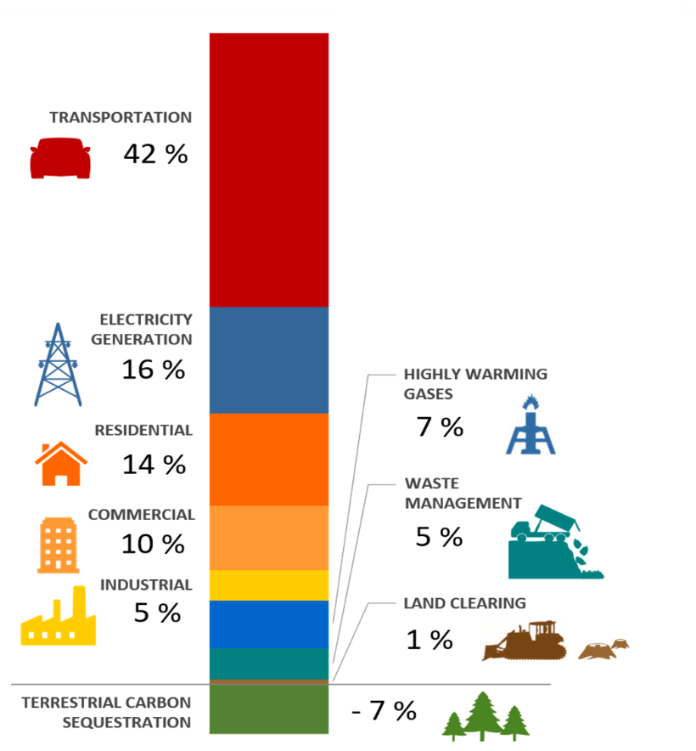
Greenhouse gas inventory
Notes:
Greenhouse gas (GHG) emissions from transportation have increased nationwide by about 17% since 1990 and will continue to rise unless there is substantial reduction in the use of fossil fuels. Based on a 2015 emissions inventory, approximately 42% of New Jersey’s GHG emissions are emitted by mobile sources. Thus, promoting the use of zero emission vehicles is a key component of New Jersey’s efforts to mitigate both GHG and NOx emissions.

Slide 6
It Pay$ to plug in NJ’s Electric Vehicle charging grants
Eligibility criteria include workplaces, public places, and multi-unit dwellings (apartments, condominiums, and townhouses).
Location | Charging station available to the general public | Charging station on government-owned property | Charging station on non-government-owned property
Public place | Yes | 100% up to maximum | 80% up to maximum
Workplace | No | 60% up to maximum | 60% up to maximum
Multi-unit dwelling | No | 60% up to maximum | 60% up to maximum
DEP will reimburse for a percentage of eligible costs, up to a maximum of:
$750 per Level 1 charging station
$5,000 per single-port Level 2 charging station
$6,000 per dual-port Level 2 charging station
Notes:
Mention how much was done and what the waitlist is currently

Slide 7
Current funding for electric vehicle infrastructure
Project Type | Funding Amount | Project description
It Pay$ to Plug In | $3.5M | Electric vehicle charging program
Electric Vehicle Ride and Drive Events | $124,000 | Promote electric vehicles by hosting electric vehicle Ride and Drive Events

Slide 8
Volkswagen Settlement (in billions)
Notes:
U.S. EPA and CARB filed a complaint against VW alleging emissions defeat devices installed on 2009-2015 diesel engines.
$15+ billion settlement covering 600,000 cars
App C –
Electrify America - $2 billion over 10 years on EVSE & education.
App D –
VW paying $3.0 Billion into a Trust that will support projects that reduce NOx emissions where the VW vehicles were, are, or will be operated.
Amt per state based on the number of impacted VW vehicles in their jurisdictions. 17K in NJ

Slide 9
Volkswagen mitigation trust
$72.2 million
2027 spending deadline
Up to 15% for EV charging & hydrogen fueling
85% for other project categories
NJDEP is lead agency

Slide 10
Eligible Vehicle Classes/Equipment
Class 8 Local Freight Trucks & Port Drayage Trucks MY 2009 and older
Class 4-8 School, Shuttle & Transit Bus MY 2009 and older
Switcher Locomotives
Ferries/Tugboats
Ocean Going Vessels
Class 4-7 Local Freight Trucks MY 2009 and older
Airport Ground Support Equipment
Forklifts & Port Cargo Handling Equipment
EV charging and hydrogen fueling
DERA
Notes:
$ can only be used for these categories.
Each has different reimbursement amounts
With the exception of #5 (OGV), eligible strategies are to replace or repower with new engine that’s diesel, electric, or alt fueled
#9 – light duty only. We can use up to 15% and we will.
#10 DERA option – Each year, USEPA provides money to state for diesel emiss reduction projects. We can use VW for the non-federal cost share. Benefit is that some projects not elgibile under CD are eligible under DERA eg. line haul locos (freight & passenger are eligible). Also, DERA allows state to fund projects on engines in older Mys than CD. Reimb amounts different

Slide 11
Questions
Melissa Evanego, Bureau Chief
Bureau of Mobile Sources
melissa.evanego@dep.nj.gov
609-292-1637

